Slide 1

Image Editing for Gimp

Slide 2
Digital Images
Digital images are made of picture elements called pixel (small square dots). Digital images are widely used such as for websites, for printing and for publishing. Digital images can be resized and distributed via emails and smart phones.
A digital size of an image is measured in:
  (K) – Kilobytes
  (MB) – Megabytes
  (GB) – Gigabytes

Slide 3

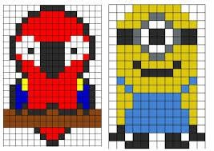
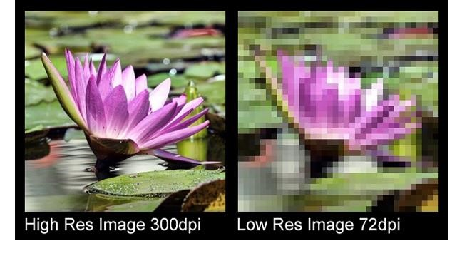
Pixels
A pixel is the smallest portion of an image or display that a computer is capable of printing or displaying. You can get a better understanding of what a pixel is when zooming into an image, as seen in the example to the right. Pixels are picture elements; tiny dots of individual colour that make up what you see on your screen.
pixels

Slide 4
Lossy and Lossless File Compression
In lossless compression, there is no information loss and the image can be reconstructed exactly as the original. Lossless files are used to make posters or large scale pictures containing the original information in the picture and are commonly contained in the ZIP files/RAR files.
PNG and GIF files only use lossless compression.

Slide 5
Lossy and Lossless File Compression
Lossy compression is when, for example, a picture is taken of a field and that photo is then converted into a Jpeg file so that it can be easily compressed down to be a smaller file and can be transferred and shared online, quickly. The file however, when converted and making itself smaller, lost some colour, though to the naked eye remains looking the same although thousands of colours have been lost in the transfer and cannot be recovered. Converting a file to Jpeg isn't a very professional way of converting a file due to the loss of some information in the file.

Slide 6
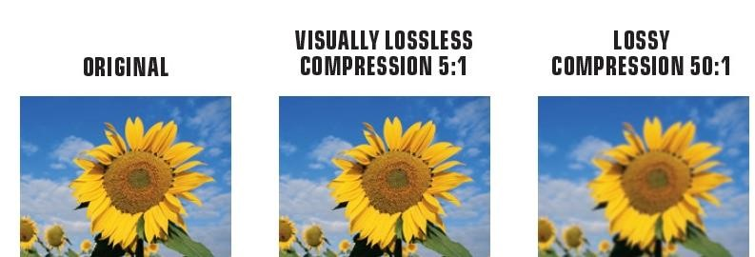
Lossy and Lossless File Compression

Slide 7
Copyright
Copyright is a legal right created by the law of a country that grants the creator of an original work exclusive rights for its use and distribution. Most images retrieved on the Internet are copyrighted, hence they can not be copied without the proper authorisation.
There are many websites which offer free graphics and clipart. These sites have the legal permission to offer you to download these images free of charge. However many websites allows the download of images against a payment fee.

Slide 8
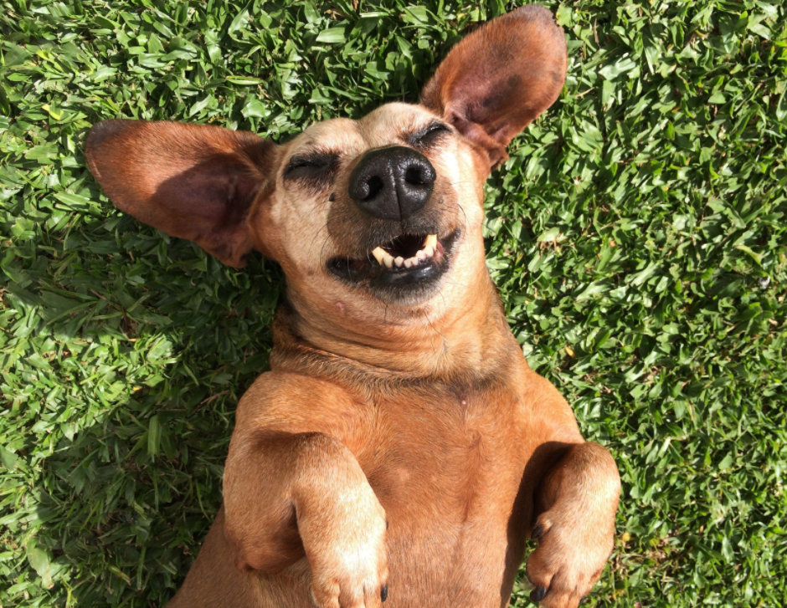
Royalty Free Images
These are images which can be downloaded for free. There might be certain restrictions on how to use the images.

Slide 9
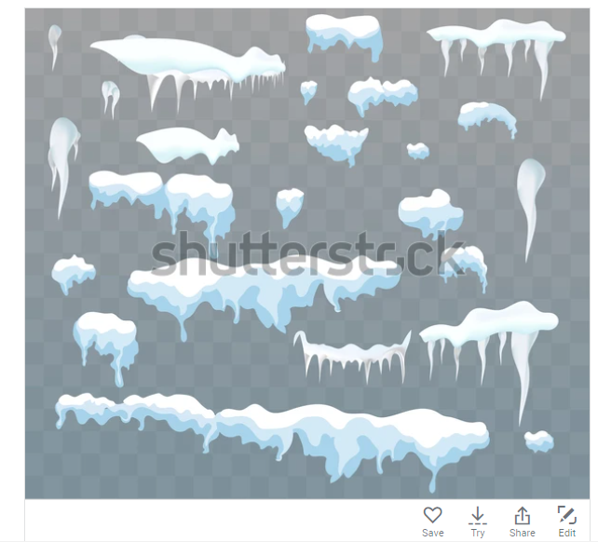
Rights Managed images
This refers to images which can be downloaded against payment. Usually a payment per picture is required.

Slide 10
Graphic Formats
An image can either be a raster image or a vector image.
Raster images are commonly called bitmap images. The term "raster device" means a device that is composed of pixels.Common examples of raster devices are computer monitors and printers. Common raster formats are pictures with jpeg (Joint Photographic Experts Group) and gif extensions (graphics interchange format).
Some common raster photo editing applications software are:
Adobe Photoshop which uses .psd (photoshop document) as file extension
Gimp and other photo editing programms used the file extension .xcf which stands for Experimental Computing Facility
Paint Shop which uses .psp (PaintShop) as file extension

Slide 11
Graphic Formats
Vector graphics are composed of paths. Vector graphics are more flexible than raster devices because they can be resized and stretched. In addition, images stored as vectors look better on devices (monitors and printers) with higher resolution, whereas bit-mapped images always appear the same regardless of a device's resolution. Note that most output devices, including dot-matrix printers, laser printers, and display monitors, are raster devices, while plotters are vector devices.
Common vector images are pictures using Scalable Vector Graphics format (svg), Encapsulated PostScript (eps) and Enhanced Windows Metafile formats (wmf).

Slide 12
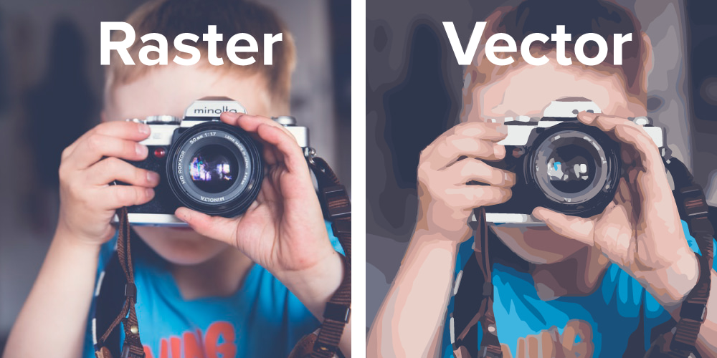
Graphic Formats

Slide 13
Colour Model
A colour model is a method to represent colours as ordered sets of numbers. The most common colour models are RGB, CMYK, and HSB.

Slide 14
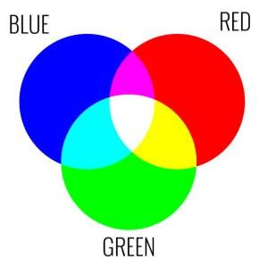
RGB (Red Green Blue)
RGB is a colour model based on the Red, Green and Blue. The three colours of light which can be mixed to produce any other colour. Coloured images are often stored as a sequence of RGB triplets or as separate red, green and blue.

Slide 15

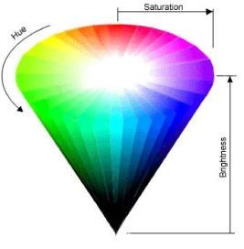
HSB (Hue Saturation Brightness)
Hue brightness saturation colour model is based on three colours. It is different from RBG because as a general rule the more colours you mix the darker the resulting colour is. Therefore mixing all the colours, you will get the black colour rather than the one as illustrated in the RGB model.
Hue is the actual colour. It is measured in degrees. Saturation is the purity of the colour, measured in percent. Brightness is measured in percent from black (0) to white (100).

Slide 16
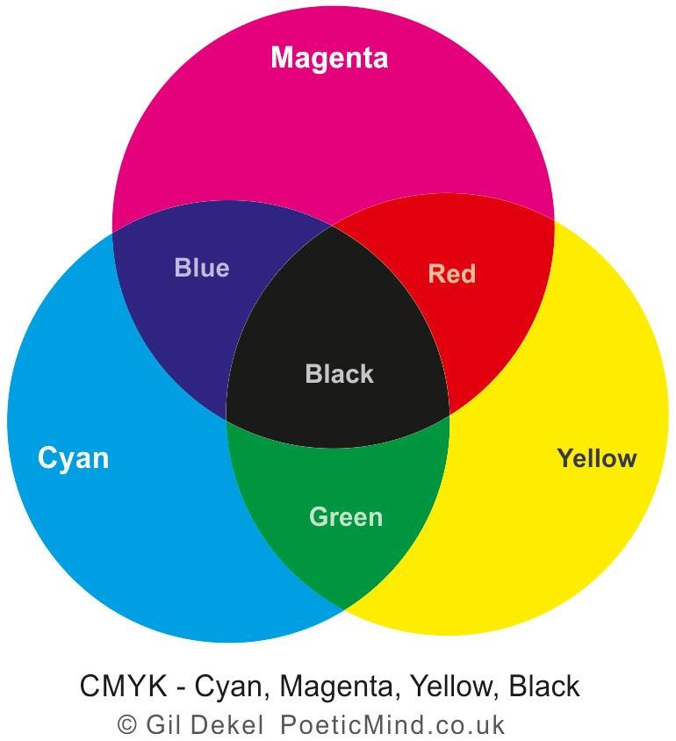
CMYK (Cyan Magenta Yellow Key)
This colour model is used in colour printing for full colour documents. It uses the colours cyan, magenta and yellow with black as an adjustment to produce more colour variations.

Slide 17
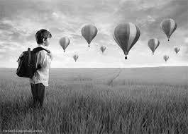
Grayscale
Combines shades of gray, varying from black to white.

Slide 18
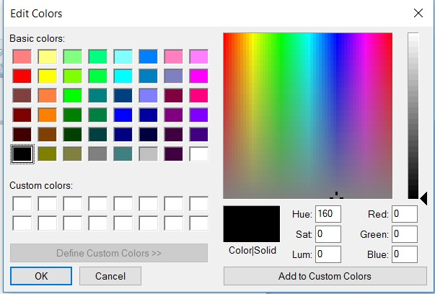
Colour Palette
The set of colours available is referred to as the colour palette. Colour depth is the number of bits to represent a colour . It describes how many colours can be displayed on a monitor's screen.

Slide 19
Colour Terms
Hue refers to colour purity which means a colour without shade or added black.
Saturation indicates the amount of grey in a colour.
Colour balance refers to the combination of the three main colours which are red, green and blue.
Contrast refers to the difference between the components a colour is made up of.
Brightness refers to how much white (or black) is mixed in the colour.

Slide 20
Colour Terms
Gamma is the way brightness is changed for the middle range of grey tones.
Transparency refers to the amount of light an image is viewed with. The less transparency, the image will appear darker.

Slide 21
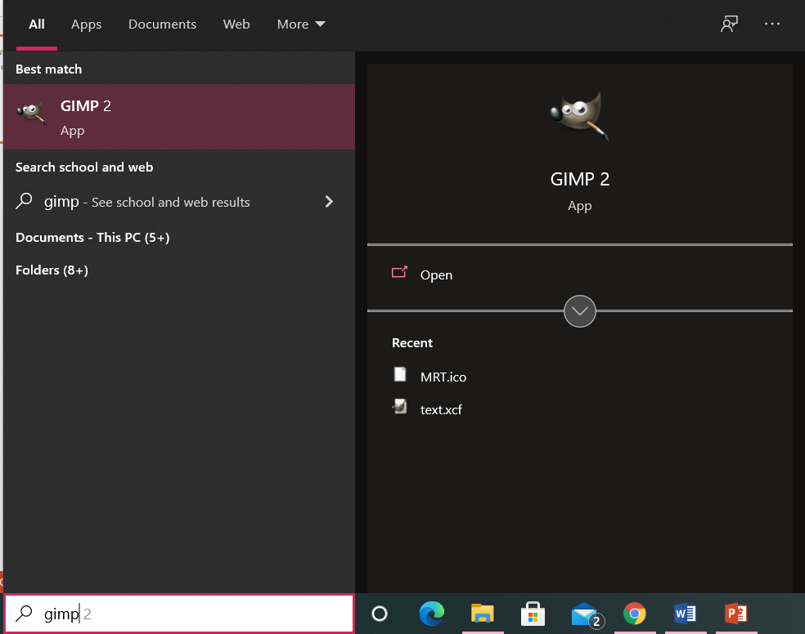
USING THE APPLICATION
1. Open the GIMP2 application.

Slide 22
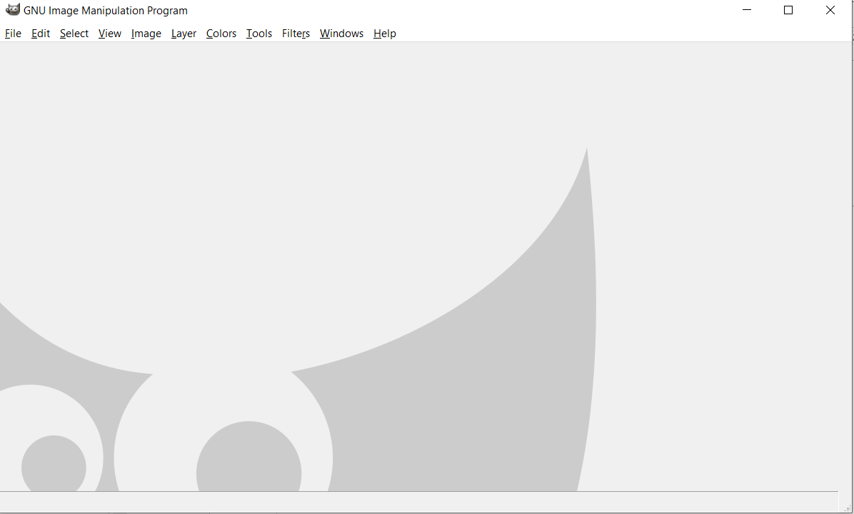
USING THE APPLICATION
2. The following start up screen will appear.

Slide 23
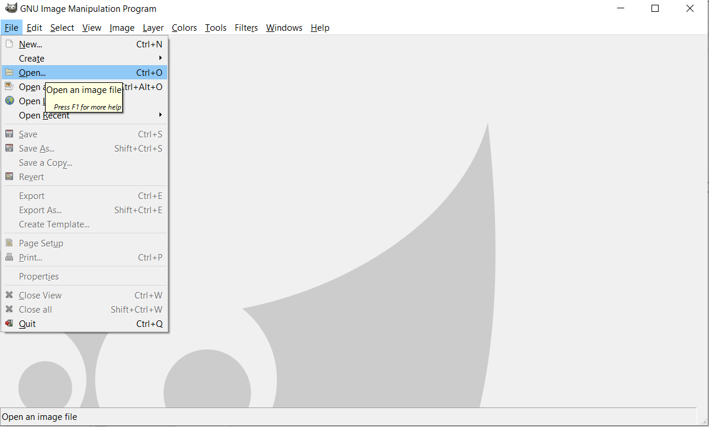
Open an image
To open an existing image file, click on File and then Open.

Slide 24
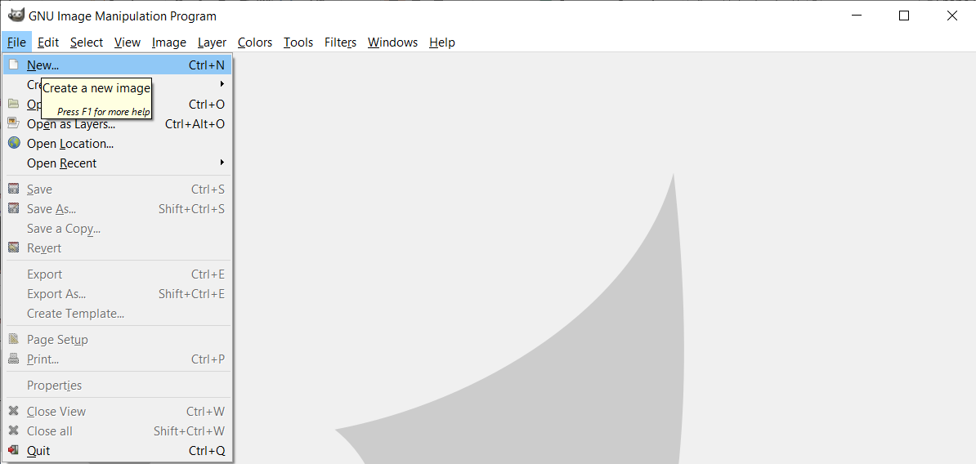
Create a new image
Click on File and then select New. The create a New Image menu will be displayed.

Slide 25
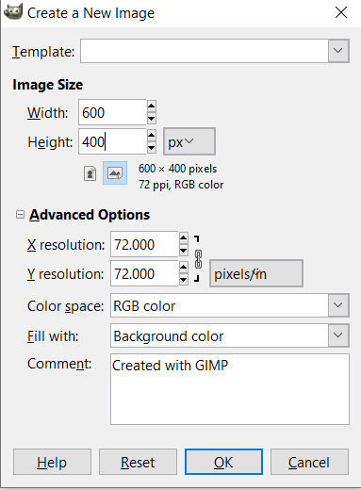
Create a new image
As an example, an image of 600 x 400 pixels resolution will be created. For the ECDL exam watch out for the settings found in the Advanced Options. Click OK when finished.

Slide 26
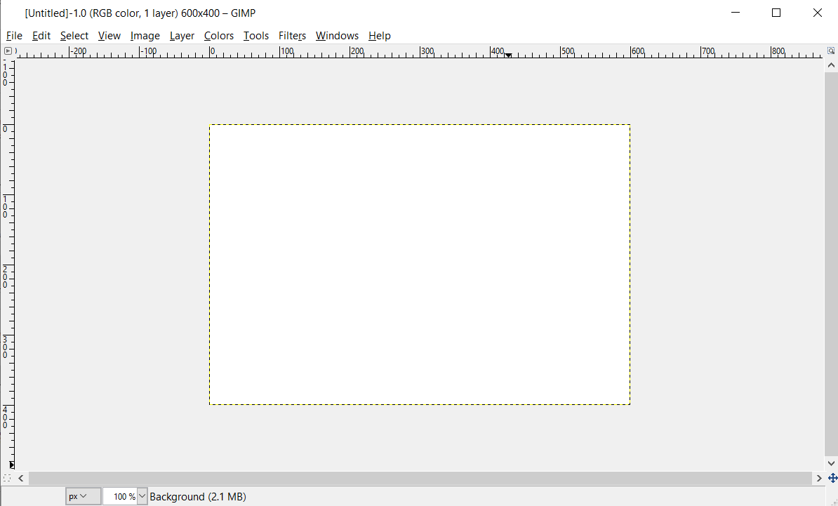
Create a new image
The following image will be created.

Slide 27
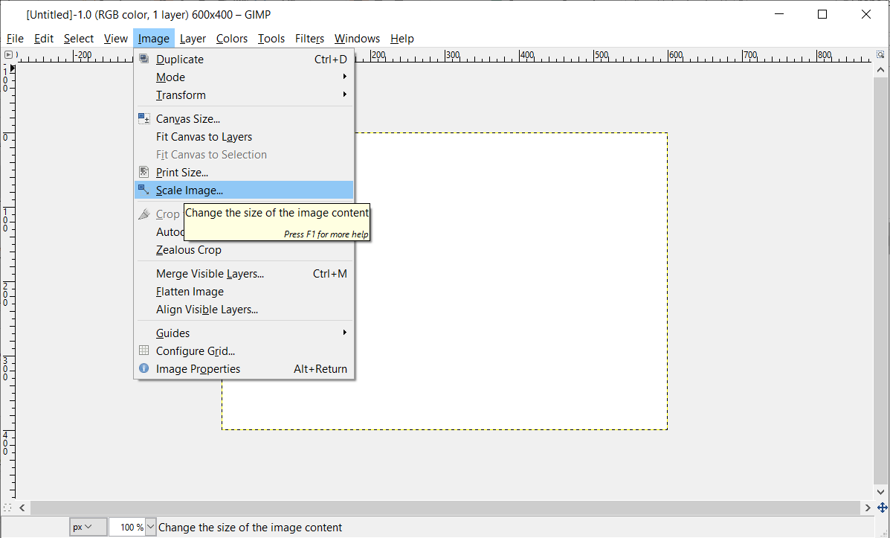
Scale Image
To re-modify the image resolution, select the image button and choose scale image.

Slide 28
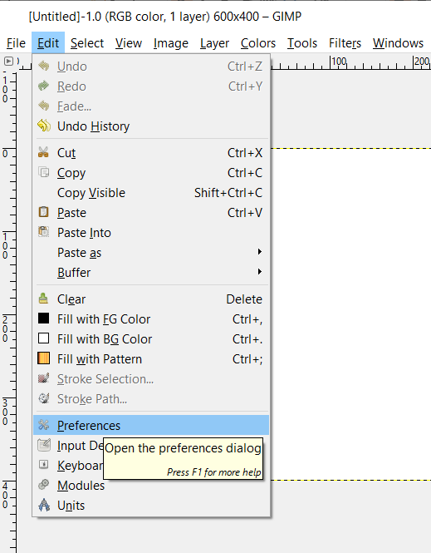
Colour Model(1)
To select a different colour model, click on the Edit button and choose Preferences.

Slide 29
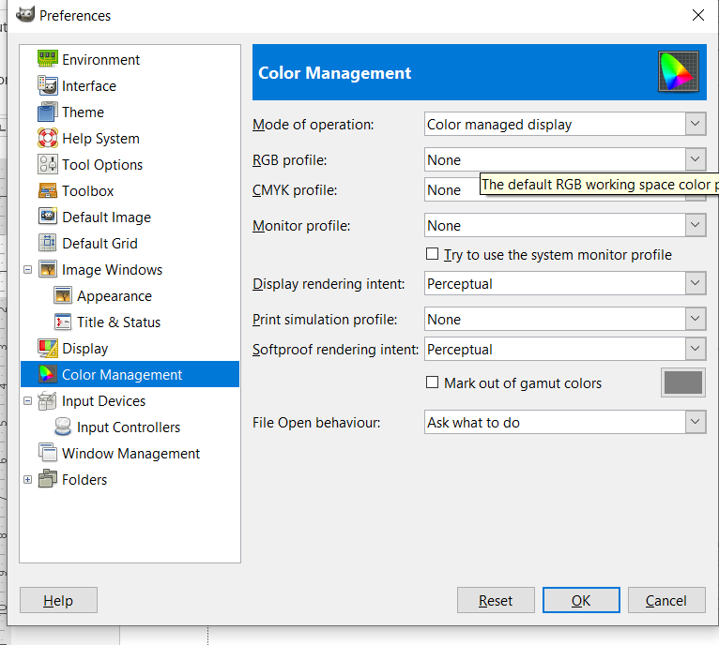
Colour Model(2)
Apply necessary setting and click OK.

Slide 30
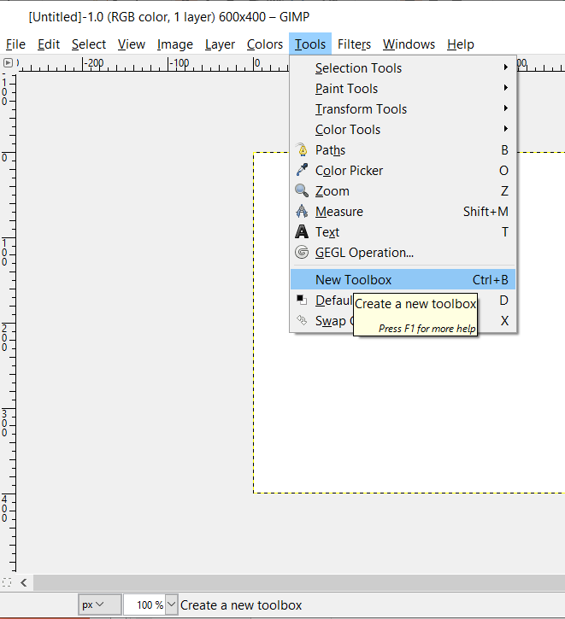
Change the background
To fill the background click on the Tools button and New Toolbox from the drop down menu.

Slide 31
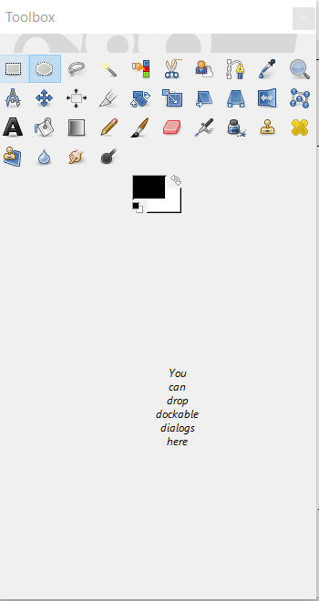
Toolbox

Slide 32
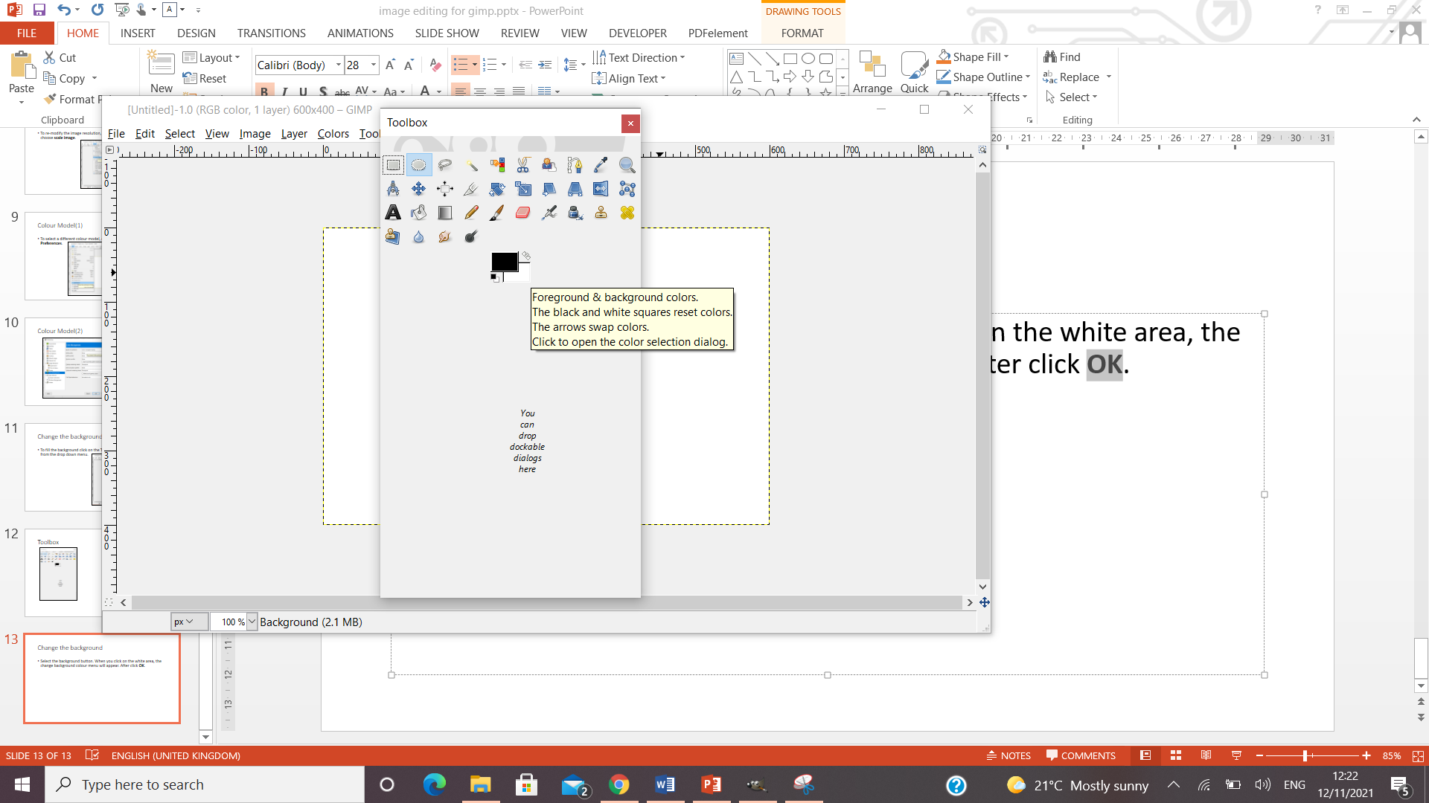
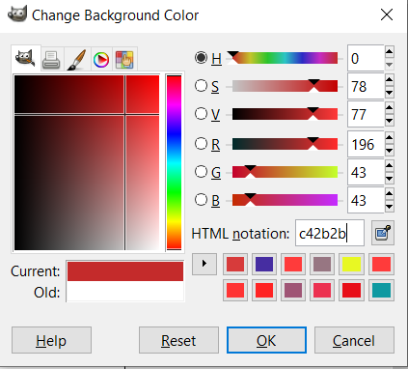
Change the background
Double click on the white area, the change background colour menu will appear. Select the colour of you choice and then click OK.

Slide 33
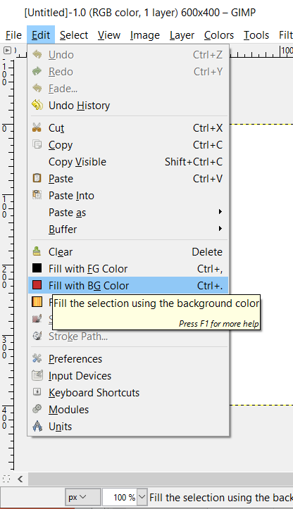
Fill with the background colour
Click on the Edit menu and then select Fill with BG colour as shown below.

Slide 34

Fill with the background colour result

Slide 35
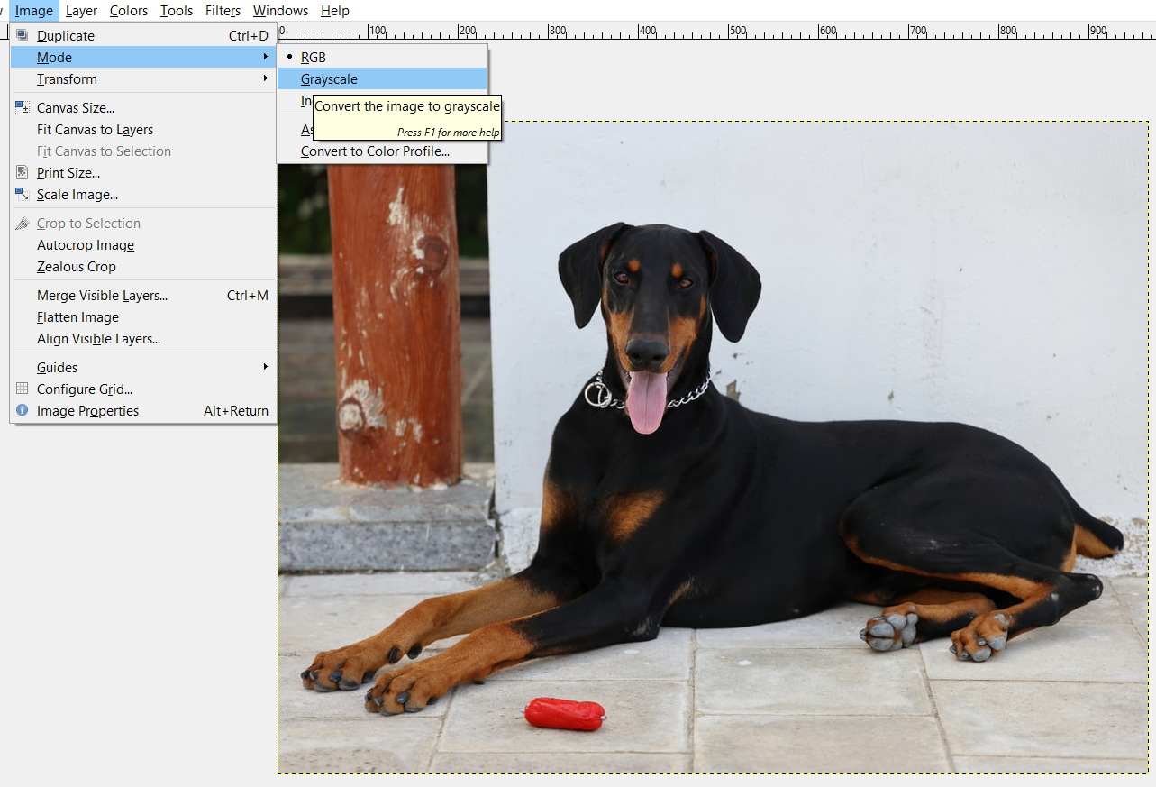
Change the colour mode
Open the Doberman image. From the Image menu proceed to mode and change the colour mode to Greyscale.

Slide 36
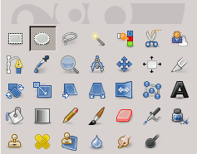
Create a new image file from clipboard
With the Doberman image opened, click on the Ellipse selection tool from the toolbox.

Slide 37
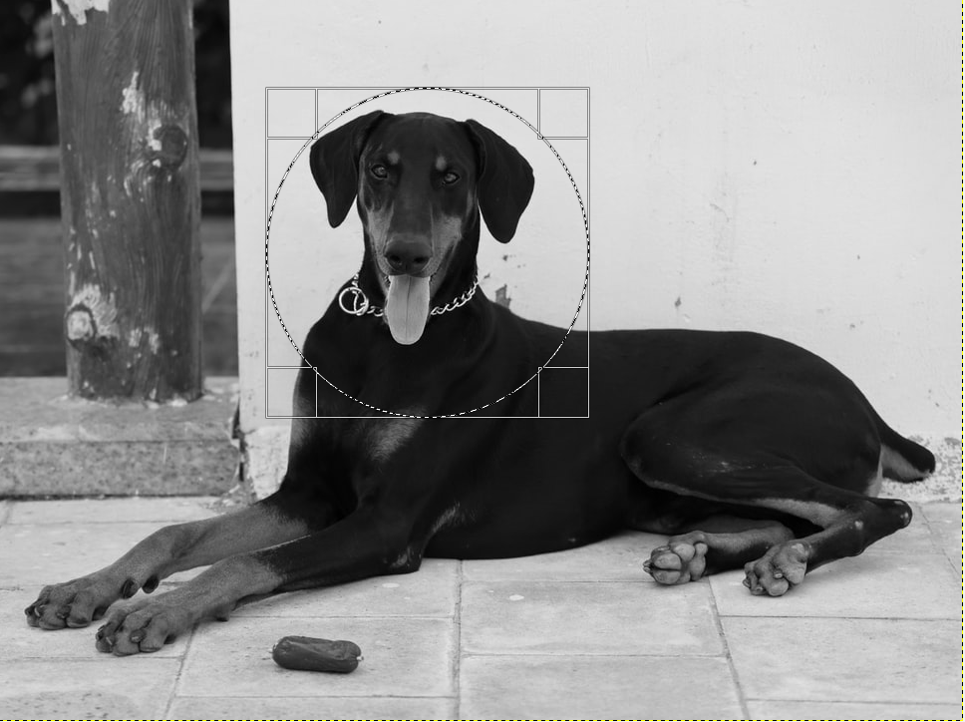
Ellipse Selection tool
Draw a circle around the dog’s face.

Slide 38
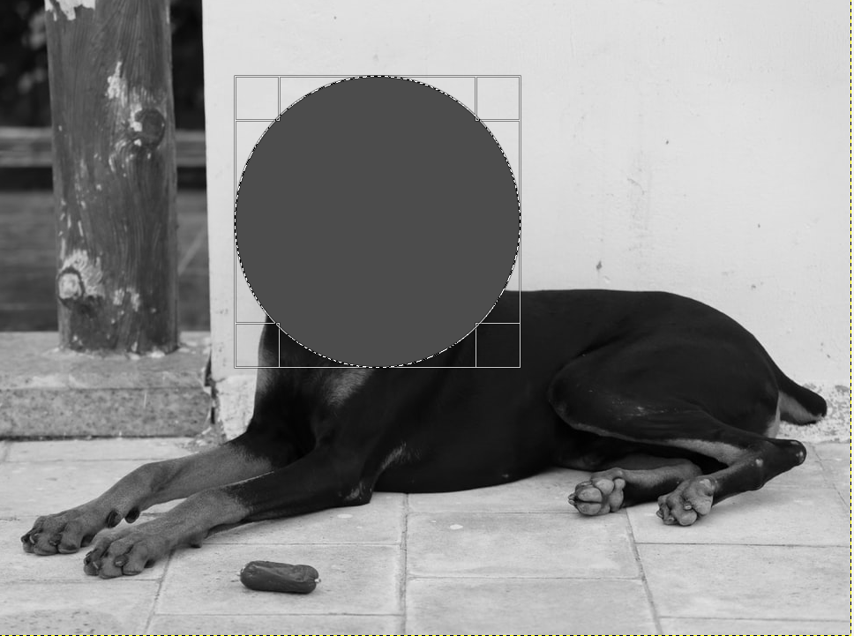
Ellipse selection tool
Click on the Edit menu and then select Cut.

Slide 39
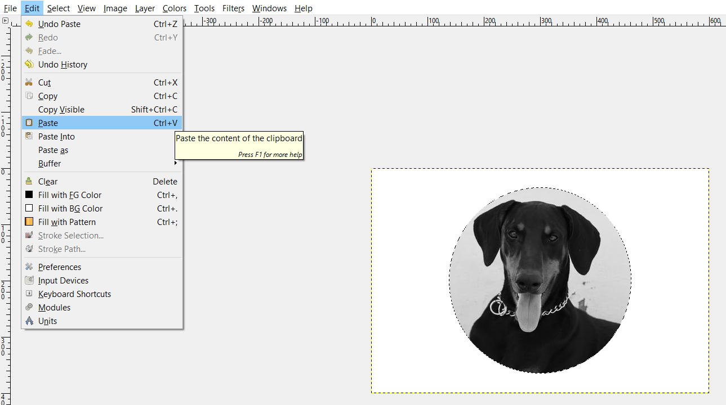
Ellipse Selection Tool
Open a new blank image. Then click on the Edit button and select paste.

Slide 40
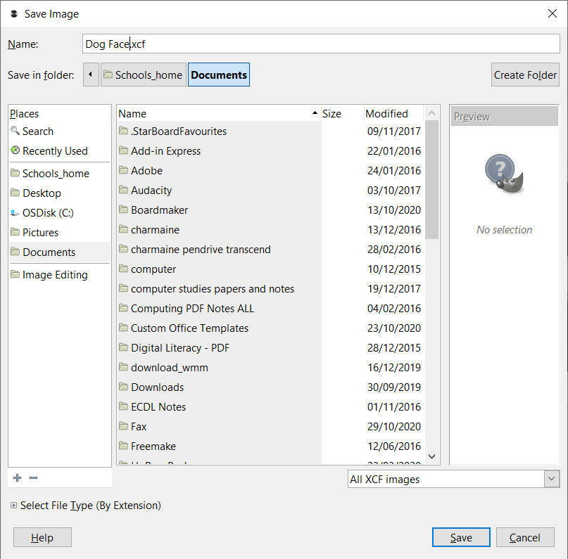
Ellipse Selection Tool
To save the new image created, click on File – Save As and choose a location.

Slide 41
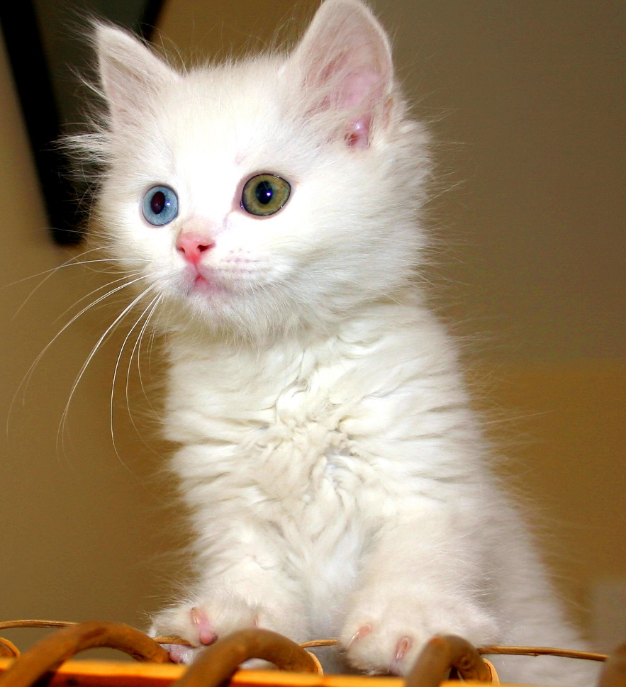
Export Image File
Open the cat image.

Slide 42
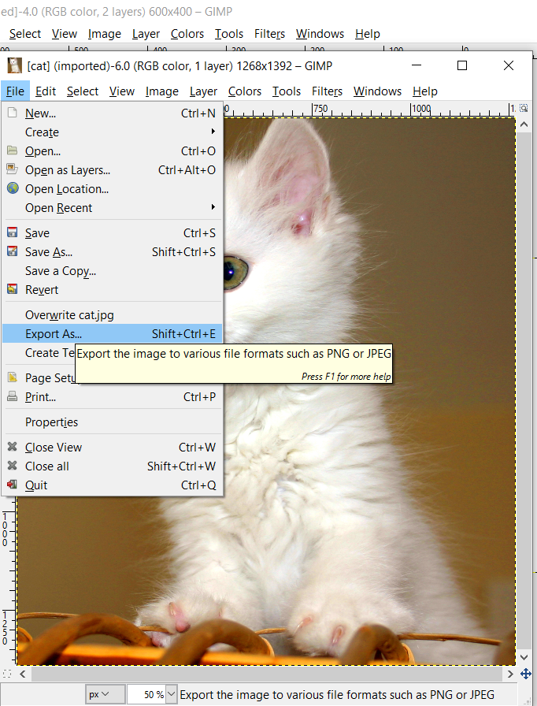
Export Image File
Click on File and select Export As.

Slide 43
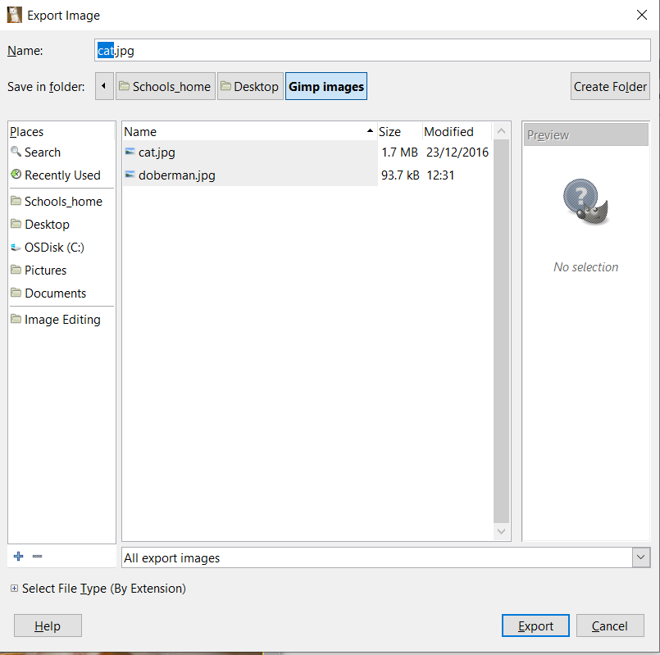
Export Image File

Slide 44
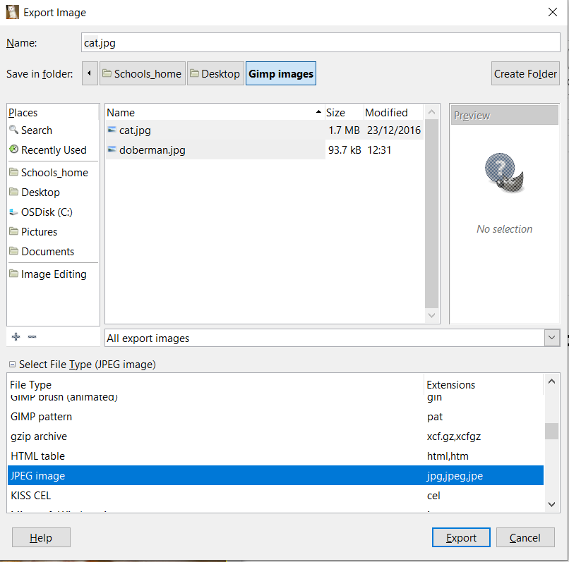
Export Image File
Click on the icon next to Select File Type (By Extension). The lower part of the window is extended. Select JPEG image. Click on Export to finish.

Slide 45
Set the foreground colour
Open an image of your choice and from the toolbox click on the black foreground colour.

Slide 46
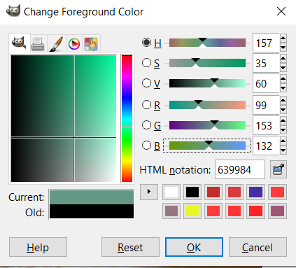
Set the foreground colour
Change the R,G and B values as you wish. Then click on the OK button.

Slide 47
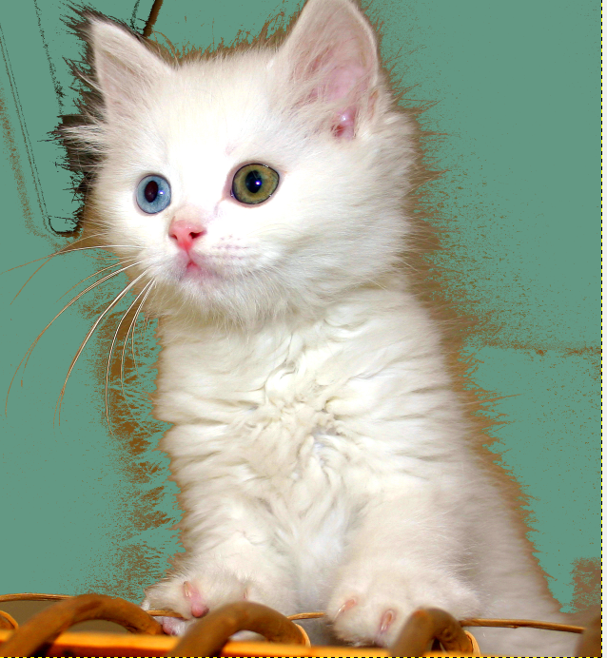
Set the foreground colour
Click on the Bucket Fill from the toolbox.
Click anywhere on the image to apply the desired effect on the selected image.

Slide 48
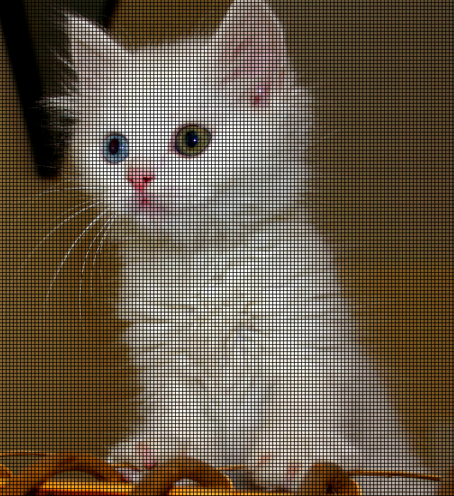
Gridlines
The grid is used to place something in an image very precisely.
Click on View button and select Show Grid from the drop down menu.
The image will be displayed with the grid lines.

Slide 49
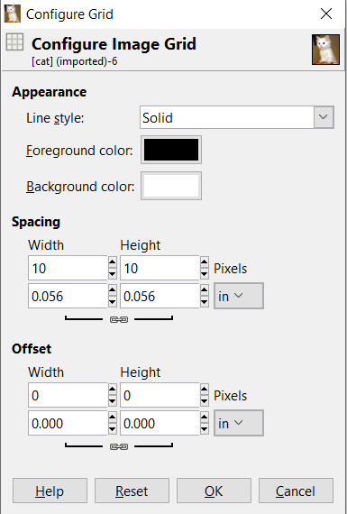
Gridlines
Click on Image and select Configure Grid.

Slide 50
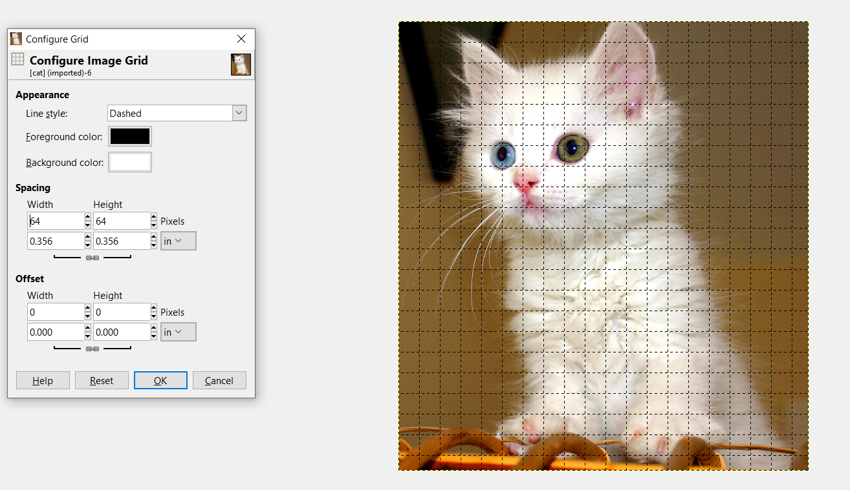
Gridlines
You can customize properties such as the Line style, Colors and Spacing.

Slide 51
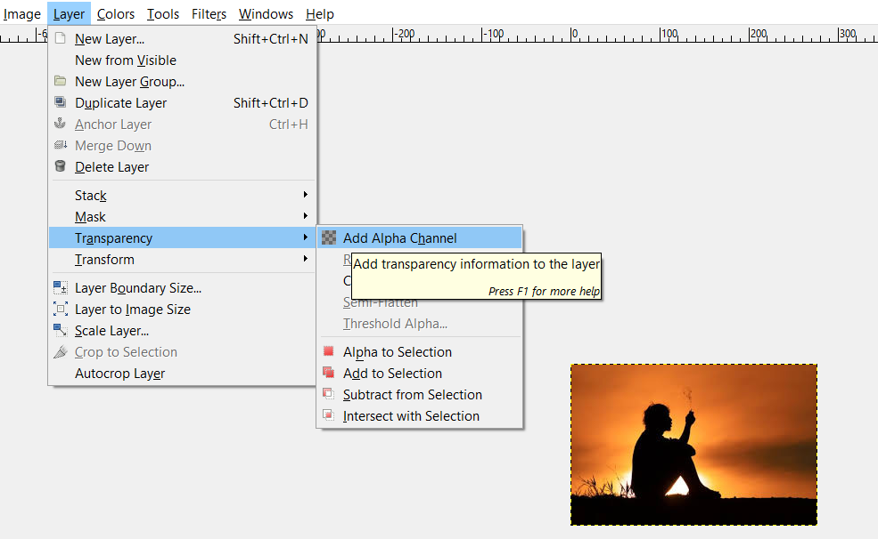
Enhancing Productivity - Transparency
Open the transparency image.
Click on the Layer button, select transparency from the drop down menu. Click on the Add Alpha channel from the given choices.

Slide 52
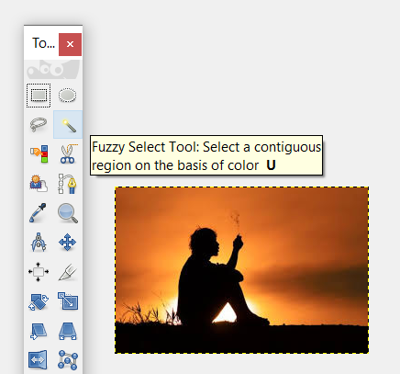
Enhancing Productivity - Transparency
Click on the Fuzzy Select Tool from the toolbox.

Slide 53
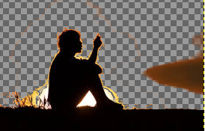
Enhancing Productivity - Transparency
Delete the sunset effect by pressing the Del Key. Repeat the step.

Slide 54
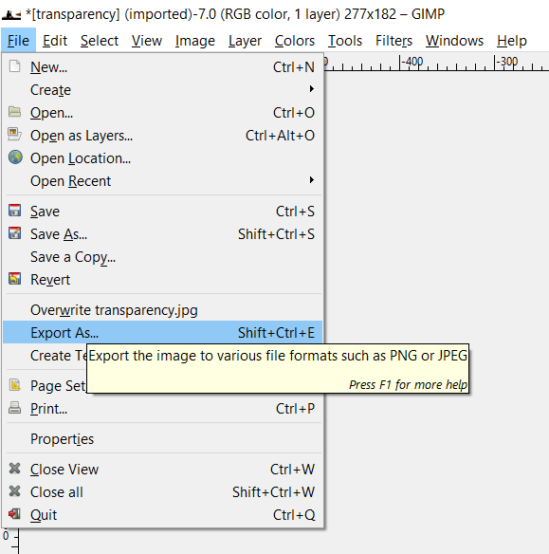
Enhancing Productivity - Transparency
Click on the File button and select Export. This will convert the jpg image to a format that supports the removal of the background such as PNG or GIF.

Slide 55
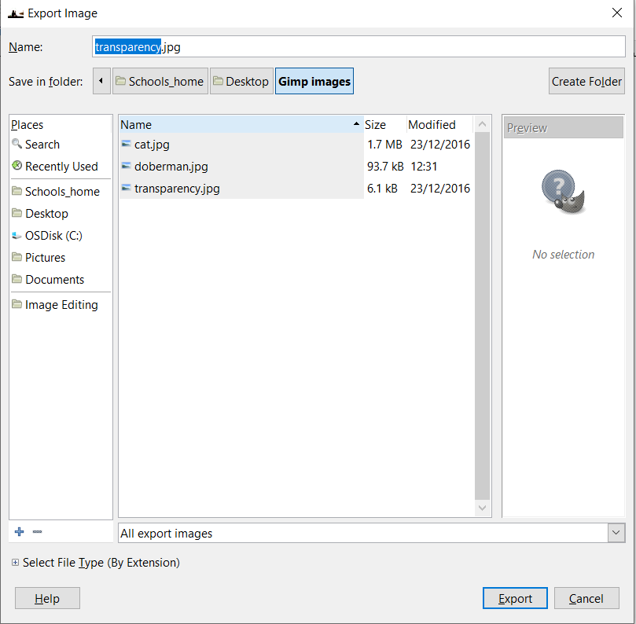
Enhancing Productivity - Transparency
Select the location where you are going to save the file and change the name of the file if you want to.

Slide 56
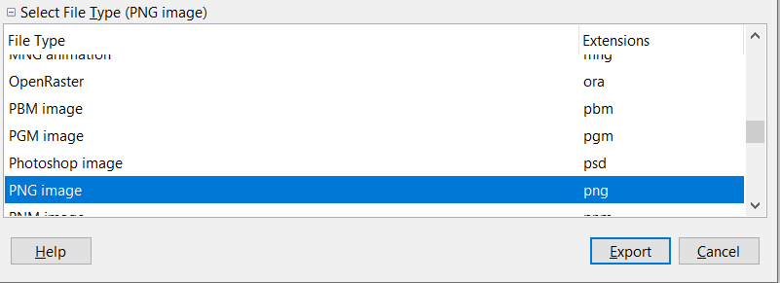
Enhancing Productivity - Transparency
Click the cross next to Select File Type. Select PNG image as File Type and click Export.
Close the opened image.

Slide 57
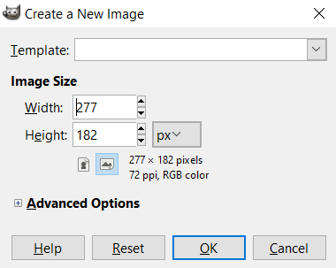
Enhancing Productivity – Measurement Units
Create a New image.
Note that if you click on the button that has px written on it, you can change the unit.

Slide 58
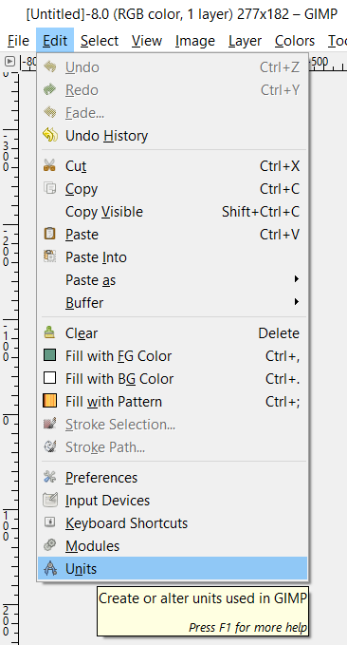
Enhancing Productivity – Measurement Units
Click on the Edit button and select Units.

Slide 59
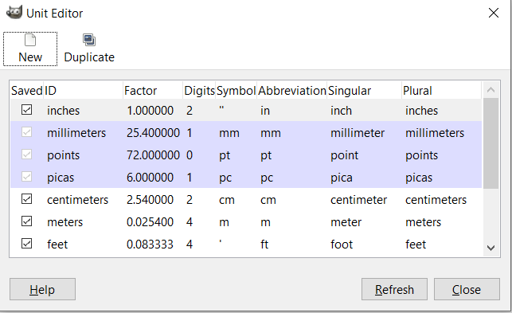
Enhancing Productivity – Measurement Units
This will display the Unit Editor window.

Slide 60
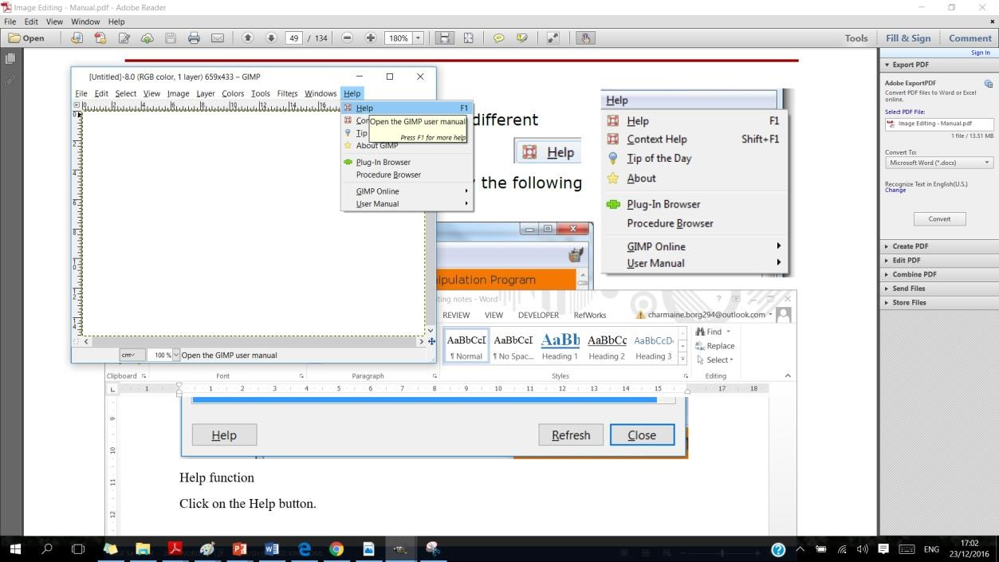
Help Function
In order to use the Help function click on the Help button.

Slide 61

Magnification/Zoom level
Open the dog image.

Slide 62

Magnification/Zoom level
Click on the arrow of the magnification/zoom button displayed in the status bar.
Select 25% and you will notice that the image will shrink.

Slide 63

Undo/Redo
Open the desert image and change it to grayscale.

Slide 64

Undo/Redo
From the Edit button select Undo Convert Image to grayscale option.

Slide 65

Undo/Redo
Click on the Edit button and select the Redo Convert Image to Grayscale.

Slide 66

Selections – Ellipse Selection
Open the Yamaha image.
Click on the Tools button. Select the Selection Tools command from the drop down menu. Select the Ellipse Select from the displayed options.

Slide 67


Selections – Ellipse Selection
Click and drag on the image to display a circle around it. You can then cut or copy the selection to another image as shown.

Slide 68

Selections – Use the freehand tool
Open the duck image.
Click on the Tools button from the menu bar. Select the Selection Tools command from the drop down menu. Choose the Free Select option.

Slide 69

Selections – Use the freehand tool
Start drawing a line around the swan by doing a single click and drag the mouse around the duck. Stop dragging the mouse when you will meet the other end of the line.
Click on the orange dot that will appear. A border will appear around the swan as illustrated below.

Slide 70

Selections – Use the freehand tool
Click on Select from the menu bar. Select invert from the drop down menu. This will select all the area except the image that we selected earlier on.
Press the delete key and the below image will be displayed.

Slide 71

Using the intelligent scissors or magnetic lasso tool and cropping technique.
Open the duck image.
Click on the Tools button from the menu bar. Select the Selection Tools command from the drop down menu. Choose the Intelligent Scissors.

Slide 72
Using the intelligent scissors or magnetic lasso tool and cropping technique.
A small scissors will appear near the mouse. Click on the border of the duck image. A small white dot will appear where it was clicked. Another dot will appear with a line joined to the first dot.
Continue to click around the duck to have a line around the duck image.
When finished press Enter.

Slide 73

Using the intelligent scissors or magnetic lasso tool and cropping technique.
A border will appear around the bike as illustrated below.

Slide 74


Using the intelligent scissors or magnetic lasso tool and cropping technique.
Click on Select from the menu bar. Select invert from the drop down menu. This will select all the area except the image that we selected earlier on.
Press the delete key and the image on the left will be displayed. Do not close the image.

Slide 75

Saving a selection
Click on Select from the menu bar and select Save to Channel from the drop down menu.

Slide 76

Saving a selection
The channel window will be displayed as shown below.

Slide 77

Saving a selection
Right click on the Selection Mask copy and select Edit the Channel Attributes.

Slide 78

Saving a selection
Type duckhighlight as channel name and click on the OK button.

Slide 79

Saving a selection
Click on the File button and select Save As command from the drop down menu.
Save the image as duck.xcf.
Click on the Save button.
Close the image.

Slide 80

Selections – Image or layer selection
Open the garden image.

Slide 81

Selections – Image or layer selection
Click on the Select menu bar and select All from the drop down menu.

Slide 82

Selections – Image or layer selection
Notice that the opened image has written one layer in the title bar.
Then click on the File button and select the Open option from the drop down menu. Select the child image and drag it onto the garden image as shown below.

Slide 83

Selections – Image or layer selection
Select Windows menu, click on Dockable Dialogs and select Layers from the given options.

Slide 84

Selections – Image or layer selection
The Layers window will be displayed.
Clicking on the garden will select the first Layer. Clicking on the child will display the second layer.
Do not close the images.

Slide 85


Layers Opacity
From the Layers window, click the arrow pointing downwards. Decreasing the opacity of the child image, means that it will start decreasing the transparency. Set the Opacity to 75% as shown below.

Slide 86

Flip Layer
Select the garden layer.
Display the toolbox by clicking on the Tools button and New Toolbox from the drop down menu.

Slide 87

Flip Layer
Select the Flip tool from the toolbox.
Click on the garden image and it will be flipped.

Slide 88

Rotate Layer
Click on the child layer.
Click on the Rotate Tool from the toolbox.

Slide 89

Rotate Layer
Click on the child image which will display the image in gridlines and the rotate tool window will be displayed.

Slide 90

Rotate Layer
Apply the following changes.
Click on the Rotate button. Notice the child image is rotated.
Undo the rotation.

Slide 91

Trim
Select the crop button from the toolbox.

Slide 92

Trim
Click on the child image and crop accordingly as shown below.

Slide 93


Scale Layers
Click on the Scale button from the Toolbox.
Click on the child image. The Scale window will be displayed on screen.
Apply the following measurements.
Then click on the Scale button.

Slide 94

Duplicate Layer
From the Layers window, click on the Duplicate button.
Another layer will appear on the Layers window.
In the layers window double click on the child.jpg copy. Rename the layer as modifiedchild.

Slide 95

Link Layers
To link the Child and the ModifiedChild images together, you need to click near the images and a chain will appear.
When linking layers together, you can move, re-size, rotate and flip layers together, as shown below.

Slide 96

Flatten Layers
Select the child layer from the Layers window.
Drag the layer upwards as shown below.

Slide 97


Flatten Layers
Then Click on the Layer menu and select MergeDown from the drop down menu.
Both layers are now considered as one.

Slide 98

Lock Layers
Select the ModifiedChild layer. Click on the lock pixels. This will lock the pixels in the ModifiedChild layer options such as scale are not possible.
Click again on the same button will unlock the pixels and you are allowed to use the image options (move, size, rotate and so on).

Slide 99

Delete Layers
Click on the ModifiedChild layer.
Click on the delete button from the Layers windows.
Close the image, without saving any changes.

Slide 100

Change the canvas size of an image
Click on the File button and open the dogrun image.
Click on the Image button from the drop down menu and select Canvas size.

Slide 101

Change the canvas size of an image
Apply the following changes.
Width: 20.249
Height: 10.266
Measurement: centimeters
Click on the Resize button and notice the
background of the picture has now increased.
Do not close the image.

Slide 102

Resize an image in pixels, measurement units
Click on the Tools button and select Transform Tools from the drop down menu. Select the Scale from the drop down menu.

Slide 103

Resize an image in pixels, measurement units
The Scale window will be displayed. Apply the below displayed changes.
Click on the Scale button. Notice that now we changed the image size, rather than the canvas size.

Slide 104

Rotate, mirror an image or selection within an image
Click on the Tools button and select Transform Tools from the drop down menu. Select the Rotate option.

Slide 105

Rotate, mirror an image or selection within an image
The following window will be displayed on the screen. Set the Angel to 20.
Click on the Rotate button. Note that the whole image is now rotated.

Slide 106

Convert a drawn image to a raster layer.
Click on the File button and select the Open option.
Open the face image.

Slide 107

Convert a drawn image to a raster layer.
Click on the File button and select the Export As option from the drop down menu.

Slide 108

Convert a drawn image to a raster layer.
This will display the Export Image window.

Slide 109


Convert a drawn image to a raster layer.
Type rasterlayer.jpg in the box next to Name.
Select the destination folder. Click on the Export button.
The Export Image as JPEG window will appear.
Click on the Export Button again.
The drawn image is now saved in a raster format.

Slide 110

Create an animated gif from layers
Open the text.xcf. The following window will appear.
Click on the Windows menu and select Dockable Dialogs from the drop down menu. Then select the Layers option.
The Layers window will be displayed.

Slide 111

Create an animated gif from layers
Double click on the Background from the Layers window and type (2000 ms).

Slide 112

Create an animated gif from layers
Click on Filters menu and select Animation from the drop down menu. Select Playback from the displayed options.

Slide 113

Create an animated gif from layers
The following window will appear.

Slide 114

Create an animated gif from layers
Click on Play button and notice that you start seeing the animated text.
Click on the Close button.
Click on File menu and select Export As from the drop down menu.

Slide 115


Create an animated gif from layers
Type Gimp.gif in the box next to Name. Then select the destination folder.
Click on the Export Button.
Tick the checkbox next to As Animation.
Click on the Export button.

Slide 116


Text manipulation – Font Size
Open the text.xcf opened earlier on. Display the Toolbox.
Click on the text tool from the toolbox.
Double click on the text Gimp.
Type 110 instead of 72 in the size box and press the Enter key.

Slide 117

Text manipulation – Font type
Select the text GIMP.
Type Arial Bold Condensed as the font type.

Slide 118

Text manipulation – Font Colour
Highlight the word GIMP and click on the red box.

Slide 119

Text manipulation – Font Colour
This will display the Change Colour window. Apply the following settings. Then click on the OK button.

Slide 120

Bold, Italic, Underline and Strikethrough
Highlight the word GIMP and select Bold.

Slide 121

Bold, Italic, Underline and Strikethrough
Now select Italic. The word is displayed in Italic.

Slide 122

Bold, Italic, Underline and Strikethrough
Now select Underline. The word is displayed in Underline.
Close the file without saving any changes.

Slide 123
Align Text
Open the definition.xcf file.
Display the toolbox and the tool options window.
To display the Toolbox click on the Tools menu button and select the Toolbox option.
To display the Option tools click on the Windows menu and choose Dockable Dialogs from the drop down menu. Click on the Tool options from the displayed options.

Slide 124

Align Text

Slide 125

Align Text
Highlight the written text. From the Tool Options window select the Centered option. The text should be displayed as follows.
Close the file.

Slide 126
Effects and filters
Open the Yamaha image.
To apply a pixelate effect, on the Filters menu, select Blur and click Pixelize.
To apply an emboss effect, on the Filters menu, select Distorts and click Emboss.
To apply a wind effect, on the Filters menu, select Distorts and click wind.
To apply a ripple effect, on the Filters menu, select Distorts and click Ripple.
To apply a twirl effect, on the Filters menu, select Distorts and click Whirl and Pinch.
To apply a desaturate effect, on the Colors menu, click Desaturate.

Slide 127
Apply blur effects: Gaussian, motion
Select part of the image using a Select Tool.
To apply a Gaussian blur effect, on the Filters menu, select Blur and click Gaussian Blur.
To apply a motion blur, on the Filters menu, select Blur and click Motion Blur.
Adjust the settings as required.
Click OK.

Slide 128
Apply lighting effects: lighting, flare
Select part of the image using a Select Tool.
To apply a lighting effect, on the Filters menu, select Light and Shadow and click Lighting Effects.
To apply a flare effect, on the Filters menu, select Light and Shadow and click Lense flare.
Adjust the settings as required.
Click OK.

Slide 129
Apply adjustments
Select part of the image using a Select Tool.
To adjust brightness-contrast, on the Colors menu, click brightness-contrast.
To adjust hue-saturation, on the Colors menu, click adjust hue-saturation.
To adjust colour balance, on the Colors menu, click colour balance.
Adjust the settings as required.
Click OK.

Slide 130
Apply sharpen mask
Select part of the image using a Select Tool.
On the Filters menu, select Enhance and Sharpen.Adjust the settings as required.
Click OK.

Slide 131
Apply unsharpen mask
On the Filters menu, select Enhance and click UnSharp Mask.
Adjust the settings as required.
Click OK.

Slide 132
Apply red eye reduction
Select part of the image using a Select Tool.
On the Filters menu, select Enhance and click Red Eye Removal.
Adjust the settings as required.
Click OK.

Slide 133



Drawing Tools : Add a line
In the Toolbox, click the Paintbrush tool.
In the Tool options, select the desired brush size,
aspect ratio and angle.
Draw the line. To draw
a straight line you have
to press the Shift key.

Slide 134

Add a shape to an image
In the Toolbox, click the Rectangle Select tool.
Draw the shape.
To create an outline shape, on the Edit menu, click Stroke selection.
To create a filled shape, from the toolbox choose the foreground colour and fill the shape with the Bucket Fill Tool.
Adjust the settings as required and click Stroke.

Slide 135

Painting Tools: Colour Picker
In the Toolbox, click the Color picker Tool.
Select the colour of the image to pick and
Click that colour to select.

Slide 136


Painting Tools: Gradient
In the Toolboxx, click the Blend Tool.
In the Tool options, adjust the
settings.
To view the effects, click and drag on the square from one corner to the opposite corner.

Slide 137


Paintbrush
Select the paintbrush tool from the toolbox.
In the Tool options, click the type of brush and size required.
Colour the portion of the image.

Slide 138

Eraser Tool
In the toolbox, click the Eraser Tool.
Erase a portion of the image.

Slide 139

Clone Tool
Open the desert image.
Display the toolbox by clicking on the Tools button and select the New Toolbox.
Click on the Clone tool from the Toolbox.

Slide 140

Clone Tool
Click on the moon image, while pressing the Ctrl Key.
A circle with a small cross will appear.
Move the mouse onto the sky. Click onto the sky while dragging the mouse down. A new moon similar to the first one will be displayed in the middle of the image as shown below.

Slide 141


Prepare Outputs: Print
On the File menu, click Print.

Slide 142

Prepare Outputs: Image Settings
Click on Image Settings tab from the print window.

Slide 143

Appropriate settings for Printing
Click on Image menu and select Print size.

Slide 144

Appropriate settings for Printing
The print size window will be displayed.
Set the image width to 800 mm and the height will automatically be set to 498.46mm since there is a chain to X and Y resolution.

Slide 145

Print: Paper Size and Orientation
To change the page set up such as the size and orientation. Click on File and select page set up from the drop down menu.

Slide 146

Print: Paper Size and Orientation
This will display the page set up window.
You can change the paper size by clicking
the arrow next to Size.
If you tick landscape, the page will be
displayed in landscape orientation.
The margins section allows you to set
the margins.

