Slide 1
ICDL – Data Protection
Lecturer: Jeanette Zammit

Slide 2
Aim of this module
On completion of this module you will:
Understand concepts relating to personal data and its protection.
Understand the rationale, objectives, and scope of the European Union General Data Protection Regulation
Outline the key principles of the GDPR relating to the lawful processing of personal data.
Understand the rights of data subjects and how they are upheld.
Understand that company policies and methods should comply with data protection regulations, and outline key technical and organisational measures to achieve this.
Understand how to respond to data breaches and the consequences of not complying with data protection regulations.

Slide 3
Section 1: THE RATIONALE FOR DATA PROTECTION
In this section, you will learn about:
• Defining privacy
• Recognising risks
• Privacy rights
• Data protection
• The General Data Protection Regulation

Slide 4
1.1 DEFINING PRIVACY
What is Privacy?
There is no single definition of privacy. People’s perspectives on privacy are influenced by many different factors. Here are some typical responses that people give when asked what privacy means to them:
• The right to be left alone.
• Freedom from interference by other people.
• The right to keep personal matters secret from others.
• A capacity to limit the sharing of personal information.
• The ability to act and communicate without intrusion by others.

Slide 5
People generally perceive privacy rights to cover a number of different aspects of their lives including, but not limited to:
• Their bodies and personal space.
• Their physical movements and behaviours.
• Their political thinking, philosophies.
• Their sex lives and orientations.
• Their digital lives and communications.

Slide 6
Technology’s Influence on Privacy
Technological developments is often presenting new challenges to personal privacy.
Privacy debates have been provoked by the popular adoption and availability of technologies such as:
• Photography and the ready publication of illustrated newspapers.
• The telephone and the subsequent “bugging” of telephone conversations.
• The personal computer.
• DNA fingerprinting.
• The mobile telephone.
• The Internet.

Slide 7
Recently we’ve seen new privacy challenges, which arise when the public start using and adopting to innovations such as:
• Drones.
• The Internet of Things.
• Wearable devices.
• Artificial intelligence systems.

Slide 8
Relationship between Privacy and Data Protection
The European Data Protection Supervisor (EPDS), the EU's independent data protection authority, offers the following definition of privacy.
‘Privacy is the ability of an individual to be left alone, out of public view, and in control of information about oneself. One can distinguish the ability to prevent intrusion in one's physical space ("physical privacy", for example with regard to the protection of the private home) and the ability to control the collection and sharing of information about oneself ("informational privacy").’
(EPDS website accessed February 2018 edps.europa.eu/data-protection/data-protection/glossary_en)
The concept of privacy therefore overlaps, but does not coincide with, the concept of data protection.

Slide 9
1.2 RECOGNISING RISKS
As computing power has grown, new challenges are prompted by the enormous volume of personal data that is being collected, used and stored.
We are witnessing a so-called 'data deluge' effect: where the amount of personal data that exists is processed and is further transferred, continues to grow.
Data analytics, in addition with location and behavioural tracking, is generating more and more data points linked to individual citizens.
This creative exploitation of personal data is helped by cheaper access to faster data processing, as well as innovations in areas such as machine learning and artificial intelligences.
While these developments have a significant potential to contribute positively to society, there is also the need to consider their potential to impact on human rights and freedoms.

Slide 10
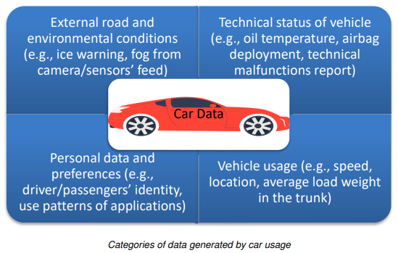
One example: developments in automotive technology.
Nowadays undertaking a car journey has the potential to generate a very large volume of data, at least some of which would be defined as “personal data.”
While this increased harvesting and connectivity of automotive data has the potential to contribute positively to road safety and provide other benefits (improved navigation and fuel efficiency) there also needs to be consideration of the potential risks where data can be exploited and used for the wrong reasons e.g. data profiling.

Slide 11
Another risk emerges as more data is generated and travels across the globe. The risks of data breaches also increase.
Organisations, both in the public and private sectors, need to implement real and effective internal mechanisms to safeguard the protection of individuals' information.
The consequences when privacy is lost are serious e.g. identity theft, fraud, financial loss, threat to professional secrecy.

Slide 12
1.3 PRIVACY RIGHTS
The right to Privacy
The right to privacy was set out as one of the articles of the Universal Declaration of Human Rights adopted by United Nations General Assembly in 1948.
Privacy was also the subject of one of the articles when the Council of Europe drafted the European Convention of Human Rights in 1950.
Due to an increasing automation and movement of data prompted the OECD to publish in 1980 what were in effect the first international set of privacy principles, Guidelines on the Protection of Privacy and Transborder Flows of Personal Data.
The Convention for the Protection of Individuals with Regard to Automatic Processing of Personal Data was adopted by the Council of Europe in 1981.
In 1995, with the objective of better aligning data protection within the member states, the EU adopted Directive 95/46/EC on the protection of individuals withregard to the processing of personal data and on the free movement of such data,usually referred to as the “1995 Directive”.

Slide 13
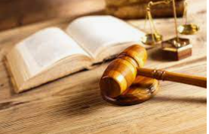
The EU Charter of Fundamental Rights (2009) in separate articles identifies both“privacy” and “data protection” as fundamental rights.
‘Respect for private and family life: Everyone has the right to respect for his or her private and family life, home and communications.’ (EU Charter of Fundamental Rights, Article 7)
‘Protection of personal data: 1. Everyone has the right to the protection of personal data concerning him or her. 2. Such data must be processed fairly for specified purposes and on the basis of the consent of the person concerned or some other legitimate basis laid down by law. Everyone has the right of access to data which has been collected concerning him or her, and the right to have it rectified. 3. Compliance with these rules shall be subject to control by an independent authority.’ (EU Charter of Fundamental Rights, Article 8)

Slide 14
1.4 DATA PROTECTION
The widespread adoption of computer technologies in the 1980’s alerted the need of privacy.
A legislation was introduced to protect and govern the processing of data.
The area of the legislation is known as ‘Data Protection’

Slide 15
Data Protection – Benefits both for the individual and for society
Data Protection regulations have a primary focus on the individual i.e. on protecting the informational privacy of citizens.
There need to be a sufficient level of trust in how personal data will be treated by all sorts of organisations, whether there to serve business, government or society in general.
While being in compliance with data protection legislation demands an investment of time and other resources from organisations, this brings benefits by helping to build trust without which it would be difficult for the digital economy to function and develop.

Slide 16
Privacy as a fundamental (but not an absolute) right
The right to the protection of personal data is not an absolute right.
It needs to be considered in relation to its function in society and be balanced against other fundamental rights.
Examples include:
Freedom of Speech
Prevention of Crime

Slide 17
1.5 THE GENERAL DATA PROTECTION REGULATION
Rationale
The General Data Protection Regulation (GDPR) was adopted by the European Parliament in 2016 (with an enforcement date of 25th May 2018).
It replaced the European 1995 Directive on Data Protection.

Slide 18
The GDPR is applicable as European law throughout the EU
This includes all European Economic Area, which is the EU plus Norway, Iceland, and Lichtenstein
Since it is a “Regulation” (as opposed to a “Directive”) it provides for the first time a standard legal basis for protecting personal data across all the countries of the European Economic Area (EEA).
For European residents, privacy rights also comes from legislation specific particular jurisdictions e.g. national laws and constitutions.

Slide 19
When does GDPR apply?
GDPR applies in nearly all circumstances in which personal data is being processed.
GDPR is applicable to personal data held in:
digital format (automated) and
manual data (i.e. personal data stored in hard copy format).
GDPR does not apply to the personal data of deceased persons.

Slide 20
Where does GDPR Apply?
One of the significant changes that has been implemented with GDPR relates to the territorial scope of data processing.
‘This Regulation applies to the processing of personal data in the context of the activities of an establishment of a controller or a processor in the Union, regardless of whether the processing takes place in the Union or not.’
(GDPR Article 3, Territorial Scope)

Slide 21
Some GDPR exceptions
Where personal data is in a physical format and is also unstructured (i.e. lacking any form of organisation or indexation)
Other examples of activities include:
A purely personal or household activity.
The prevention, investigation or prosecution of criminal offences.
The prevention of threats to public security.

Slide 22
1.6 REVIEW EXERCISE
1. The right to privacy is one of the fundamental rights that is protected under European Charter. List some aspects of private life that the “fundamental right to privacy” might help to protect.
An example is to prevent intrusion in one’s physical space e.g with protection of what happens in one’s private home.

Slide 23
2. List some other fundamental rights that are protected under European Charter.
Respect for private and family life
Protection of personal data.

Slide 24
3. Explain the difference between a “Directive” and a “Regulation” under EU law. Into which category does the GDPR fall?
A "Regulation" is defined as a binding legislative act. It is immediately applicable in full in all Member States and it overrules national laws.
A "Directive" is a legislative act setting guidelines that all EU countries must reach and translate into their national legislation within a defined time frame.
GDPR is a Regulation

Slide 25
4. Look at each of the following examples and decide whether it comes within the scope of GDPR.
Maintaining a home database (containing names, addresses and telephone numbers) for the purpose of communicating with friends and family.
(ii) Maintaining a database (containing names, addresses and telephone numbers) while acting as voluntary secretary to a sports club.
(iii) Maintaining in a home office a database containing a list of business names and addresses.

Slide 26
Section 2: DATA PROTECTION DEFINITIONS
In this section, you will cover the topics of:
Personal data
Data processing
Data controller
Data processor

Slide 27
2.1 PERSONAL DATA
Data protection law is only relevant to personal data.
This is data that can be linked to an identifiable living person.
Living persons are known as data subjects under data protection legislation.
Data protection law uses the term natural person to refer to a living person.
The term legal person is also used. This term refers to an organisation, for example a company or corporation, which can take on legal responsibility.
Data protection law applies to natural persons only.

Slide 28
When is Data classified as Personal?
For data to be considered personal data, it must be possible to connect it to a living human being.
Sometimes it is very easy to identify that we are dealing with personal data because the link between the data and an individual is very easy to see. E.g. Date of Birth
On other occasions, the connection may not be as obvious, but if it is somehow possible to connect the data we are using to an identifiable person then we are in fact handling personal data.

Slide 29
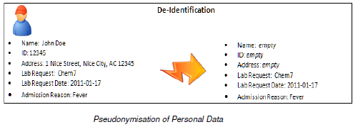
Pseudonymisation
One way of protecting personal data during processing is to remove the most obvious identifiers, such as a person’s name.
This helps to protect the data subject’s identity during processing.

Slide 30
Anonymisation
The blood test results in the previous slide example remain personal data because it is possible to use additional information to associate the results with the names of specific patients.
If it were not possible to link the results with patient names then the data would have been anonymized.
When we anonymise personal data, it means that it should never be possible in the future to re-establish a linkage between the data and the data subjects.
In this case data is no longer “personal data” and therefore the data protection regulations no longer apply to how we process this data.

Slide 31
Special Categories of Personal Data
The processing of personal data that falls into these special categories is prohibited unless certain conditions are satisfied.
For example, in the field of employment law, social protection law, for health security reasons, or to protect the vital interest of data subject.

Slide 32
2.2 DATA PROCESSING
What is Data Processing?
The term data processing is defined in the GDPR as follows:
‘processing’ means any operation or set of operations which is performed on personal data or on sets of personal data, whether or not by automated means, such as collection, recording, organisation, structuring, storage, adaptation or alteration, retrieval, consultation, use, disclosure by transmission, dissemination or otherwise making available, alignment or combination, restriction, erasure or destruction;
(GDPR Article 4, Definitions)’

Slide 33
2.3 DATA CONTROLLER
A Data Controller makes decisions about how personal data is collected and used.
The term is defined within GDPR as follows:
‘controller’ means the natural or legal person, public authority, agency or other body which, alone or jointly with others, determines the purposes and means of the processing of personal data;
(GDPR Article 4, Definitions)
So, any organisations big or small, self employed or even voluntary organisation, that decide to collect or use personal data in any way are in fact acting as “Data Controllers”.
These organisations, whether big or small, will all have responsibilities under GDPR.

Slide 34
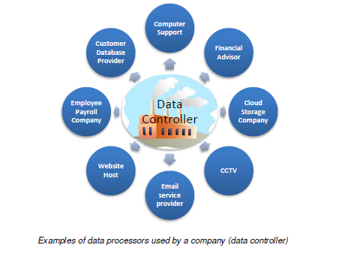
2.4 DATA PROCESSOR
A Data Processor acts on the instructions of a Data Controller.
‘processor’ means a natural or legal person, public authority, agency or other body which processes personal data on behalf of the controller;
(GDPR Article 4, Definitions)
In practice a data processor is very often an organisation that is carrying out some task on the instructions of another organisation.

Slide 36
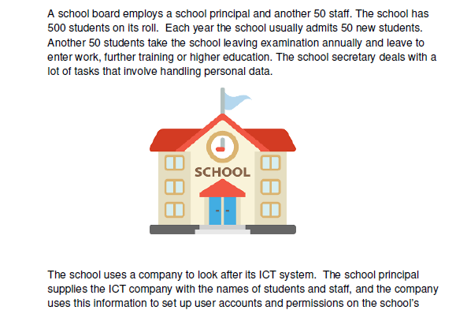
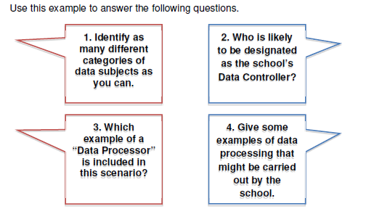
2.5 CONTROLLER - PROCESSOR EXAMPLE

Slide 37
2.6 REVIEW EXERCISE
1. List some examples of information that would be personal data.
a name and surname;
a home address;
an email address such as name.surname@company.com;
an identification card number;
location data (for example the location data function on a mobile phone);
an Internet Protocol (IP) address;

Slide 38
2. Examine each of the following statements for personal data.
Mary Brown of 21 Main Street, Boston was born on 25th May 2001.
(ii) John lived in Paris before moving to New York.
(iii) Half the students leaving Catherine’s school entered university.

Slide 39
3. List some examples of special categories of personal data.
Personal data revealing racial or ethnic origin.
Political opinions.
Religious or philosophical beliefs.
Trade union membership.
Genetic data and biometric data processed for the purpose of uniquely identifying a natural person.
Data concerning health

Slide 40
4. “Personal data that has been truly anonymised is no longer subject to the GDPR”.
True
(ii) False

Slide 41
5. Think of an example of a work place that is familiar to you. Identify the following:
(i) Data Controller
(ii) Data Subjects
(iii) Categories of Personal Data
(iv) Examples of processing activities
(v) Data Processors (if any)
- CEO or Board Members of the company
– Employees, Board Members, Customers
– Employees/Board members: Names, DoB, Employment History, Peformance
- Customers: Names, DoB, Purchase History, Credit Rating, Transaction, Address
– Recruiting a new employee
Entering data of a new customer
Updating address of an existing customer
–ICT company who is processing the data
- Cloud where the data is being saved.

Slide 42
Section 3: DATA PROTECTION PRINCIPLES
In this section, we will cover:
The data protection principles
Lawfulness, fairness and transparency
Purpose limitation
Data minimisation
Accuracy
Storage limitation
Integrity & confidentiality
Accountability

Slide 43
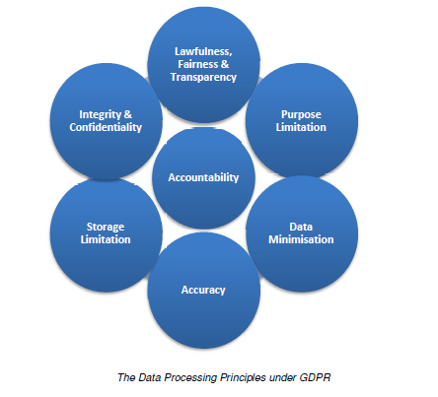
3.1 THE DATA PROTECTION PRINCIPLES
The General Data Protection Regulation (GDPR) sets out 6 core principles and 1 special principle.
These principles are primarily designed to protect the fundamental rights and freedoms of natural persons whose personal data may be subject to processing.
Each one of these principles must be considered anytime personal data is processed.
This means that the data processing that is being undertaken cannot be considered lawful if any one of these principles is disobeyed.

Slide 44
3.2 LAWFULNESS, FAIRNESS AND TRANSPARENCY
Personal data shall be processed lawfully, fairly and in a transparent manner in relation to the data subject;
(GDPR Article 5, Processing Principles)
Personal data can only be processed if there is a lawful basis for doing so.
This means that, amongst other things, people should understand how their personal data is being used.

Slide 45
3.3 PURPOSE LIMITATION
Personal data shall be collected for specified, explicit and legitimate purposes and not further processed in a manner that is incompatible with those purposes;
(GDPR Article 5, Processing Principles).
When we share personal data with others we have an expectation about the purposes for which it will be used. Specification of purpose is an essential first step in applying data protection laws.
The principle of purpose limitation prevents mission creep i.e. personal data being processed for purposes beyond those for which it was originally collected.
At the same time the purpose limitation principle does offer some flexibility to data controllers. Processing for a different purpose may be acceptable if it is considered compatible with the purpose for which the data was originally collected.

Slide 46
3.4 DATA MINIMISATION
Personal data shall be adequate, relevant and limited to what is necessary in relation to the purposes for which they are processed;
(GDPR Article 5, Processing Principles)
Data Controllers must not fall into the trap of collecting personal data “just in case” it might be needed for some purpose in the future.
Personal data should be processed only if the purpose of the processing could not reasonably be fulfilled by other means.

Slide 47
3.5 ACCURACY
Personal data shall be accurate and, where necessary, kept up to date; every reasonable step must be taken to ensure that personal data that are inaccurate, having regard to the purposes for which they are processed, are erased or rectified without delay;
(GDPR Article 5, Processing Principles).
Every reasonable step should be taken to ensure that personal data which are inaccurate are rectified or deleted.
Personal data that is being processed for a particular purpose must be kept accurate and up to date.
Controllers need to ensure that they have systems in place to amend or delete inaccurate or outdated personal data.
There may be circumstances where maintaining a record of ‘inaccurate’ information is also appropriate.

Slide 48
3.6 STORAGE LIMITATION
Personal data shall be kept in a form which permits identification of data subjects for no longer than is necessary for the purposes for which the personal data are processed
(GDPR Article 5, Processing Principles).
This principle requires that one must ensure that the period for which the personal data are stored is limited to a strict minimum.
Data controllers need to:
Define for how long they need to retain personal data.
Regularly review the personal data that they hold.
Delete any personal data whose storage purpose is no longer justified.

Slide 49
3.7 INTEGRITY & CONFIDENTIALITY
Personal data shall be processed in a manner that ensures appropriate security of the personal data, including protection against unauthorised or unlawful processing and against accidental loss, destruction or damage, using appropriate technical or organisational measures.
(GDPR Article 5, Processing Principles)
When we pass over our personal data to others, whether to an organisation or individual, we need confidence that they will do the necessarily to keep our data safe and secure at all times.

Slide 50
If you are a data controller, or a data processor, you need to plan very carefully so that the design and organisation of your security fits the nature of the personal data you hold.
This means that you will need to:
Assign clear responsibilities for information security.
Plan for appropriate physical and technical security.
Ensure robust policies and procedures and reliable, well-trained staff.
Prepare to respond to any personal data breach swiftly and effectively.

Slide 51
3.8 ACCOUNTABILITY
The controller shall be responsible for, and be able to demonstrate compliance with (the above principles).
(GDPR Article 5, Processing Principles).
Accountability requires data controllers to implement appropriate and effective measures to effect the principles and obligations of the GDPR and to be able demonstrate this on request.
What does this accountability principle mean in practice? Data controller should be able to point towards explicit measures they have put in place.

Slide 52
3.9 REVIEW EXERCISE
Accountability could be described as an “oversight” principle that governs the processing of personal data. List the other six principles.
1. Lawful, Fair and Transparent
2. Purpose Limitation
3. Data Minimisation
4. Accuracy
5. Storage Limitation
6. Integrity & Confidentiality

Slide 53
2. An interviewer has collected personal data by carrying out a door-to-door survey. They leave their interview records behind after having lunch in a restaurant. Which of the data processing principles have they broken?
This is an example of an Integrity & Confidentiality Breach.

Slide 54
3. Who is legally responsible for ensuring that the 7 data processing principles are obeyed?
Both the Data Controller and the Data Processor are responsible.

Slide 55
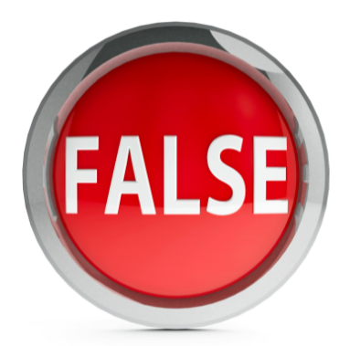
4. For each of the following statements, review and decide whether it is TRUE or FALSE.
(i) A data controller may be able to process personal data for a purpose that is different from that for which it was first collected if that new purpose is compatible with the original purpose.
(ii) A data controller must keep personal data up to date at all times and in all circumstances.

Slide 56
Section 4: LAWFUL BASES FOR DATA PROCESSING
In this section, we will learn about:
When data processing is allowed
The lawful bases
Appropriate lawful basis
Using consent as a lawful basis
Issues around consent

Slide 57
4.1 WHEN IS DATA PROCESSING ALLOWED?
A Lawful Basis is needed
The first principle established that personal data must be processed in a manner that is “lawful, fair and transparent”.
This means that anytime a data controller intends to process personal data, they must establish the “lawful basis” for doing so.
This lesson explains the 6 different bases that can be used to make data processing “lawful.”

Slide 58
Restrictions on processing data
Personal data should be processed only if the purpose of the processing could not reasonably be fulfilled by other means.
Therefore an assessment of its necessity and proportionality may need to be undertaken prior to commencement.
This assessment would consider whether the processing is necessary to achieve the designated purpose, or whether some other less intrusive method is available.
The processing of “special categories” of data is more restricted than that of other personal data.
In fact, the processing of special category personal data is forbidden unless certain conditions are met.

Slide 59
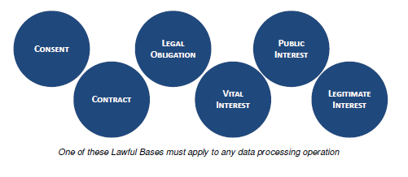
4.2 THE LAWFUL BASES
Processing shall be lawful only if and to the extent that at least one of these applies.

Slide 60
1. Consent
The data subject has given consent to the processing of his or her personal data for one or more specific purposes.

Slide 61
2. Contract
Processing is necessary for the performance of a contract to which the data subject is party or to take steps at the request of the data subject prior to entering into a contract.

Slide 62
3. Legal Obligation
Processing is necessary for compliance with a legal obligation to which the controller is subject.

Slide 63
4. Vital Interests
Processing is necessary to protect the vital interests of the data subject or of another natural person.

Slide 64
5. Public Interest
Processing is necessary for the performance of a task carried out in the public interest or in the exercise of official authority vested in the controller.

Slide 65
6. Legitimate Interest
Processing is necessary for the purposes of the legitimate interests pursued by the controller or by a third party.

Slide 66
4.3 APPROPRIATE LAWFUL BASIS
Before a data controller starts to collect and use personal data, they should be clear about which lawful basis they plan to use.
This forms part of the fair processing information that must be communicated to any data subject.
It is therefore very important that controllers assess the purposes and the lawful grounds prior to collecting the data.
The processing of personal data collected can sometimes have more that one lawful basis.

Slide 67
4.4 USING CONSENT AS A LAWFUL BASIS
Consent is one of six lawful bases to process personal data.
When initiating activities that involve processing of personal data, a controller must always take time to consider whether consent is the appropriate lawful ground for the envisaged processing or whether another ground should be chosen instead.
Consent can only be an appropriate lawful basis if a data subject isoffered control and is offered a genuine choice with regard to accepting or declining the terms offered or declining them without detriment.

Slide 68
Informed
Specific
Clear & Unambiguous
Freely Given
Consent must be …
The request for consent must be presented using clear and plain language,
The data subject should be aware who is the the controller and the purposes of the processing.
The request for consent must be presented in a manner which is clearly distinguishable from other matters.
When the nprocessing has multiple purposes, consent should be given for all of
them.
Consent requires a clear affirmative act, silence, pre-ticked boxes or inactivity cannot constitute consent.
Consent can be a statement which clearly indicates the data subject’s acceptance and controller must be able to demonstrate it.
Consent must be freely given means that data controllers who are in positions of power must be very careful that the data subject felt able to decline and not penalised in any way.

Slide 69
4.5 ISSUES AROUND CONSENT
Consent must be easy to withdraw - It should be as easy to withdraw as to give consent and the data subject has the right to withdraw his or her consent at any time.
Digital Age of Consent - The GDPR defines certain conditions that apply to consent where a child is using information society services. When relying on parental consent, the data controller is required to make “reasonable” efforts (taking into consideration available technology) to verify that consent is being given or authorised by a holder of parental responsibility.
Explicit Consent - The term explicit refers to the way consent is expressed by the data subject. Explicit consent is required in certain situations, for example where the processing of special categories of data is based on consent.

Slide 70
4.6 REVIEW EXERCISE
1. Give the definition of consent under GDPR.
Consent is when the data subject have freely given permission to the Data Controller to process his/her personal data. The consent must be
Informed
Specific
Clear & Unambiguous
Freely Given

Slide 71
2. Suggest an appropriate legal basis for each data processing activity.
An employer obliged to send details of employee earnings to the national taxauthority.
(ii) A business wishing to email marketing information to a potential customer.
(iii) A hotel processing credit card details to take a payment for a vacation.
Legal Obligation
Consent
Contract

Slide 72
3. A shop plans to install a CCTV system within its premises. Which legal basis would you suggest it rely on to process personal data? What other factors would the data controller need to take into consideration as part of its planning?
The suggested lawful basis is ‘Vital Interest’. Controller must ensure that stickers are installed to inform the Data Subjects and also follow the necessarily laws in relation to Data Retention.

Slide 73
4. For each of the following statements, review and decide whether it is TRUE or FALSE.
Valid consent is needed to process personal data under GDPR.
(ii) The rights and freedoms of a data subject may prevent processing by a data controller who is relying on “legitimate interest” as the lawful basis.

Slide 74
Section 5: DATA SUBJECT RIGHTS
In this section, we will cover:
The rights of data subject
The right to be informed
The privacy notice
The right of access
Other rights

Slide 75
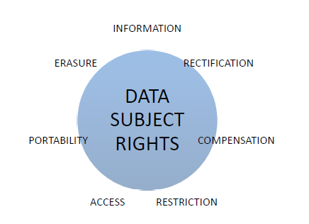
5.1 DATA SUBJECT RIGHTS
Data protection law is designed to protect the fundamental rights and freedoms of living individuals.
Amongst those rights identified as fundamental are the following:
The right to be informed
The right of access
The right of rectification
The right of erasure
The right to restrict processing
The right to data portability
The right to compensation.

Slide 76
5.2 THE RIGHT TO BE INFORMED
It is of utmost important that when the subject person trust a person or an organisation with their personal data, that the data controller is transparent in the way the data is collected, used, consulted and processed.
The Data subjects should be informed of any risks, rules and safeguards as well as being given information about their rights and how those rights can be exercised.

Slide 77
5.3 PRIVACY NOTICES
The principle of transparency requires that any information and communication relating to the processing of those personal data is easily accessible and easy to understand and that clear and plain language should be used.
The information is usually communicated to the data subjects in the form of a “fair processing” or a “privacy” notice.
This notice should be provided at the same time as the personal data is being collected.

Slide 78
The different ways to communicate a privacy notice
Hard-copy written format: - written explanations, leaflets, information in contractual documentation, cartoons, infographic, and flowcharts printed media.
Signage: visible notice boards, public signage, public information campaigns, newspaper/ media notices.
Electronic screens: in text messages; on websites; in emails; in mobile apps.
Screenless technology: icons, QR codes, voice alerts, written details or videos incorporated into set-up instructions, written information on smart devices;
Telephonic: oral explanations by a real person, automated or pre-recorded information with options to hear further more detailed information;
Person to person: oral explanations, written explanations provided in hard or soft copy format.

Slide 79
What information must be communicated to the Data Subject?
The GDPR provides clear guidance as to what information must be provided to data subjects. In summary then, data subjects will always need to know:
The identity and contact details of the Data Controller.
The purpose and legal basis of the processing.
How long the data will be held (or the criteria used to determine retention period).

Slide 80
In addition, whenever applicable, data subjects must also be provided with information about:
Any transfer of data outside the EEA (and safeguards) such as third countries.
The contact details of any data protection officer.
Any recipients of the personal data.
The identity of any controller’s representative.
Other relevant information such as the rationale for any processing based on legitimate interests; the existence of automated decision-making, including profiling etc.

Slide 81
Other Transparency Communications
Transparency needs to be considered not only when personal data is being collected, but also at key times throughout the life cycle of any processing.
Examples include:
when there is some significant change to the processing and does not match the initial reason when collected
when a data breach occurs
When data is obtained from another source and not the data person
Data subjects must be informed in a reasonable time, at least within one month.

Slide 82
Information appropriate to the audience
A controller must assess the audience that is providing personal data to their organisation and ensure that “transparency” information is presented in a manner that is understandable by that audience.
Examples when the data subjects are underage or have a disability.

Slide 83
5.4 THE RIGHT OF ACCESS
Any data subject can ask a data controller if personal data concerning him or her are being processed, and the purposes of the processing.
The data subject can also seek a copy of whatever personal data is being held.
This “right of access” is exercised by an individual making a “data access request” or a “subject access request”.
The controller is required to respond to such a request within one month of receipt.
If data subject makes the request by electronic means, the data controller is expected to provide the information in a commonly used electronic form.

Slide 84
5.5 OTHER RIGHTS
Right to Rectification - A data subject can ask that a controller rectify, without undue delay, any inaccurate personal data that hold about him or her. This could also involve the adjustment of a personal record where the data might not be complete.
Right to Erasure (‘right to be forgotten’) – A data subject can ask a controller to erase his or her personal data. This will particularly be relevant where:
The personal data are no longer needed in relation to the purposes for which they are collected, or where.
A data subject has withdrawn his or her consent or objects to the processing of personal data concerning him or her.
A data controller is not always obliged to erase personal data. Examples of grounds for retention could include: Compliance with a legal obligation ; The defence of legal claims.; Exercising the right of freedom of expression and information; Performance of a task carried out in the public interest; Research purposes and public archiving.

Slide 85
Right to restrict processing - In some circumstances a data subject has the right to restrict processing.
Right to data portability - The right the portability generally applies where the processing is carried out by automated means. This right allows a data subject to request that a copy of their personal data is provided in a “machine-readable format” for transmission to another controller.
Right to object - A data subject has the right to object to the processing of his or her data. In many (but not all) circumstances, processing will need to stop as a consequence of an objection.

Slide 86
5.6 REVIEW EXERCISE
1. List the different rights of a data subject under GDPR.
The right to be informed
The right of access
The right of rectification
The right of erasure
The right to restrict processing
The right to data portability
The right to compensation.

Slide 87
2. What media might be used to communicate privacy information concerning use of CCTV to a data subject?
Any appropriate media can be used, however in this particular case a Visible Signage may be the most appropriate.

Slide 88
3. A data subject has been asked to provide personal data by completing an online form. The text of the privacy notice provided is as follows: “If you give your consent we will use your personal data to provide you with information about our products”. To what other information should the data subject have ready access, in order to make this processing legal?
The data subject as a basis need to know:
The identity and contact details of the Data Controller.
The purpose and legal basis of the processing.
How long the data will be held (or the criteria used to determine retention period).
In addition, they need to have easy access to decline or to opt out in the future.

Slide 89
4. For each of the following statements, review and decide whether it is TRUE or FALSE.
A data controller must respond to a subject access request within 1 month.
(ii) The “right to erasure” is commonly known as the “right to rectification”.
(iii) Data subject rights are absolute rights and a data controller must always do as asked.

Slide 90
Section 6: PERSONAL DATA BREACHES
In this section, we will cover:
What a data breach is
How to deal with a data breach
Preventing data breaches

Slide 91
6.1 PERSONAL DATA BREACHES
Data protection legislation helps to keep personal data safe.
The principle of “integrity and confidentiality” means that controllers must have appropriate security in place to protect data from unauthorised access or accidental loss.
A “personal data breach” is defined as:
‘A breach of security leading to the accidental or unlawful destruction, loss, alteration, unauthorised disclosure of, or access to, personal data transmitted, stored or otherwise processed.’
(GDPR Article 4, Definitions)

Slide 92
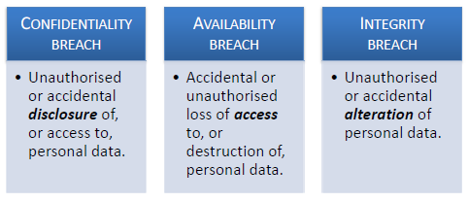
Any personal data breach can fall into one or more of the following categories:
If a controller hasn’t taken appropriate steps to ensure that “technical and organisational measures” are in place to keep personal data secure, then they are likely to be in breach of the law.

Slide 93
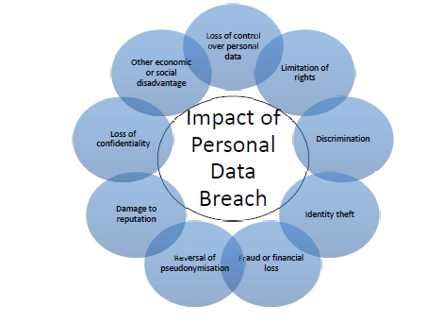
6.2 IMPACT OF A BREACH

Slide 94
6.3 COMMUNICATING A DATA BREACH
Data controllers are required by law to take action when a personal data breach has occurred.
The data controller should report personal data breaches to the supervisory authority as soon as possible and, where possible, within 72 hours.
If reporting after 72 hours, they shall also report the reasons for the delay.

Slide 95
When a personal data breach occurs, the law requires data controllers to consider communicating with both:
1. The Supervisory Authority.
2. The individual Data Subjects.
Notification to the competent supervisory authority is triggered where a breach is likely to result in a risk to the rights and freedoms of individuals.
Communication of a breach to the individual is triggered where it is likely to result in a high risk to their rights and freedoms.

Slide 96
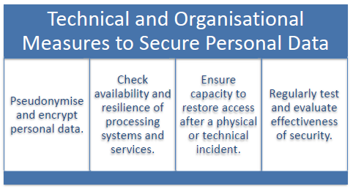
6.4 MINIMISING DATA BREACH PROBLEMS
A key element of any data security policy is being able, where possible, to prevent a breach and, where it nevertheless occurs, to react to it in a timely manner.
Appropriate Technical and Organisational Measures
State-of-the-art encryption
Data Processing Agreements

Slide 97
6.5 REVIEW EXERCISE
1. Give the definition of a “personal data breach” under GDPR.
A data breach is when there have been an accidental or unlawful destruction, loss, alteration, unauthorised disclosure and/or unauthorised access to personal data.

Slide 98
2. How many of the following examples constitute a personal data breach?
The loss of a file containing a financial statement of a company.
(ii) The theft of a laptop secured with industry standard encryption.
(iii) The accidental destruction of the only copy of a file containing medical records.

Slide 99
3. A company accidentally publishes a list of its customer details on its website. This list of personal data includes bank account details. Identify the actions that the company must take in terms of (i) the supervisory authority (ii) the data subjects.
The company must:
Inform the Supervisory authority within 72 hours if there is a delay explain why there was a delay.
Since the risk is high, then a notification is to be issued to the data subjects.

Slide 100
4. For each of the following statements, review and decide whether it is TRUE or FALSE.
Data subjects must always be contacted in the event of a data breach.
(ii) The notification regulations do not apply if the data controller has taken every reasonable step to prevent a data breach.
(iii) Notification of a data breach to the supervisory authority by a data controller is not necessary if there is no risk to the data subjects.

Slide 101
Section 7: ORGANISATIONAL RESPONSIBILITIES
In this section, we will be covering:
Accountability
The importance of record keeping
Policies and guidelines
Training and awareness
The role of a data protection officer
Privacy by design and by default
Data protection impact assessment

Slide 102
7.1 ACCOUNTABILITY REQUIREMENT
Accountability means that controllers need to be ready to demonstrate the measures they have taken to ensure compliance with the various data processing principles.
Data processors (i.e. organisations or individuals - not employees of the data controller - who process personal data on behalf of the controller) also carry significant responsibilities for compliance under data protection legislation.
Many of the accountability measures that are described in this lesson are just as applicable to processors as to controllers.

Slide 103
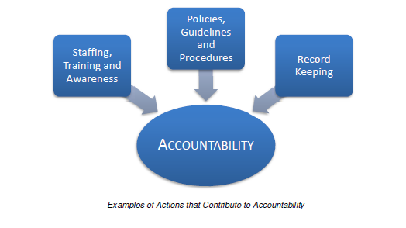
7.2 ACCOUNTABILITY MEASURES
Good governance from a data protection perspective requires effective organisational policies, procedures and guidelines as well as thorough and rigorous record keeping. It also requires appropriate “buy-in” from a human resource perspective, and this should pervade the organisation as a whole.

Slide 104
Policies, Guidelines and Procedures
A key way for organisations to show accountability is through the development of appropriate data protection policies. Demonstrated adherence to internal guidelines and procedures will also assist with this purpose.
Some examples of policies include:
Policies governing data processing operations (e.g. Data quality, security etc.)
Procedures to manage access, correction and deletion requests.
Procedures for the management and reporting of security breaches.
Procedures prior to creation of new personal data processing operations (internal review, assessment, etc.)
Procedures to verify that measures are implemented in practice (internal or external audits, etc.)
Mechanisms to handle complaints.
Contracts to enforce data protection.
Managerial oversight.

Slide 105
Record Keeping
Organisations can demonstrate accountability by maintaining records of their processing activities. The nature of the records that need to be maintained may be derived from internal organisational policies or stem from legal requirements.
Controller may need to maintain records that include the following factors (this list is not complete but provides an example of some of the GDPR requirements):
The categories of data subjects and the purposes of the processing.
Any sharing or disclosure of the personal data.
Any transfer of data outside the EEA and the associated safeguards.
Time limits for erasure of the different categories of data.
A description of the technical and organisational security measures in place.
Processors are also expected to maintain records and to be ready to demonstrate their accountability by making these records available to the supervisory authority on request.

Slide 106
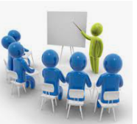
Staffing, Training and Awareness
An understanding of appropriate data protection responsibilities should apply at all organisational levels, relevant to members of boards or senior management as well as to operational staff.
This means ensuring that adequate data protection, training and education has been offered to, and
availed of by, staff members.

Slide 107
7.3 DATA PROTECTION OFFICER
When is a DPO needed?
According to the GDPR an organisation (whether a controller or processor) must appoint a data protection officer when one of the following circumstances applies:
Processing is carried out by a public authority or body.
Core processing activities require regular and systematic monitoring of data subjects on a large scale.
Core activities consist of processing on a large scale of special categories of data (i.e. Sensitive data) or data concerning criminal offences.

Slide 108
What is the role of the DPO?

Slide 109
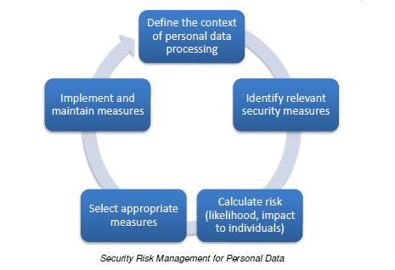
7.4 PRIVACY PLANNING
Risk Assessment
The assessment and management of risk is presented throughout the GDPR as an important skill for those who handle personal data.
In order to maintain security, organisations need to evaluate the risks inherent in their processing and implement measures to mitigate those risks.

Slide 110
Data Protection (Privacy) by Design
The “Privacy by Design” principle requires organisations to build data protection considerations into their processing operations and systems from the ground up, rather than as a last-minute compliance issue.
Hence organisations need to take early account of data protection rights whenever they are developing and designing products, services and applications.
PbD concept assumes a holistic approach by transforming how an organisation manages privacy.
Organisations should adopt PbD principles into all aspects of their operations wherever and whenever personal information is collected, used, disclosed, retained, transferred, and/or disposed.

Slide 111
Data Protection (Privacy) by Default
The “Privacy by Default” principle requires organisations to ensure that from the start personal data is processed with the highest privacy settings and protection.
The data collected is the minimum needed for the service to be offered to the data subject.
Similarly, the data should be stored for the shortest possible retention period and with minimum accessibility so that by default personal data isn’t made acessible to an indefinite number of other people.
This principle means that the privacy intrusive features and settings of a certain product or service are initially set to those needed for its most basic use.
The data subject is then left to decide whether to allow use of his or her personal data in a broader way.

Slide 112
Data Protection (Privacy) Impact Assessment
A Data Protection Impact Assessment (DPIA), also known as a Privacy Impact Assessment, aims is to identify the potential privacy risks of new or redesigned programs, systems or products.
The GDPR provides some circumstances where a DPIA would be mandatory. For example:
processing that involves automated decision making that produces a significant effect on data subjects;
systematic monitoring of data subjects in a publicly accessible area; or
large scale processing of sensitive data (special categories of data and data regarding criminal offences).

Slide 113
7.5 REVIEW EXERCISE
1. Give three strategies that an organisation can use to help show its accountability with regard to its data protection responsibilities.
Policies, Guidelines and Procedures
Record Keeping
Staffing, Training and Awareness

Slide 114
2. Who is responsible for record keeping under GDPR?
(i) Data Controller.
(ii) Data Processor.
(iii) Both Controllers and Processors.

Slide 115
3. Give three examples of technical and organisation measures that can help to minimise risk during data processing.
Data Protection Privacy by Design
Data Protection Privacy by Default
Data Protection Privacy Impact Assessment

Slide 116
4. For each of the following statements, review and decide whether it is TRUE or FALSE.
The Data Protection Officer is in charge of all of an organisation’s data processing activities.
(ii) Privacy by design is defined as the process for making sure that data protection websites are easy to understand.
(iii) A data protection impact assessment (DPIA) is mandatory under certain circumstances.

Slide 117
Section 8: Enforcement
In this section we are going to cover the areas of:
Supervisory authorities
Sanctions

Slide 118
8.1 SUPERVISORY AUTHORITY
Each EU member state must have a “Supervisory Authority”, a body that has a responsibility to oversee the implementation of the data protection legislation within its jurisdiction.
Some member states may have more than one supervisory authority (SA). This arrangement reflects different constitutional, organisational and administrative structures.
Each supervisory authority must have its own staff who operate Independently of any other state function. This is a safeguard to help ensure that each SA performs its tasks and exercises its powers with complete independence.
Data subjects have the right to lodge a complaint with a single supervisory authority in the Member State where they live, work or where the alleged infringement of their rights occurs.

Slide 119
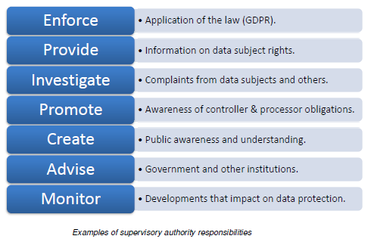
8.2 TASKS

Slide 120
Supervisory Authorities are also required to cooperate with each other and are facilitated in this by being represented on a pan-European body, the European Data Protection Board (EDPB).
The EDPB is an independent body that helps to ensure the consistent application of data protection legislation across the Union.

Slide 121
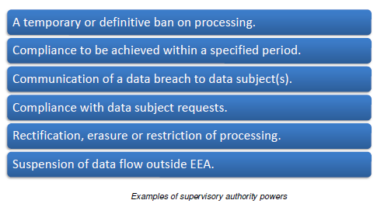
Supervisory authorities possess very significant powers and these can be either investigative or corrective in nature.

Slide 122
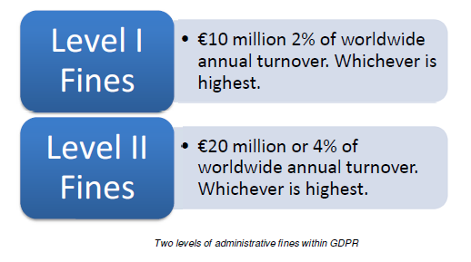
8.3 SANCTIONS AND PENALTIES
Administrative Fines
A supervisory authority has the power to impose fines for breaches of the data protection regulation.
The GDPR states that fines must be “effective, proportionate and dissuasive.”
Notes:
Level 1 Fine
The most serious category of breaches generally relates to non-observance of the
processing principles (lesson 3), the lawful processing requirements (lesson 4) or
data subject rights (lessons 5). Examples would be a controller who has been
processing personal data without a lawful basis to do so, or a processor who has
failed to implement security measures appropriate to the identified risks.
Level 2 Fines:
The second category generally relates to breaches of the regulation that concern
non-observance of GDPR requirements such as those set out in lessons 6 and 7:
For example a processor or controller might have failed to appoint a Data
Protection Officer or neglected to carry out a Privacy Impact Assessment.

Slide 123
Other Penalties including Judicial Remedies
All organisations, including public authorities and bodies, need to be aware that exposure to administrative fines is only one of the potential sanctions that may result from a GDPR breach.
Data subjects are free to exercise their right to seek remedy through the courts.
Data subjects have the right to bring legal proceedings against a data controller or data processor in the Member State where the controller or processor has an establishment or where the data subject lives. This is called litigation.
Data subjects also have the right to receive compensation from the controller or processor for damages suffered.
Another key consequence of an organisation that fails to implement relevant data protection regulations is that they may suffer damage to their reputation, which may lead to loss of consumer trust and business.

Slide 124
8.4 REVIEW EXERCISE
1. What is the primary function of a supervisory authority?
The main aim of the “Supervisory Authority”, is to oversee the implementation of the data protection legislation within its jurisdiction.

Slide 125
2. Which of the following powers can a supervisory authority exert?
(i) A temporary ban on all personal data processing.
(ii) Communication of a data breach to data subjects.
(iii) Suspension of all data flow outside the EEA.
(iv) All of the above.

Slide 126
3. Name the Supervisory Authority responsible for data protection in your jurisdiction.
The Information and Data Protection Commissioner (IDPC) is the Supervisory Authority responsible for data protection in Malta

Slide 127
4. List three possible consequences for an organisation that can result from a breach of the GDPR
Fines up to Eur20 million or 4% of the organisation’s total worldwide annual turnover.
Data subjects can ask for Compensation
Company will damage their reputation and loose trust with their customers.

Slide 128
5. What is the maximum fine that could result from each of the following:
A data controller fails to notify a data breach to the supervisory authority.
(ii) A data processor causes personal data to be leaked to outside agencies.
(iii) An organisation undertaking data processing fails to keep a record of its processing activities.

