Slide 1
Computer Essentials
Module 2

Slide 2

ICT
ICT stands for Information and communication technology.
IT focuses on communication technologies
People have created a global village i.e. – e-community in which people communicate in real time even if they are not communicating face to face

Slide 3
Mobile Technology
Smart phone – in smart phone we find operating system as well. Smart phones offers advanced features like PCs such as browsing the internet, miniature keyboard, read documents such as Word and Adobe.
Mobile phones – these are used to communicate (texting, voice and browsing)

Slide 4
Office productivity applications
These are applications that can be used in an office environment.
Some examples are
  Shared online calendar
  Online file storage
  Microsoft office applications
    Microsoft Word
    Microsoft Excel
    Microsoft Power Point
    Microsoft Access

Slide 5
Hardware
Hardware refers to the physical components of the computer.
Hardware can be split in two groups
  Internal hardware (The components that are inside the system unit)
  External hardware(The components that are connected with the system unit)

Slide 6
Internal Hardware
Processor: to receive input and to provide the appropriate output. It handles all instructions such as processing mouse and keyboard
Read Only Memory (ROM): It is a chip that holds software in order to boot the computer. (Non volatile – built it/ read only and not written)
Random Access Memory (RAM): the memory used by the computer. RAM is used while the computer is switched on. This is a temporary memory.
Notes:
Non volatile – unstable

Slide 7
Storage
Hard drive – stores the operating system, application software, files and folders.
SD cards – used by camera
Pen drives – connect via USB
External hard drives – connect via USB
Blue Ray - it is capable of storing high-definition video resolution (1080p)
The last three are used as backup. Backups are used in case of fire or data lost from hard drive

Slide 8
External Hardware
Printers: There are many types of printers. The most common is Laser printer. Ink jet printers are mainly used at home.
Screens: VDU – Visual display unit is used to show the output of the PC. Projection devices can be attached with the PC. Touchscreens serve as an input and output device.

Slide 9
External Hardware
Scanners: These serve to convert printed material into a file format which can be used in the computer.
Keyboard: The keyboard’s main function is to type characters that you want to appear on the screen. It can also be used to facilitate work by using keyboard shortcuts.
Mouse/ trackpad: These components are used to point, click and select items.

Slide 10
External Hardware
Webcam: It is used to record video clips on the computer.
Speakers: The speakers are used to output sound from the computer so that the user can hear when watching a video or listening to an audio file.
Microphone: This input device is used to convert sound waves so that we can be heard when doing a voice or video call or even recording a sound or video clip.

Slide 11
Types of Computers
Desktop Computers: These are designed to stay in one location
Laptops: A portable computer. A newer term is Notebook; a smaller version of a laptop. Both have VDUs (Video display units).
Tablets: a portable computer that uses a touch screen as a primary device.

Slide 12
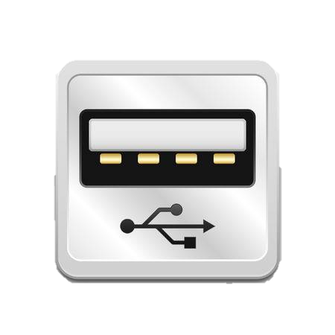
USB Port
USB stands for Universal Serial Bust
Through the USB port we can connect peripherals and other components to the computer.
The USB port can be also used to connect storage media and transfer files from and to the computer.

Slide 13
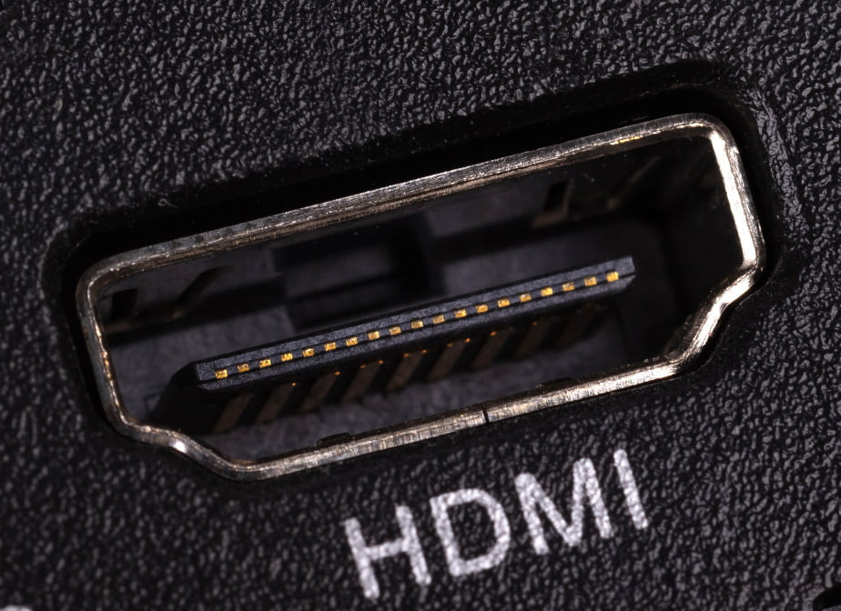
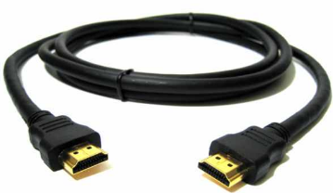
HDMI
It stands for High Definition Multimedia Interface
HDMI is proprietary audio/video interface for transferring uncompressed video data and compressed or uncompressed digital audio data from an HDMI-compliant source device, such as a display controller, to a compatible computer monitor, video projector, digital television, or digital audio device
Notes:
A cable from laptop to TV

Slide 14
Software
These are the instructions that make the computer work
There are two types of software
Operating System (this always comes first)
Application Software

Slide 15
Operating system or System Software
Refers to the files and programs that make up your computer’s operating system
It loads automatically when you switch on the computer
Operating system is the first thing that is installed to your computer. (Before Applications)
There are many types of operating systems: IBM, DOS, XP, Vista, Windows 8, LINUX, UNIX, IOS (apple)

Slide 16
Application Software
The type of program which you use once the operating system is loaded
Examples of office productivity: Microsoft Word, Microsoft Excel, word pad
Examples of communication: Skype, What’s app
Examples of social networking: Facebook, Twitter
Examples of design: Kompozer, photo shop
Examples of mobile application: calendar, play store

Slide 17
EULA
It stands for End User Licence Agreement
When you buy a software you are buying the licence to use the software.
This is a legal contract between the author and the user.
Copyright – the right reserved for the author.
This does not contain any offers when it comes to buy
Notes:
Mock definition

Slide 18
Types of Software Licenses
Proprietary – software is closed. Does not allow you to make any modification.
Open source software – software code is open to enhance.
Shareware – free software with limited functions.
Trial version – fully versioned for a period of time - try before buying.
Freeware – the software is copied and downloaded for free. The author preserves all rights.

Slide 19
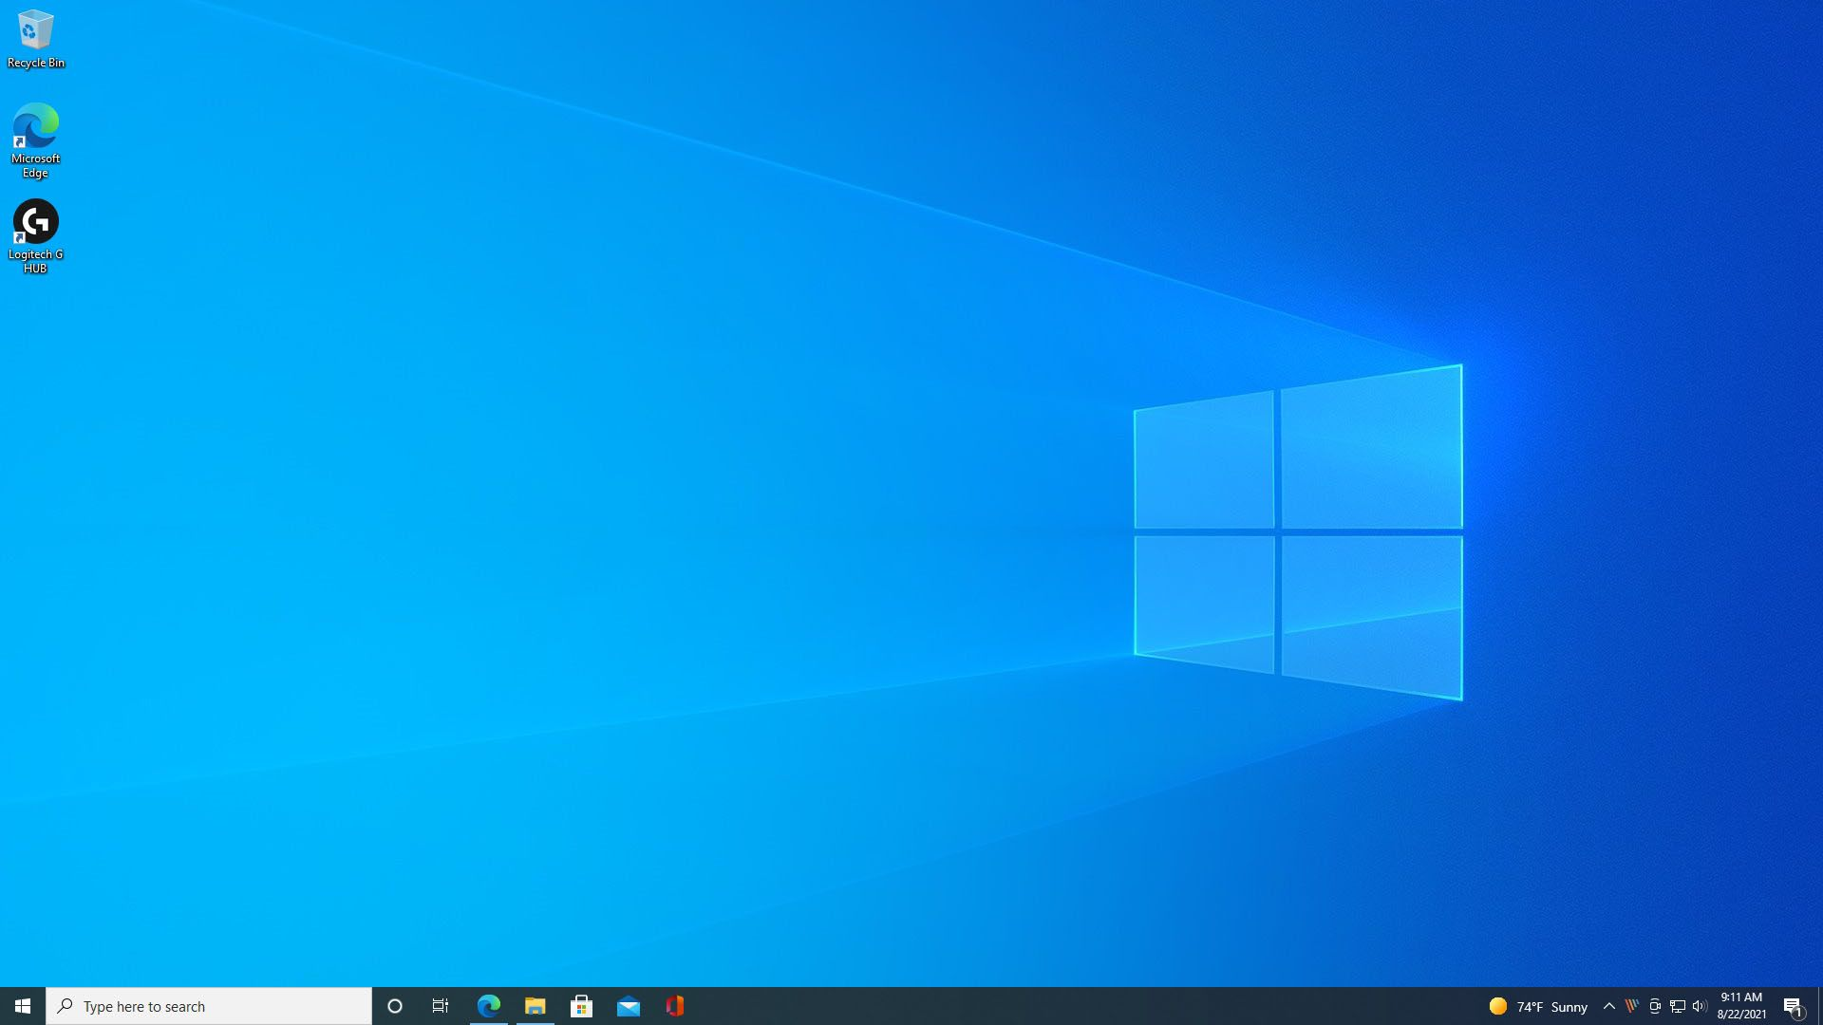
Desktop and Taskbar
The purpose of Desktop is to illustrate all icons
The purpose of Taskbar is to provide an easy way of opening and managing programmes.

Slide 20
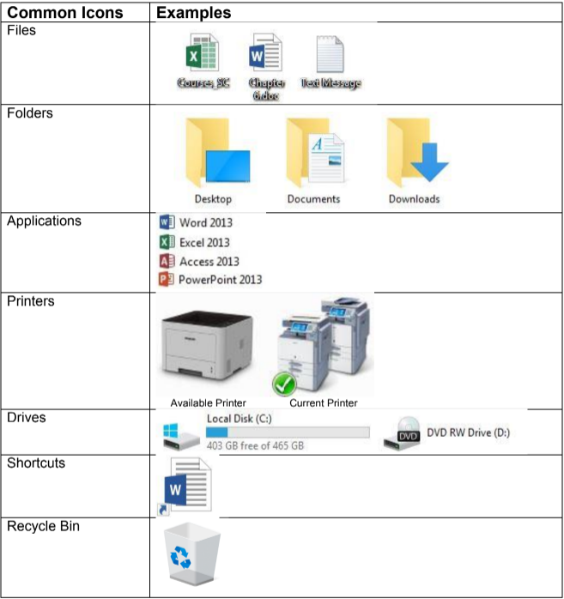
Icons
Icons represent a file, application or folder.

Slide 21
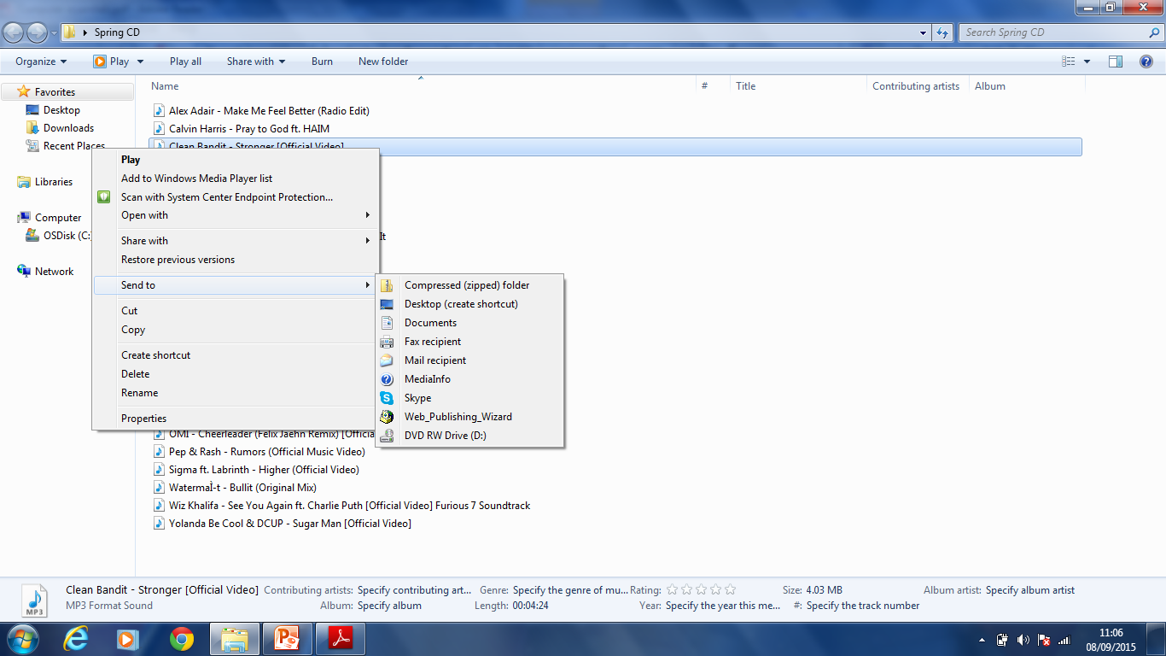
Creating shortcuts
Shortcuts are created to access the program easily and quickly. These are created automatically on desktop → send to
However shortcuts can be created in other location by using Create Shortcuts

Slide 22
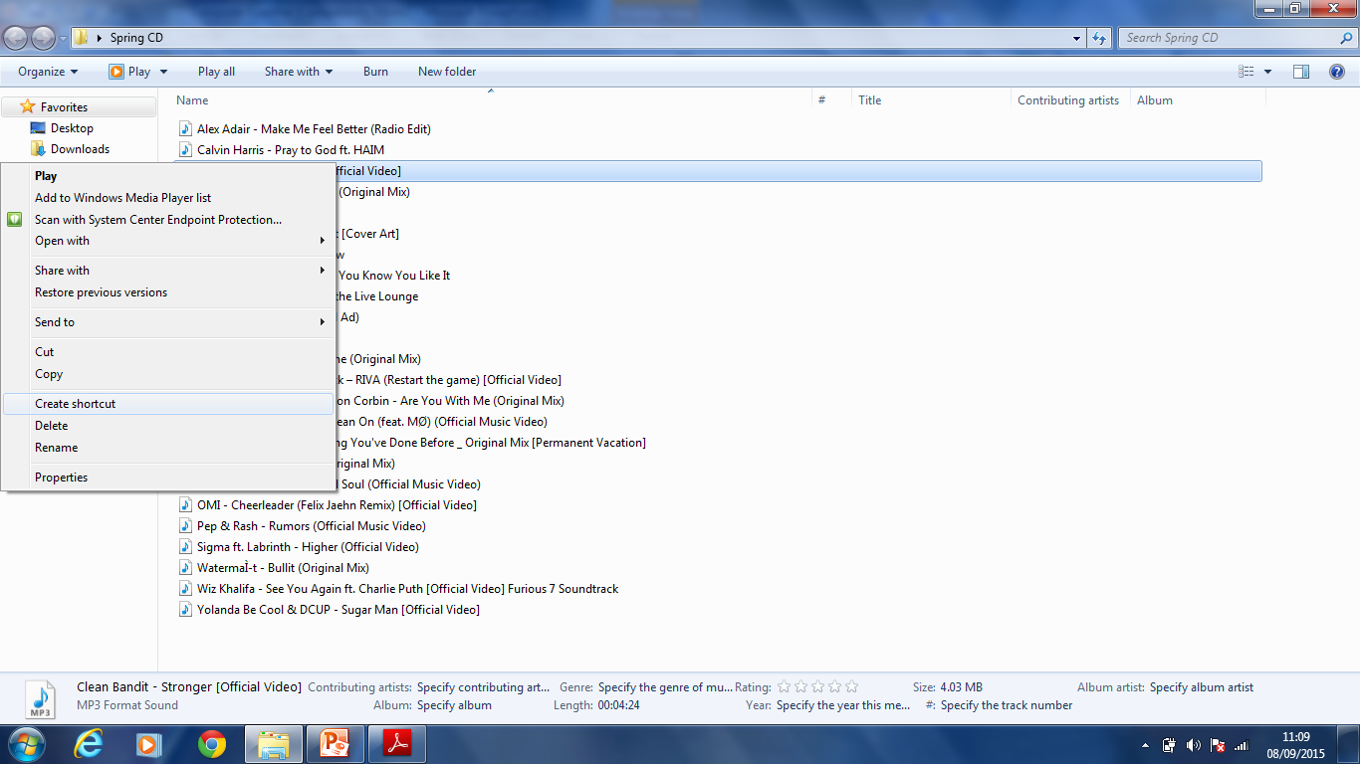
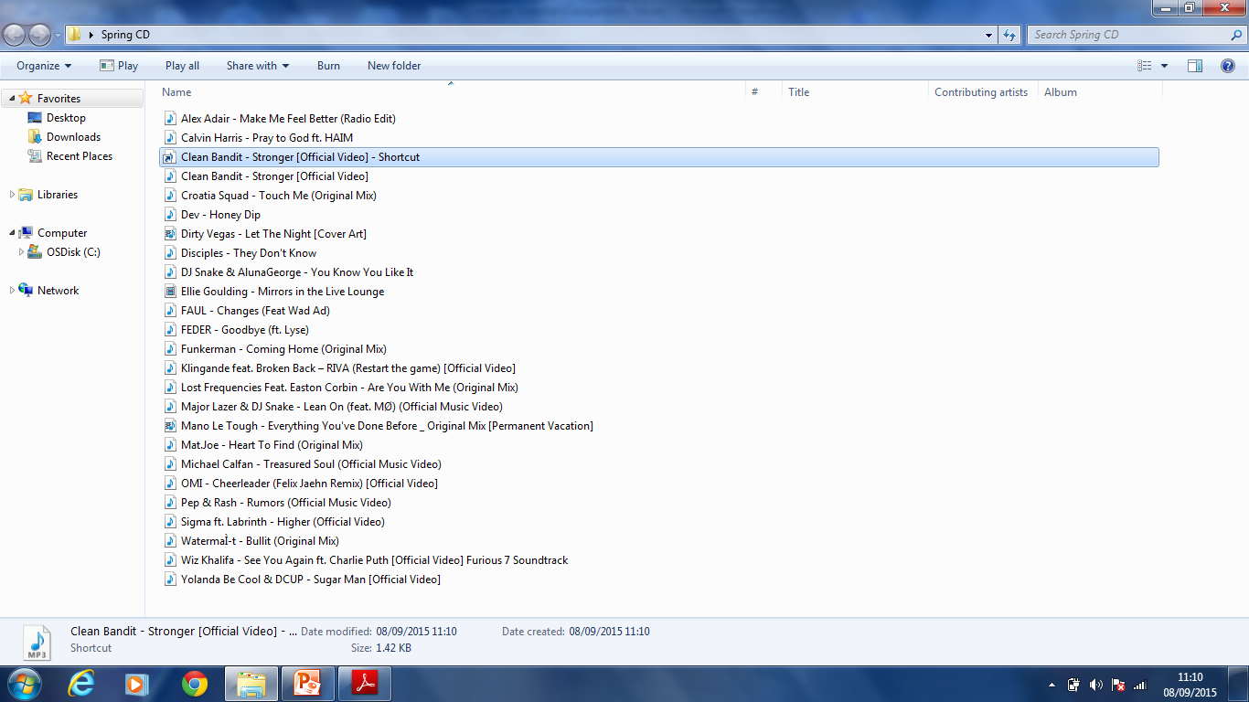
Create shortcut to another location
2
1
Right click
Create shortcut
Cut
Paste on other location

Slide 23
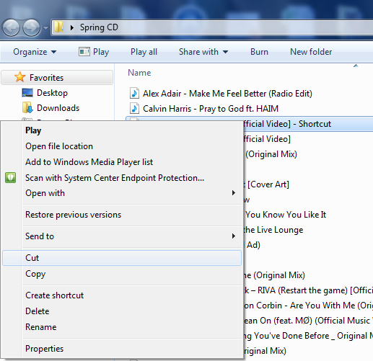
3

Slide 24
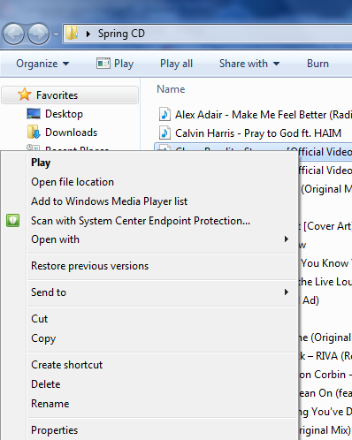
To Rename/Delete Folder or file
Notes:
Two possible answers

Slide 25
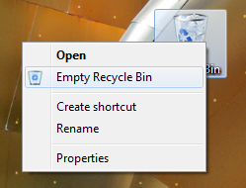
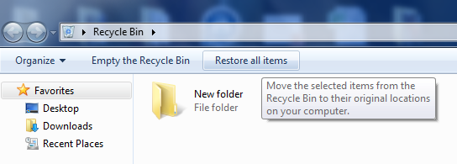
Using the recycle bin
To delete all items from the recycle bin
Double click on it and choose restore all to restore items

Slide 26
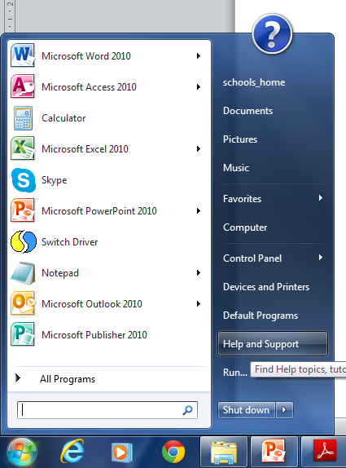
Help and Support
Help and Support is used to find information such as on computer devices, network etc.

Slide 27
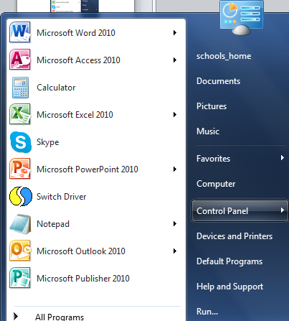
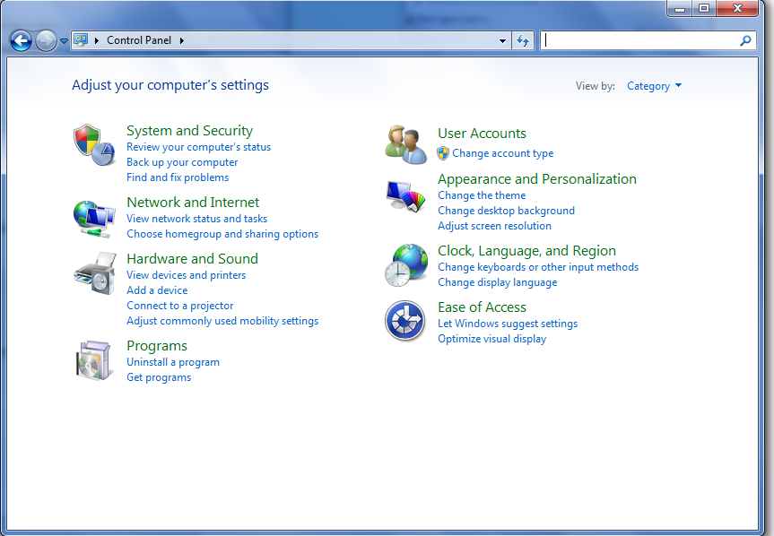
Control Panel
This is used to view basic system information

Slide 28
Control Panel
To view RAM or any other System Information
2. To change desktop background (personalize)
3. To change date and time
4. To change default language
5. To uninstall a program
6. To modify volume

Slide 29
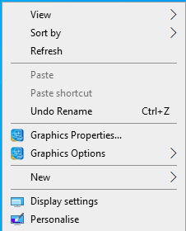
Screen Resolution
Screen resolution refers to the clarity of the text and images displayed on your screen.
To change the screen resolution of our computer
  Right click on the desktop.
  Select Display Settings.
  Adjust resolution.

Slide 30
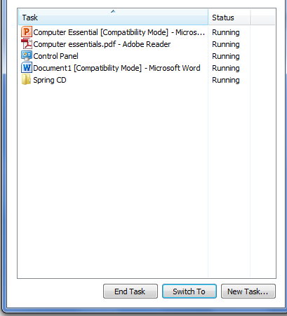
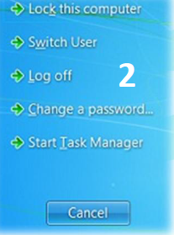
Shut down an unresponsive application
1. CTRL+ALT+DELETE
3

Slide 31
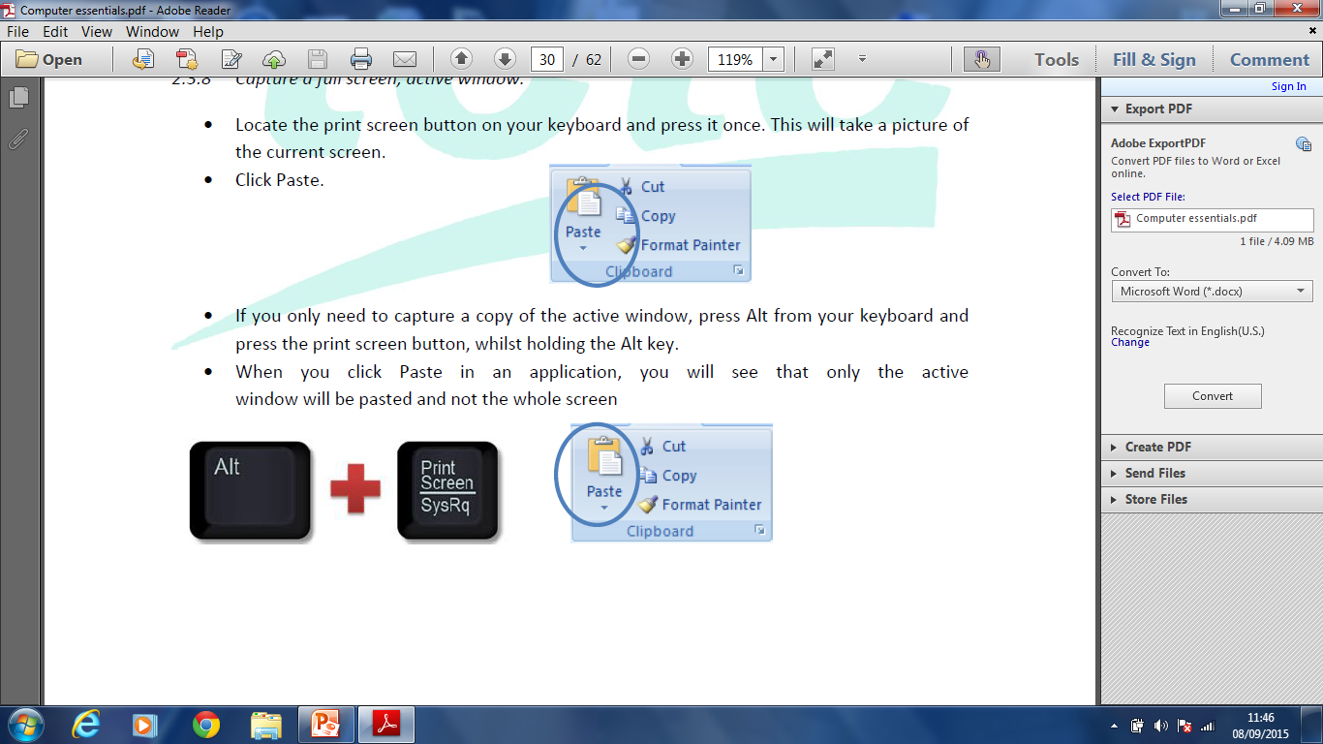
Print Screen
PrntScr is used to capture an image of the current window. Paste is used than to illustrate the image.
If you only need to capture an image of the active window press ALT+PrntScrn

Slide 32
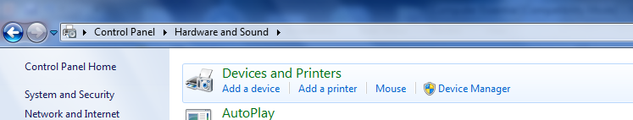
Printing
Printing options are accessed from the control panel i.e. Hardware and Sound

Slide 33
Print Tab
Add a device – adding a another storage device or laptop
Add a printer – to add another printer or fax
See what’s printing – to cancel a print job
Manage default printers – to change default printer
Print server properties – to view specifications
Remove device – to delete a device

Slide 34
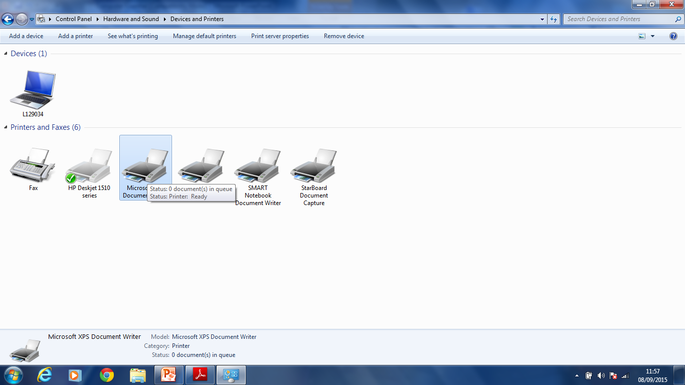
Preview of the Print tab

Slide 35
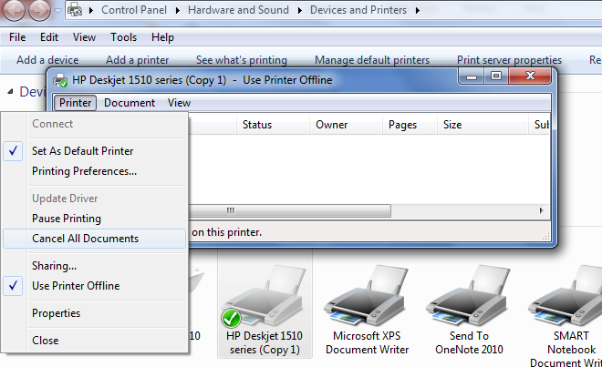
Pause, Stop/ Cancel a Print Job
See what’s Printing tab will enable you to stop or to pause a printing document

Slide 36
File Management
Drives
Windows uses a system of drive letters to point to different physical drives. For instance a Hard drive is usually marked as C while floppy disks are referred as A. Removable disks may be assigned with different letters depending on the number of disks.

Slide 37
Files
Files are organized into folders. (these are referred to as directories) – to divide and subdivide. This hierarchy is usually referred as directory tree. The very top folder is referred as the root folder.
From the properties option you can know the name, size and location

Slide 38
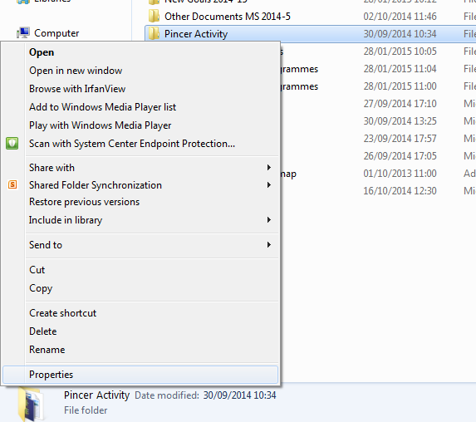
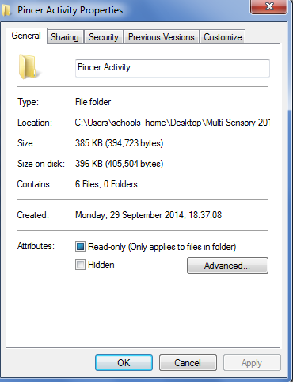
File/folder Properties

Slide 39
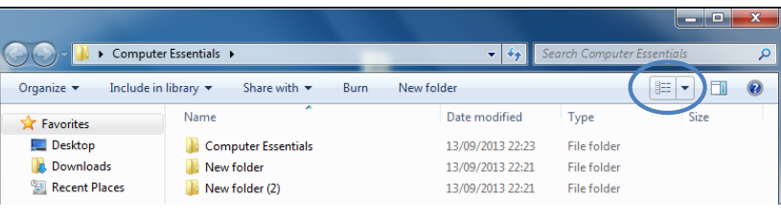
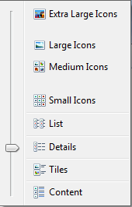
View Tab – Change View
If you need to sort by Name or Size just click on the heading

Slide 40
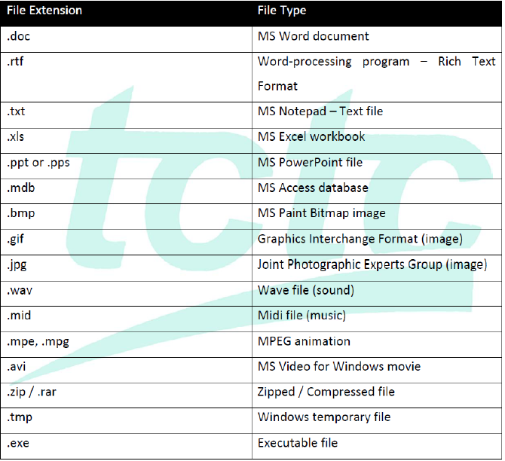
File Extension
Usually a file ends up with a 3 character.

Slide 41
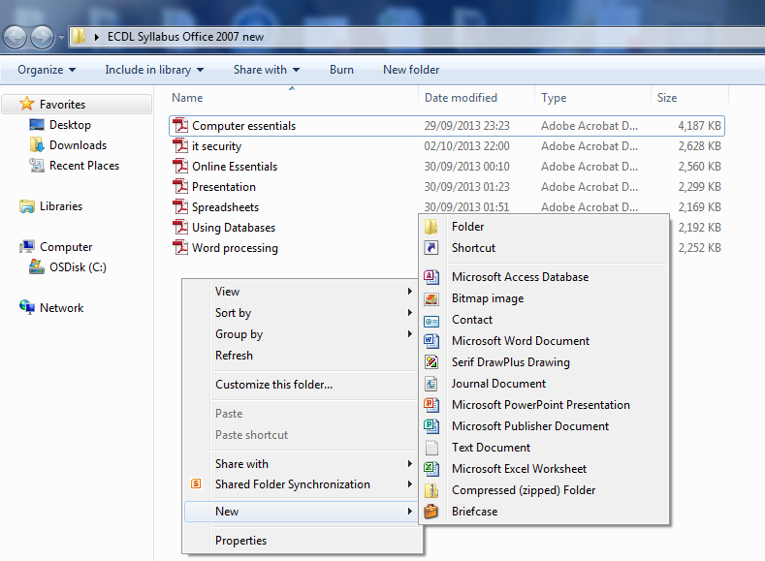
Create Folders
Notes:
Find the location and then right click

Slide 42
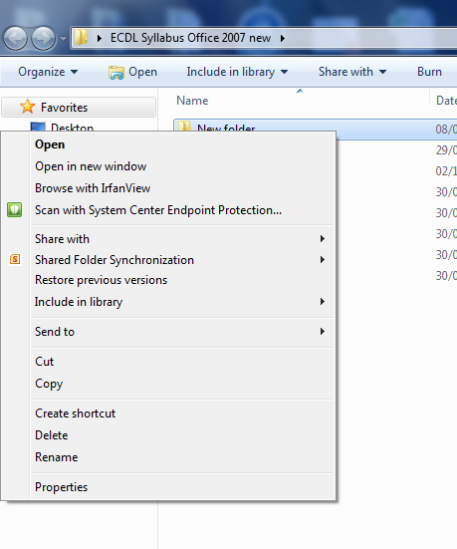
Rename/ Delete
Right click on the folder it self

Slide 43
Good Practice
Use meaningful names for files and folders to help search
Names should be logical and meaningful to all users.

Slide 44
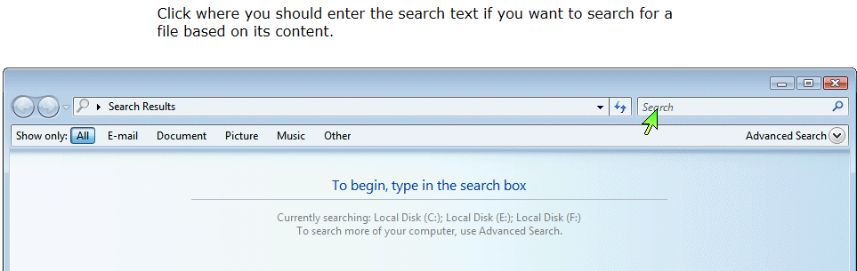
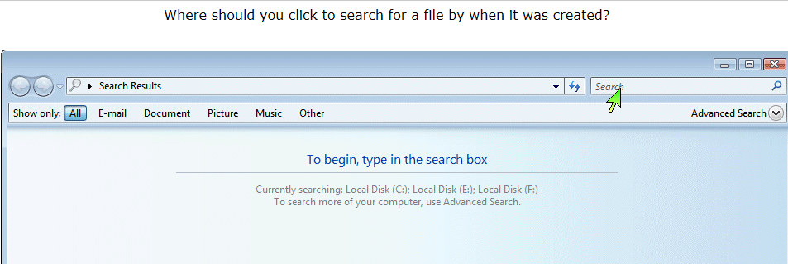
Search Tab

Slide 45
Search Files by properties
To search you can either use part of name of the file/ folder or wild cards.
Examples of wildcards:
z* : starting with z
z???: all files containing 4 characters but starting with z
za*: all files starting with za
za???.xls : all excel files starting with za with 5 characters
&.txt , &.xls : & is used to find all files with the requested extension
Date Modified – example →datemodified:11/2/2016

Slide 46
Organising Files and Folders
To select an individual file / folder – click on it and it will highlight in blue
To select a number of files and folder under each other – click on the first folder and use the shift button
To select a number of non adjacent files/folder – click on the first folder and than hold the CTRL while clicking on other files/folders

Slide 47

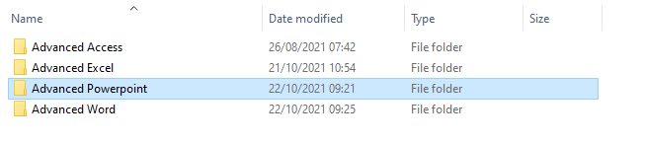
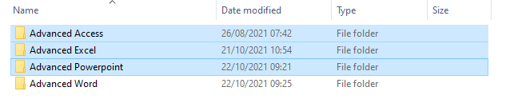
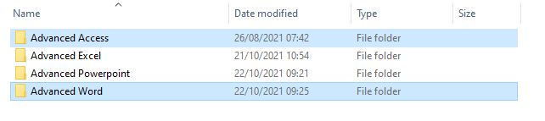
1
2
3

Slide 48
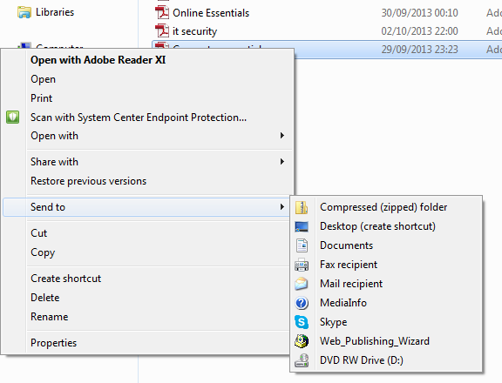
File/Folder Compression
Files/folders are compressed for a smaller size. This allows you to save disk space.

Slide 49
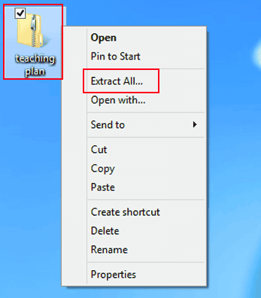
Extract
Files/ Folders that are compressed can be extracted to desired location.

Slide 50
Network Concepts
Network is when you have two or more computers connected to each other.
This will enable sharing of files and information between multiple system
Computers are connected through cables such as phone lines or wireless

Slide 51
The Internet
Internet: a global network of interconnected networks. The internet relates all the software and hardware related to it.

Slide 52
Internet Services
Wi-Fi – wireless access to the internet to the people
Cable – these supply TV access and also internet access (fast connection)
VPN: Virtual private network. This is used by companies to provide remote offices to its users. (Username + password)

Slide 53
Transfer Rate
Transfer rate is commonly used to measure how fast data is transferred from one location to another.
Common units: Bps, kps, mps, gps
Downloading – transfer data from the internet/ network to your computer
Uploading – transfer data from your computer to another computer /internet

Slide 54
ISP
This term stands for Internet Service Provider. The ISP gives you connection to the internet either via telephone line or cable connection.

Slide 55
Malware
Malicious software. This is designed to damage your computer without consent. There are different types: viruses, spyware, worms, Trojans, rootkits and so forth.
Viruses present them selves as harmless to deceive the user.
Virus needs to infect the host file to infect the computer
Anti virus programs can be installed to your computer to protect against these viruses.
Anti viruses software should be updated regularly to protect against newly created viruses.

Slide 56
Types of malware
Worm: it infects additional computers via network
Trojans: these appear harmless. These are found in websites such as gaming or gambling or also via emails. These can be also hidden in free software
Spyware: this can capture information like e-mail, passwords and usernames, credit card information
Running an unknown downloaded file can be a common way to infect a computer

Slide 57
Anti-Virus
Anti-virus is a software that is used to scan the computer for malware.
It is important to keep anti-virus software up to date.
A windows based computer will have an already installed anti-virus software when the operating system is installed. Windows Defender.
Firewall: prevent unauthorised computer access. However firewall do have some limitations

Slide 58
Computer accessibility
Voice recognition software (Give commands to the computer using your voice)
Screen reader software (designed for the visually impaired)
Screen magnifier software (makes the screen easier to read)
High contrast (Changes scheme of colours)

