Slide 1
Module 5
Using Databases

Slide 2
Key Concepts
Database: Database is a collection of information. Database can be used for Telephone directory, Address book, government services, bank account, airline booking etc. These are used by large businesses.
Data - Data is raw and factual. This is the information entered in tables. Data gives room for interpretation.
Information - Information is processed data. Now data has a meaning.
Database is made up of multiple of tables.
A database contains fields and records stored in tables.
When creating database it is important to keep in mind that every table should contain only one data subject.

Slide 3
Tables
Tables are made up of fields and records.
Record implies to a data of a single individual or item. Record = Row.
Field defines what record to enter. Field = column

Slide 4
Creating Tables

Slide 5
Important
Every table should contain data related to a single subject type.
Therefore if you have a table about customers information, don’t enter information about other thing.

Slide 6
Field
Every field should have the smallest element of data i.e. one type of data
ID | Name | Surname | Address 1 | Address 2 | Locality | P.Code
1 | Juli | Grima | 3, Sunshine | Psaila Str | Zejtun | ZTN0145

Slide 7
Field Content
Every field content should have the appropriate data type. The data type is modified by viewing the datasheet in design view
If we change the data type after inserting the date, data can be lost.

Slide 8
Primary Key
Every Table should have a primary key. A primary key is a unique identifier. Usually it is the ID field i.e. AutoNumber/ Number data type
Notes:
Mention how to create a Primary Key. Mention how to remove the Primary Key as well. (Click on and than click on the icon on the ribbon)

Slide 9
Field Properties
Every Field has its properties. This can be viewed by clicking to design view
Important: Field size, Validation rule, Default Value, Index, Format

Slide 10
Index
Index are used to access the data faster.

Slide 11
Validation rule
A validation rule limits the amount of value to be entered. This is done to prevent errors.
Example: To enter years greater than 2007
Notes:
Pg 26

Slide 12
Validation Rule Symbols
> greater
< less
= equal
<> no equal
>= greater than or equal to
Notes:
>20/7/2015, >=2007

Slide 13
Default Value
A value that is automatically entered in this field for a new record
Notes:
Example New: New tigi mal-ewwel fil field. New isibha hemm fid datasheet view.

Slide 14
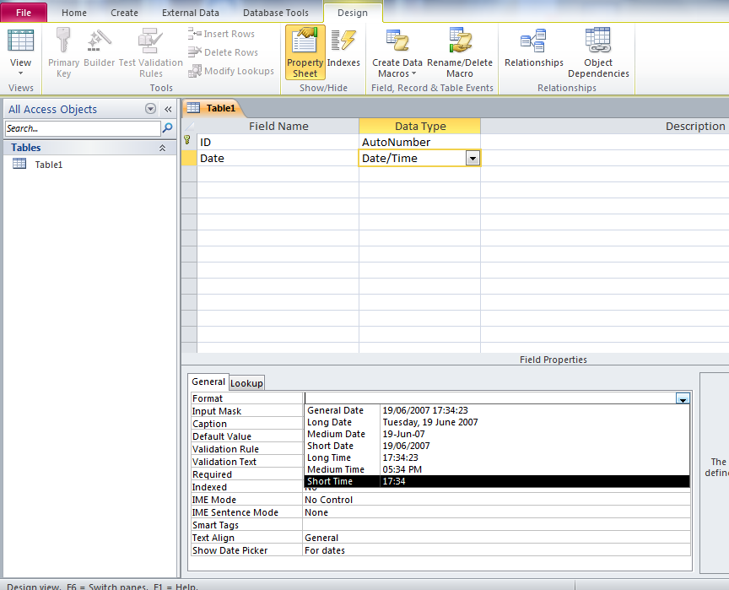
Format
Format depends on the Data Type

Slide 15
Using Tables – Filter Option
Click on no2 of the Class ID field.
Press on selection and than choose Equals 2.
2
3
1

Slide 16
To Remove Filter
To Remove Filter press on Toggle Filter

Slide 17
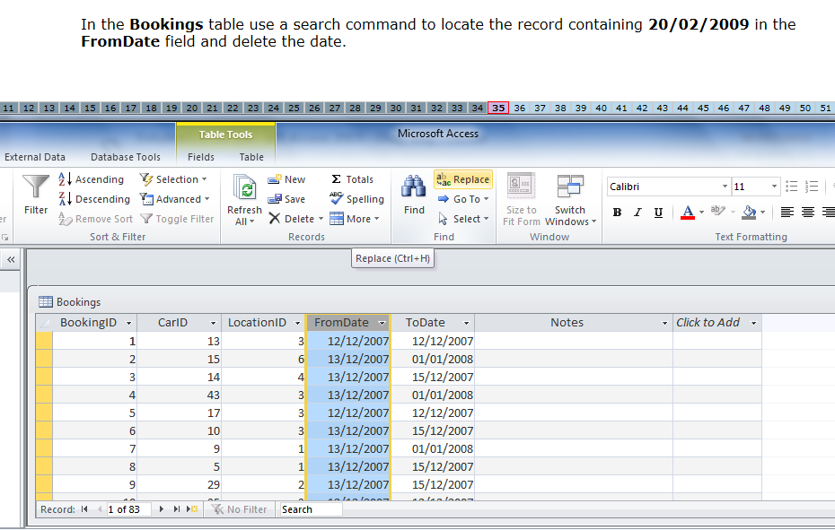
Find and Replace Command
2
1
Click on the field requested and than Replace

Slide 18
Replace Command
6
3
4
5
3. Insert the requested Finding
4. Replace with: Empty

Slide 19
Relationships
This is done when matching a unique field of a table with another unique field of another table.
Relationships prevent data from being lost, changed or deleted.

Slide 20
Query
A query is used to extract and analyse data.

Slide 21
Query Tips Criteria
Criteria | Examples
Matching a number (200) or name (Mary) | 200 / Mary
Greater than 100 | >100
Less than 50 | <50
Range of numbers | Between 10 and 20
All values except Naxxar | <>Naxxar

Slide 22
More Criteria tips
Using wildcards: a special character than can stand for a single character or a string of text.
Characters | Examples
Yor* | Yorkshire, New York
Mar? | Mark
To start with a particular letter | Like “B*” : Borg, Bugeja
To end with | Like “*B”
Notes:
* - string of text, ? – single character

Slide 23
More about Query
In the exam, might ask you to create a query with no criteria.

Slide 24
Creating Query
1

Slide 25
Choosing Tables as requested
2. Click on the tables requested and click on Add

Slide 26
Query
3. Click on the requested fields
4. Write down the criteria in the requested field

Slide 27
Saving the Query
1.
2.

Slide 28
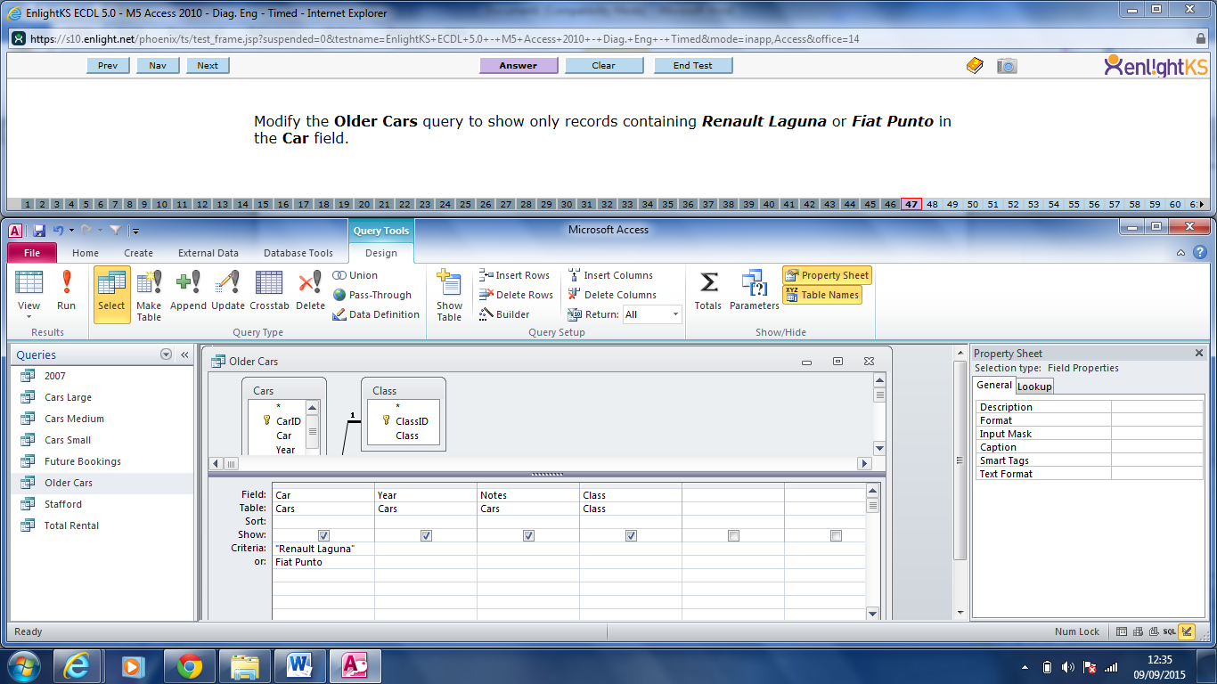
Query: Using OR

Slide 29
Query: Using Wildcards

Slide 30
Hiding Fields while using Queries
Tick the box with the row named Show if you want to hide.
To show again… just tick in the box to mark it very good

Slide 31
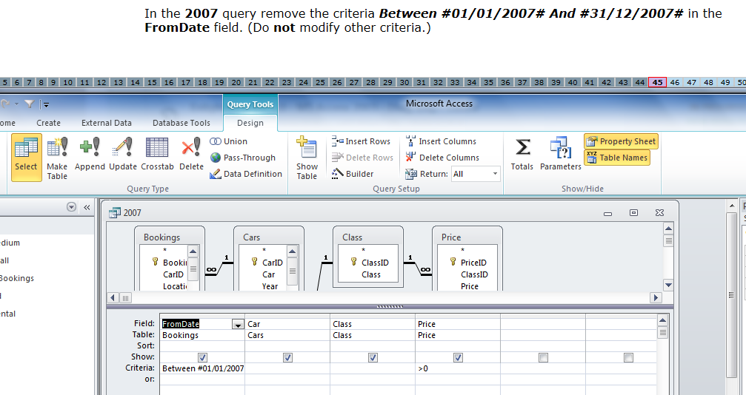
To remove a criteria
Put the curser in the requested field and delete the criteria using the backspace button from your keyboard

Slide 32
Change Page Orientation of a Query
1
3
2

Slide 33
Query: Landscape or Portrait

Slide 34
Run a Query

Slide 35
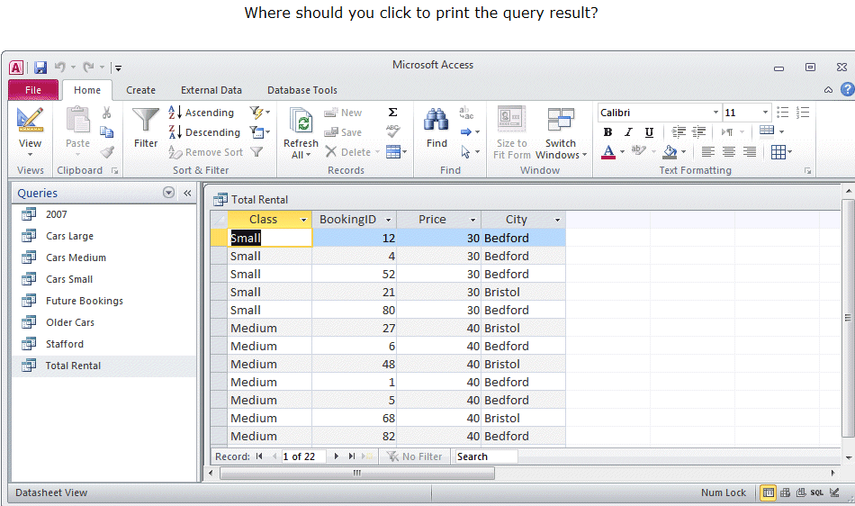
Printing a Query

Slide 36
Form
Forms are used to display and to maintain records

Slide 37
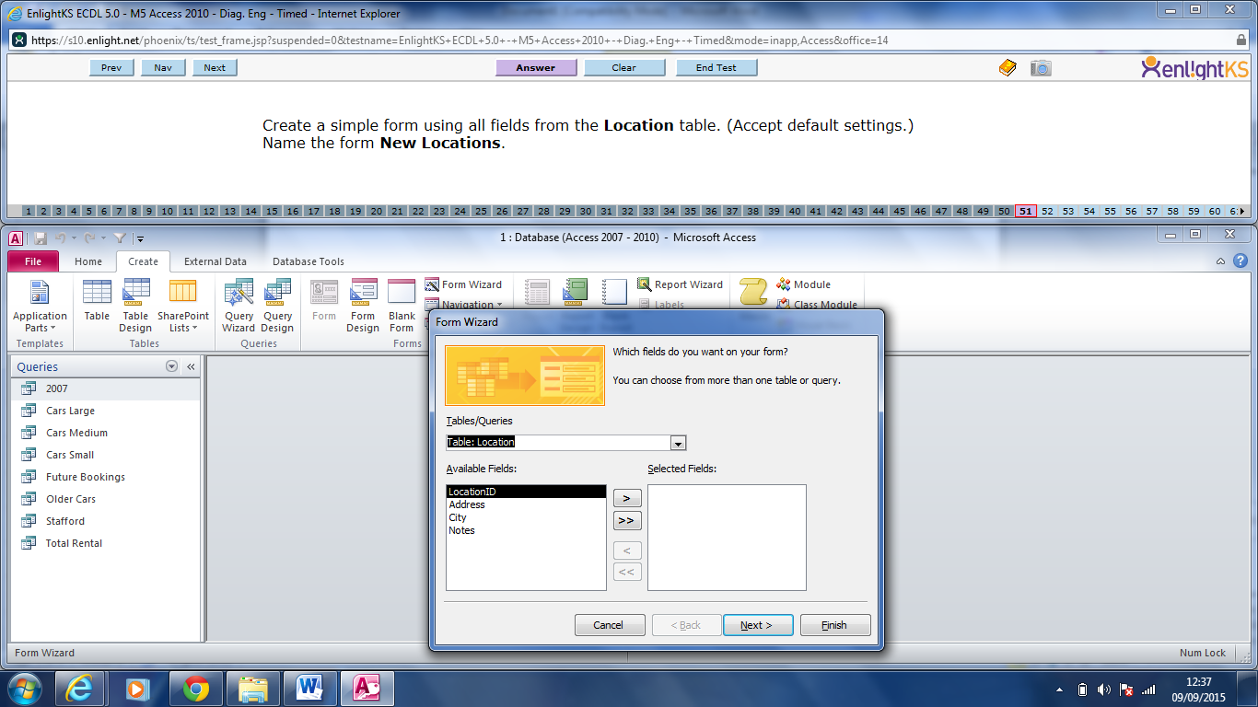
Creating Forms
1
2
3

Slide 38
Choosing all Fields
This is used to choose all fields

Slide 39
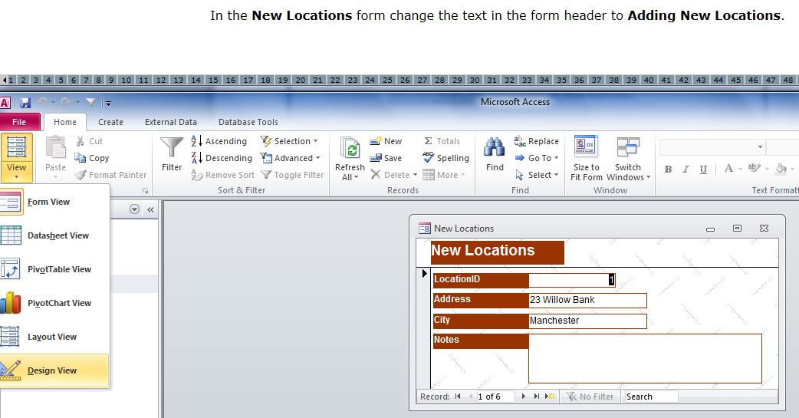
Modifying Forms
Put the curser in the requested field and start writing
Before modifying it is important to stay on the Design View

Slide 40
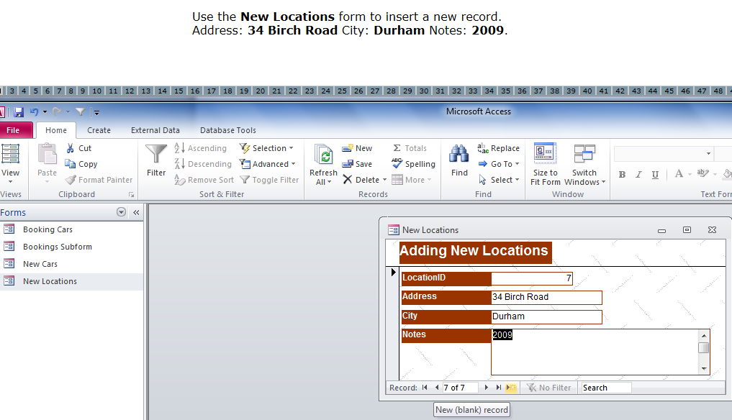
Adding a New record using Forms

Slide 41
Delete record while using Form
Click the arrow until you reach the requested record and press the delete button from the ribbon

Slide 42
Modifying Forms
It is important to stay on the design view while modifying

Slide 43
Report
Reports are used to compile information for printing.

Slide 44
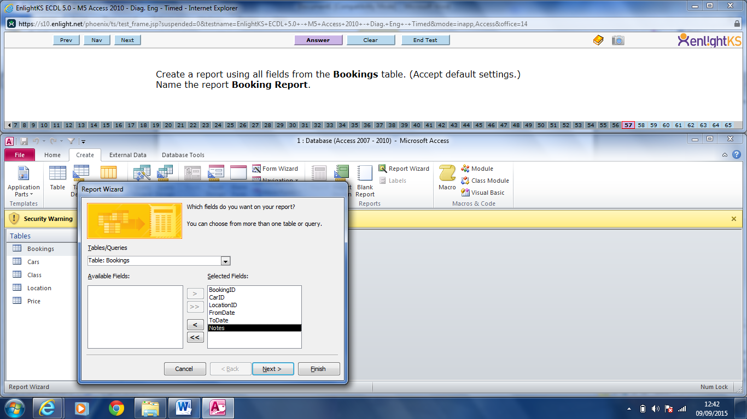
Creating a Report
1
2
3
4
All fields

Slide 45
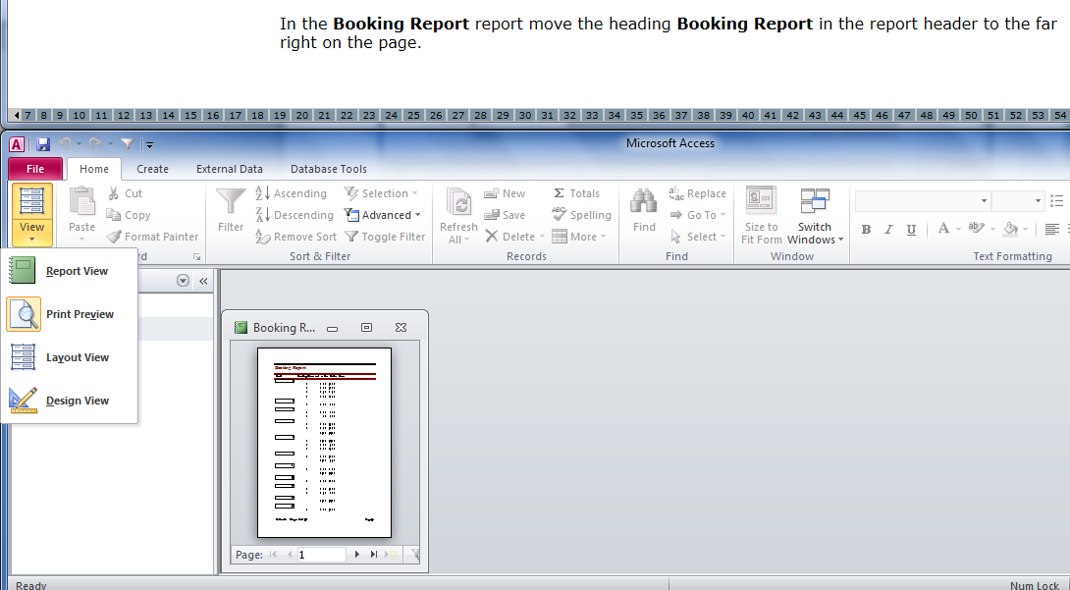
Modifying a Report Layout
Always go to design view before modifying
Answer

Slide 46
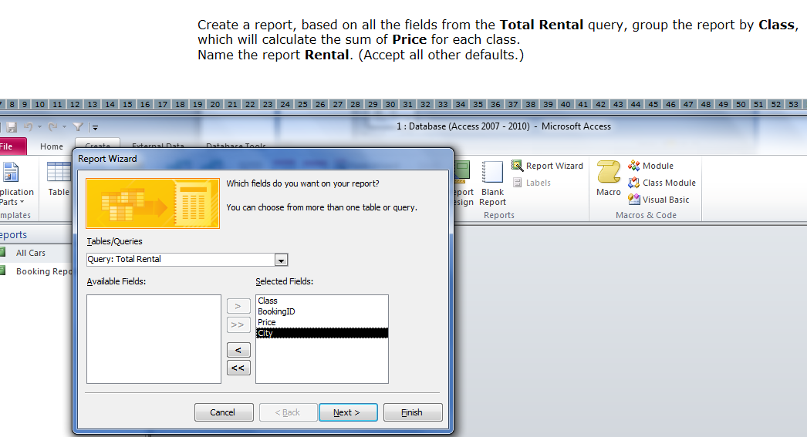
Creating a Report using the Grouping Option
1.
2
3. Choose the requested Table/Query
4. All Fields
5. Press Next

Slide 47
Grouping Option
6. Class was chosen as a grouping as requested in the question
6
7
7. This arrow was used to add Class as grouping as illustrated

Slide 48
More about grouping
10
9
8
9. Tick Sum since it was requested to calculate the sum of price of all classes

Slide 49
Saving Report
After accepting default setting by pressing Next, now it’s time to save and name the report as requested.

Slide 50
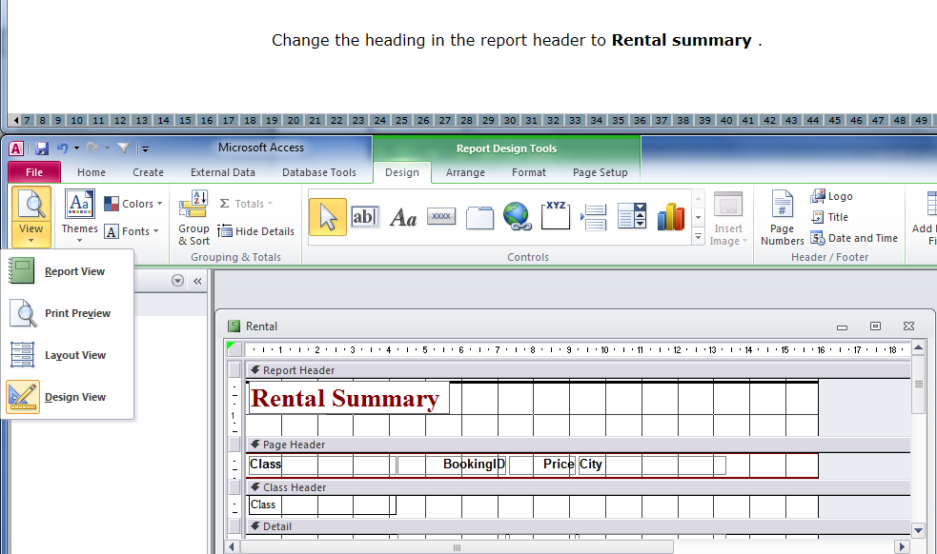
Modifying Reports
Always go to Design View to Modify Reports
Place the curser where requested and modify as requested

Slide 51
Printing

Slide 52
More Printing Options

Slide 53
To Export Data
Data is exported in order to be used within another application. It can be either .txt, .pdf etc.

Slide 54
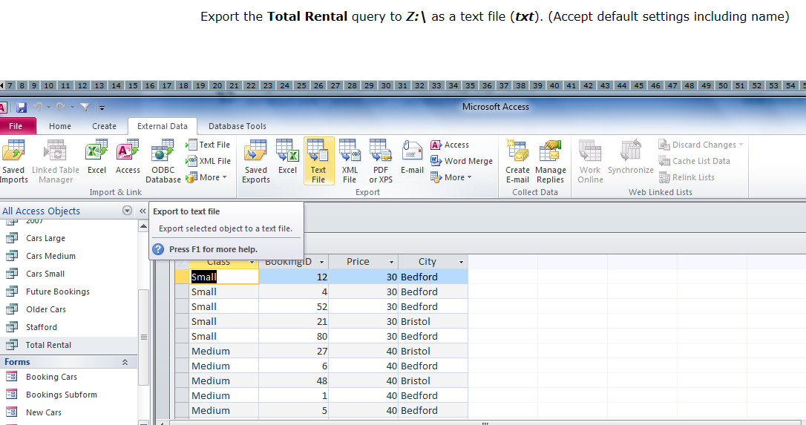
How to Export Data
2
1. Click on the query/form/ table requested

Slide 55
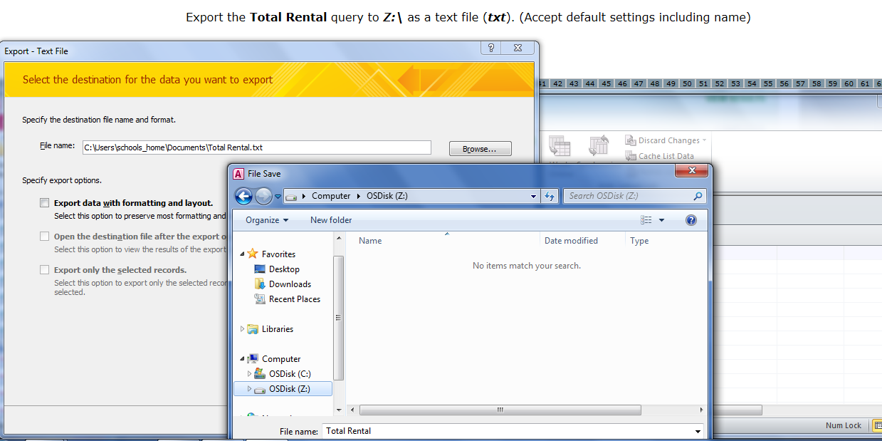
More steps to Export Data
Important: Browse in order to save in the requested location

