Slide 1
Online Essentials
Module 7

Slide 2
What is the Internet?
The Internet is a world-wide-web system, of interconnected computer networks, linking billions of devices.
Ways to connect to the Internet
A common way of connecting to the Internet is through a telephone line, which can carry normal phone calls and Internet data at the same time.
Alternatively, you can connect to the Internet by using a service from a mobile network providers. Known as the ISP (Internet Service Provider) for example, melita, go, epic.
Download and Upload Speeds
Bandwidth (download and upload rates of speed) is measured in bits per seconds (bps). This is the number of single bits that can be transferred across a network connection in one second. The higher the bandwith the faster the transfer rate.

Slide 3
Hyperlink
A hyperlink is a piece of text or a picture on a web page that when clicked will automatically do one of the following:
1. Take you to a different part on the same page.
2. Take you to a different page within the web site.
3. Take you to a page in a different web site.
4. Enable you to download a file.
5. Launch an application, video or sound.
If a piece of text or a picture is a hyperlink, when you point to it with your mouse, the mouse pointer will change into the shape of a hand.
Hyperlink text is usually blue and underlined.
Uniform Resource Locator (URL)
URL stands for Uniform Resource Locator (another name for web address / website address).
Example: https://www.ecdl.org

Slide 4
Website Address
The following table shows you what the different parts of the URL (Uniform Resource Locator) mean. In other words the website address.
https://www.icdl.org
Domain name e.g
.com
.org
.uk
.mt
Hypertext
transfer
protocol
(s) Secure
World
Wide
Web
Site name
e.g facebook
ebay

Slide 5
Some common Domain Names :-
.com (commercial site)
.edu (educational / institution)
.gov (government site)
.net (network site)
.org (non-profit or private organisation)
.mt (geographical site with a two letter identifier
listing where the site is registered e.g. mt – Malta
uk – United Kingdom, de – Germany etc.)

Slide 6
Website Browser
A web browser is a software program that allows you to browse the Web by simple point and click navigation.
Examples of web browsers include:-
Internet Explorer
Mozilla Firefox
Google Chrome
In order to browse to a specific website you need to enter its URL (Uniform Resource locator) in the address bar. Then hit the Return key on your keyboard.

Slide 7
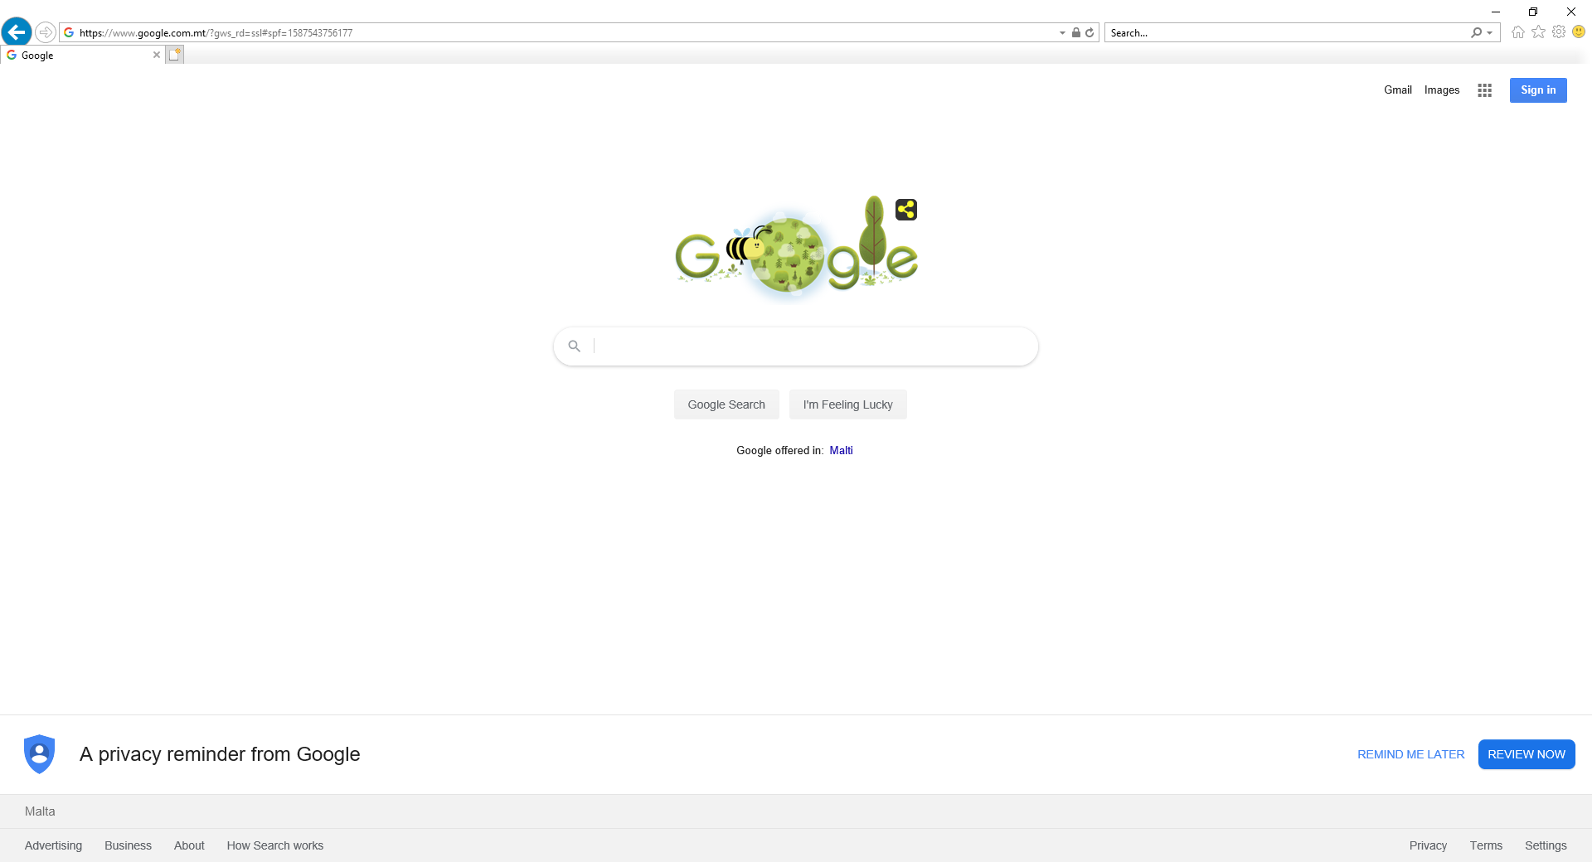
Address Bar: Where we input the URL to go to a specific website.

Slide 8
Internet Activities
There are a huge range of activities that you can carry out on the Web by using a browser. These include:
Information Searching
People browse the Web for information, specific topics that are of interest to them.
Entertainment
You can stream videos, play games with people on the other side of the world,
or listen to music.
Communication
People connect via each other through various IM services like Skype, messenger etc.
often for free!
Shopping – E-Commerce
Buying on Line using Shopping carts and paying on-line.
Learning
E-learning refers to learning on a computer or device, often over the Internet.
One trainer can train many students at different locations.

Slide 9
Publishing
The Web provides a range of often low-cost opportunities to publish different types of
content. For example, you can publish information on web pages or even a book that can
be made available through online book stores.
Banking
More and more financial institutions give their customers access to a range of services online,
such a paying a bill or transferring funds between accounts. This gives people much more
flexibility because they are not restricted by the opening hours of a bank branch.
Government services
E-government (short for electronic government) refers to the use of technology to
provide and improve government services, transactions and interactions with citizens
and businesses, and within the government.

Slide 10
The Internet Window
Help Function
As with most applications, Internet Explorer has a built-in support feature.
To use Help, simply click on the Help menu in the main view. Then choose Internet Explorer Help.
Minimise the Ribbon
To quickly minimise the Ribbon, double-click the name of the active tab. Double-click a tab again to restore the Ribbon, or
select the View and then Toolbar and untick the Menu bar.
Restore the Ribbon
Right Click on the space next to the address bar, and tick
Menu bar.

Slide 11
Navigation Buttons
Internet Explorer uses four buttons for navigation:
Back– Refresh - Home button
Homepage – (A page which appears every time you open your web browser) You can change the homepage by going into Tools – Internet Options – General – you can select (use current – use default – use new tab)
New Tabs – click on the next tab e.g. the plus sign (you can flick from one tab to another)
To close tab – click on the x

Slide 12
Bookmarks
To re-visit a site you can bookmark it, this means you can save it, and open it from here next time.
How to Bookmark Pages
Go to the selected website first
Click on the Star on the right hand side of the browser
Select Add to Favourites
Give a name to your bookmark and then Click Add
Delete and viewing your bookmarks
Click on the star icon
Select Favourites
Select Bookmark you wish to delete, right click
Choose delete from the menu

Slide 13
Creating a Bookmark folders
You can create folder so that you can group related bookmarks, or bookmarks with a common theme.
Select the Star Icon (Favourites)
click anywhere in the favourites
Right Click
Select - Create New Folder
Press Enter
Browsing History
You can review the list of website that you have visited, and you can also delete this information.
Select the Star Icon
Click on History (the information is displayed in date order)
To Delete browsing history:
Select Tools from menu bar
Select delete browsing history from the menu

Slide 14
Search Engines
A search engine is a tool used to search for information on the World Wide Web.
Examples of Search engines are:
www.google.com
www.bing.com
When searching you may not always get all the results on the internet, search engine like Google will only search through a list of maintained sites, that have been registered with that particular search engine. So you will get differing results on
different search engines.

Slide 15
Downloading
On the Hyperlink – Right Click - Save Target As – enter the desired
location / drive
(The “Save as” wording may vary depending on the internet version
you are using)
Copying Text, Image or URL
Text Highlight the text
Right Click (keep the cursor on the highlighted text) - Select Copy
Go to where you want to copy it to – Right Click Paste
Image Right Click on the Image - Select Copy
Go to where you want to copy it to – Right Click Paste
URL Highlight the URL from the address bar – Right Click - Select Copy
Go to where you want to copy it to – Right Click Paste

Slide 16
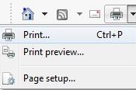
Preview and Print
On the print icon, press the icon and select print or print preview
Or select the File tab, print or print preview
A printer dailog box will appear, make any necessary changes before printing.
In the Page Range section you can choose to:
Print all the pages in a specific webpage.
Print a Selection from the webpage (you need to highlight the text first.)
Print a range of pages.
You can also set the number of copies for a specific print page.
When you have made all the necessary changes click the Print button.

Slide 17
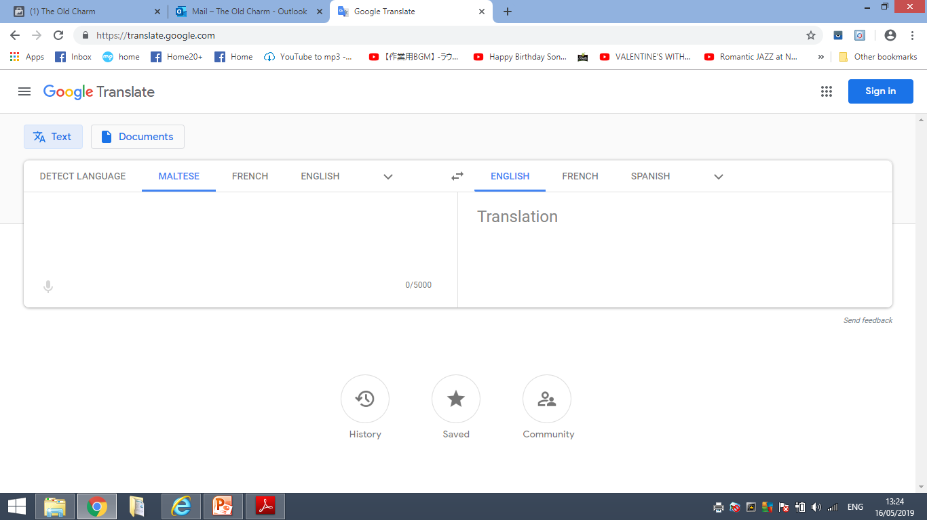
Google Translate
Various online tools can be used to translate for free a web page or text to another language. Google Translate is one such service.
Website: https://translate.google.com

Slide 18
Choosing a Credible Website
There are a few factors that can be considered when judging the credibility of a website and its material.
Author
It is important to recognise the author of what you are viewing when
online.
Referencing
If an author or website is quoting individuals, statistics or other factual
pieces, there should be clear references to the work they are getting
their information from.
Up-To-Date Content
A website’s dates etc. are important to note when taking into
account information that may be statistical or time-sensitive.

Slide 19
POP UPS
What is a Pop Up?
Pop ups are windows that appear automatically. These pop ups are
generally unnecessary, and some can be related to gaming or have
explicit content.
What is a pop-up blocker?
Pop-up Blocker is a feature that lets you limit or block most pop-ups. You set the level of blocking you prefer, from blocking all pop-up windows to allowing certain pop-ups. When Pop-up Blocker is turned on and it blocks a Pop-up, the browser displays a message saying "Pop-up blocked. To see this pop-up or additional options click here."
Click Tools, point to Pop-up Blocker, and click Turn on Pop-up Blocker.

Slide 20
Cookies
Cookies are small pieces of data that are sent by websites to your browser when you are browsing. They have different functions, including recording of browsing activity. Their use raises privacy concerns, but they can also make navigating the Web easier.

Slide 21
Security and Safety
There are a range of measures that you can take to protect yourself when you are online.
Avoid unnecessary disclosure of personal and financial information
Log off from websites
Purchase from Secure Reputable Websites

Slide 22
Checking the security of a website
Lock Icon and Https
Lock indicates that the website has valid digital certification.
(S) in Https = secure website
Secure Websites
When you use a website that handles private or financial information, you should check that it is secure.

Slide 23
Encryption/Decryption
Encryption is the conversion of data into a form that cannot be easily read and understood by people.
Encryption is used to protect data as it’s passed over a network. It is often used to prevent illegal access to or reproduction of information.
A common use of encryption is when data is sent through a secure web connection.

Slide 24
E-Mail
An E-mail address contains information about the e-mail box to which e-mail messages are delivered. username@domain.extension joeb@gmail.com

Slide 25
E-mail Attachments
An e-mail attachment is a computer file, such as a document, image, or audio clip, that is sent together with an e-mail message.
It is important to note that some attachments can be size restricted to 25MB
Or type restricted. E-mail providers will not attach executable files, files
Ending with .exe, these files are used to perform various tasks and cannot be read.
E-mail Scams
Unsolicited commercial e-mail, or “spam,” can be the starting point for many e-mail scams. Before the advent of e-mail, a scammer had to contact each potential victim individually by post, fax, telephone, or through direct personal contact.
Phishing – E-mails appearing to be sent from a legitimate source – aim is to obtain personal information

Slide 26
To Create a new email message
Select New Email from the ribbon.
Fill in the TO, CC, BCC and Subject fields.
Write the email message.
Click send.
To: The e-mail address(es), and alternatively name(s) of the message's recipient(s).
Cc: Carbon copy; for optional recipients who are not the primary intended recipient.
Bcc: Blind carbon copy; addresses added to the list but not recorded in the message information, so that they cannot be read by other recipients.
Subject: A brief synopsis of the topic of the message. Abbreviations are usually utilised as a part of the subject, including "RE:" for reply and "FW:" for forward.

Slide 27
Opening an E-mail
New e-mails are usually found in the Inbox, you can click on inbox, then click on the message you want to open
Replying to E-mail
You can choose to reply to the sender of the message or to the sender and all other message recipients.
When you reply to a sender, the sender’s e-mail address is automatically entered in the To field.
Replies sent to you display the text RE: and the original message subject in the Subject column in your Inbox folder.

Slide 28
Forwarding on an e-mail
Forwarded messages include all the header information in the original message plus the message body. You can also add your own comments, which appear at the top of the message. You can forward messages to other recipients directly from the Reading Pane or the Message window.
Changing the Read Status
In your Inbox, unread messages have bold subjects and are highlighted with a blue vertical line. After you click on a message, and then click on something else, the message is no longer bold, indicating that it has been read.
However, you may want to change the status of read message back to unread, if for example you haven’t had time to properly deal with the message, and need to return to it.

Slide 29
Attaching a file to a message
When typing the message. Select the paperclip icon or Attach file.
Navigate to the required file and Insert.
Opening and saving an attachement
Select the message from the inbox which obtains the attachment,
you will see there is an attachment as it will be indicated by a
paperclip.
Right Click the paperclip icon – Right Click and you will have the
Options to Preview or Download or Save As.
Preview – You can see the attachment before saving or printing
Download or Save As – You can Save to a Drive on the computer

Slide 30
Flagging a Message
You can insert a follow-up flag next to a message as a reminder or to call attention to the item. You can also send a message with a flag as a reminder for the message recipient.
When a message is flagged, a colour is applied to the flag and the flag background in the Flag Status column in the message list, making it easier to spot flagged messages.
Printing a Message
Open the Message from the INBOX – Click the Print Icon or the File
From the tab. Select Print. Select number of copies and select Print.

Slide 31
Signature
An email signature is a block of text appended to the end of an email message which often contains the sender's name and contact information.
Notes:
31

Slide 32
Out of office
You can use the Out of Office to create Automatic Replies.
Automatic Replies are messages that are automatically sent to anyone who sends you a mail while you are out of the office.
In the Settings Section – Select Automatic Replies and set the dates,
times and a message if required for the automatic out of office reply.

Slide 33
Creating a contact – New Items, Contact, fill in details,
Help function – tell me what you want to do.
Using search – Search Bar at the top of the pane.
Creating a new folder – Select Folder Tab or go to the end of the folders – select New Folder
Moving a message to a different folder – Click on the message to be moved and click Move.
Deleting a message – Select the message and Delete
Emptying the deleted items folder – Go to the Folder and right Click – Empty Folder
Recovering deleted items – Select the Delete Folder – and select Recover Deleted Items
Junk Mail – Right Click on the message which is not junk and select Not Junk
or Mark as not spam – then select the folder you want to put it into.

Slide 34
Arranging and grouping messages
Message headers can be displayed in a different order by selecting one of the pre-set arrangements. Each arrangement groups and sorts the messages based on a message property (field).
The default arrangement of messages is by Date. However, messages can also be arranged by other properties.
Go to View or Filter Down arrow
Other Sorting and Filtering Options
Unread, To me, Attachments, From, Size, Importance, Subject

Slide 35
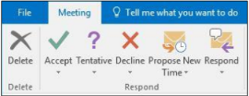
Calendar
You can enter and track appointments, meetings, and tasks using Calendar in conjunction with other components of Outlook to help manage all of your information. Calendar items are saved in the Calendar folder, which you can access through the Calendar pane. You can open the Calendar pane from the Navigation bar.
Calendar options
Scheduling a new appointment
Colour Categories – e.g. Different colours for different projects
Accepting and Declining meeting requests
Changing a meeting
Cancelling a meeting

Slide 36
The End

