Slide 1

Online Collaboration
Google and Related Tools

Slide 2
Contents
Collaboration Concepts
Preparation for online Collaboration
Using Online Collaborative Tools
Mobile Collaboration

Slide 3
Collaboration Concepts
ICT and promotes online collaboration since it is referred to as Technology that allows sharing of communications and information globally.
The main types of services and tools supporting online collaboration are:
Services | Tools
Cloud Computing | Productivity Applications
 | Social Media
Mobile Technology | Online Calendars
Mobile Technology | Online Meetings
 | Online Learning Environments

Slide 4
Characteristics of Online Collaborative Tools
Multiple Users can access, work and contribute on the same document or project.
Real time – Responses, edits and updates are shown immediately.
Global Reach – Can be used from any location with the right set-up and internet connection.
Concurrent access – multiple user access allows for faster editing an decision making.

Slide 5
Benefits and Risks of Online Collaborative Tools
Benefits
Risks
Shared files and calendars
Reduced travel expense
Ease of communication
Enhanced teamwork
Unauthorised access
Insufficient management of version control
Malware threats
Identity theft
Service loss or interruptions

Slide 6
Intellectual Property Rights
Intellectual property rights such as copyrights, trademarks, patents, designs and trade secrets are important because they give the creator exclusive right over the use of their creation for a specified period.
It is important for the owners of the shared materials to ensure that no private and confidential, copyrighted or patented materials are given public access.
As a user it is important to obtain permission before using copyrighted material such as articles.

Slide 7
Cloud Computing
Cloud computing is the use of computing resources that are delivered as a service over the Internet.
It is an online network where members can access, share and edit their data as if they are operating on a regular hardware network.
End users access cloud-based applications through a web browser since user's data are stored on servers at a remote location.

Slide 8
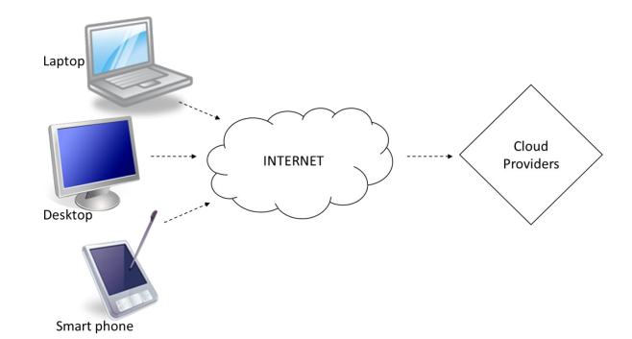
Cloud Computing
Cloud computing facilitates online and mobile collaboration in 2 main ways:
  Provides storage of shared documents and files.
  Offers a range of online applications and tools.

Slide 9
Benefits and Risks of Cloud Computing
Benefits
Risks
Reduced Cost
Enhanced Mobility
Scalability
Automatic Updates
Dependence on provider
Data protection and control
Potential loss of privacy
Potential loss of data

Slide 10
Preparation For Online
Collaboration
Setup of Equipment
  It is important that we know about the essential software and hardware needed in order to use an online collaborative tool.
Desktop / Laptop Computer
  A computer is essential to collaborate with others efficiently.
External equipment
  Webcam, Microphone and Speakers (sometimes combined into a headset) are the key to have a good quality of audio and video input/output.
Smartphone
  Online collaborative environments can be accessed by downloading smartphone apps which will allow you to work from different locations in different times.
  Work done using smartphone apps can be linked to the work done on a computer system
Plugins
  To use certain online collaborative tools one might have to install or update a few plugins.

Slide 11
Setup In A Collaborative Environment
Firewall – It blocks unauthorized access from outside the network to keep the internal users of a network safe. Since it is the bridge between the outside and inside of the organisations network.
The firewall only allows traffic from the external network if it is secure and trusted.
Firewall restrictions may cause accessibility issues for users of collaborative tools.
  It may cause a user denied access to online collaborative tools.

Slide 12

Google
One of the most popular online collaborative environments is Google.
Google is a technology company that provides Internet-related services and products, which include search engine and cloud computing.
Creating an account with Google allows you to use these Internet-related services and products.

Slide 13
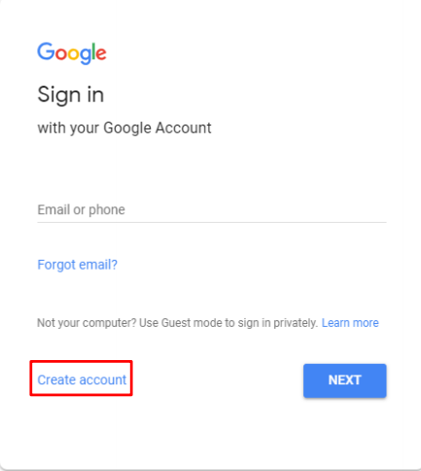
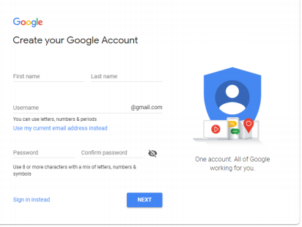
Setting Up an Google Account
To create a google account we must press the More options button or Create account button
Provide your name and create a Username and Password in the appropriate spaces provided in the pop-up window.

Slide 14
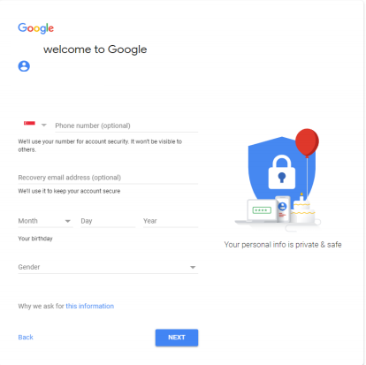
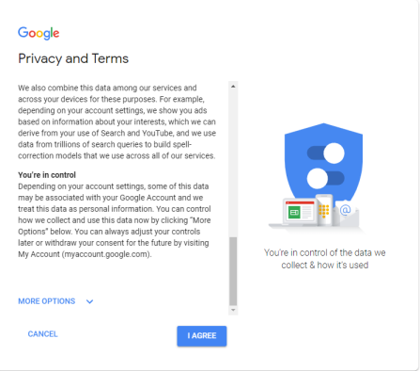
Setting Up an Google Account
Provide a valid phone number and a recovery email address to secure your
account.
Click on I AGREE to agree to the Privacy and Terms set by Google to activate
your account.

Slide 15
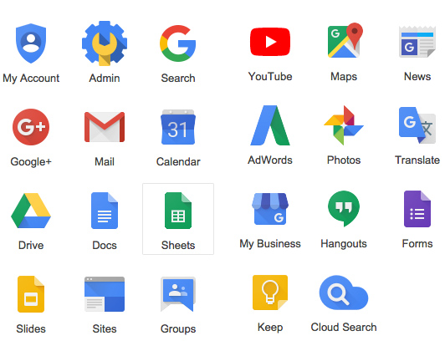
Setting Up an Google Account
Gmail is a web-based email service with its typical address as xxxxx@gmail.com.
Contacts serves as a central storage for the contacts details of personnel.
Drive service provides 15 GB of free storage.
Calendar is an online calendar that can be shared with other users to help keep track of time and schedule
Docs is a web-based word editor. It allows users to create and edit documents online while collaborating in real-time with other users.
Hangouts supports text, voice and video conversations up to 25 participants.
Keep is a note-taking service with a variety of tools for notes.

Slide 16
Communication Tools
Voice over Internet Protocol (VoIP)
  Voice over Internet Protocol (VoIP) is a service of voice communications and multimedia sessions over the Internet.
  By using some of the free VoIP software that is available to make Internet phone calls, you can bypass the phone company (and its charges) entirely.
Instant messaging (IM)
  Instant messaging (IM) is a type of online chat which offers real-time text transmission over the Internet.
  More advanced instant messaging can add file transfer or clickable hyperlinks.

Slide 17
Using Online Collaborative Tools
Online Storage
  Storing your work files online is the first step towards online collaboration. Online storage is a file hosting service that allows you to upload, store, and access your files online. It is also referred to as a cloud storage service.
  Users can upload files to the online storage site via the Internet from a computer, tablet, smart phone or other networked device. Other users can access these files, after a password or other authentication is provided.
  By making the soft copies of our work available for access online, we allow others to work collaboratively with us in the work.

Slide 18
Limitations of Online Storage
Size Limit – Pay for extra storage.
Time Limit – Will not let you download or upload data once trial is over therefore data is lost until you pay a subscription.
Sharing restrictions – Limits the number of people your files can be shared with
Connectivity – If the internet connection is not stable or not present the online storage platform will not function.

Slide 19

ONLINE COLLABORATIVE TOOLS
  Google Drive, One Drive and Dropbox are examples of file storage and sharing services, aimed at allowing users to upload and share all types of files across all the devices they use. These services allow users to share and collaborate on document files, such as word processor documents, and spreadsheets.

Slide 20

Google Drive
It is a software available for storing and sharing documents online.
Provides several functionalities to help us manage our files and their access.
Allows us to upload files from our devices and grant access to these files to others.

Slide 21
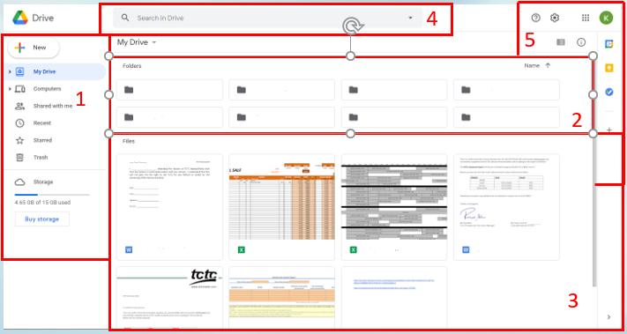
Google Drive
Once we have successfully logged in with our google account and entered the google drive this is the first screen shown.
Navigation Pane
Folders
Files
Search bar
Other tools / View modes

Slide 22
Web Based Productivity Applications
Multiple users can update files in real-time
  This allows everyone involved to work together from anywhere and at any time, thereby facilitating global web-based collaboration and virtual teamwork.
Allows sharing of files
  A group of people can share a document without the need to run their own server.
Google account enables access to several web-based productivity applications including Google Docs, Sheets, Slides and Forms.

Slide 23

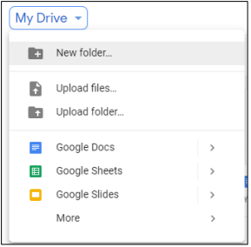
Creating A New File Or Folder In Google Drive
From the google drive we are going to click the New button.
Then we are going to choose whether we want to create a new folder, upload existing files/folders or even start blank documents, spreadsheets and more.

Slide 24

Uploading Files And Folders
If we choose to upload an already existing file or folder the drag and drop option is also available.
When the file / folder is successfully uploaded a notification will pop up in the bottom right corner.

Slide 25
Editing and Saving Files
To edit an existing file on a google drive account we just double click the file and the respective web based productivity app will open.
From there we just need to make the wanted changes.
When we are done editing we just close the file because files created or edited in the Google Drive are automatically saved, therefore we don’t need to manually save our work.

Slide 26
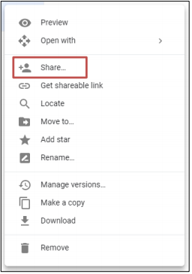
Sharing Files or Folders
Files and folders stored on Google Drive can be shared to allow other users to view, edit or own them.
To share a file/folder we just right click on the item and select share from the menu.

Slide 27
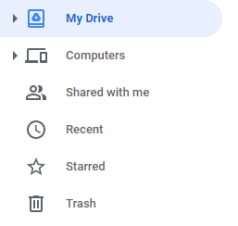
Sharing Files or Folders
Afterwards Enter the names or email addresses of the person whom you want to share the selected files or folder and change the user settings (EDITOR / VIEWER). Click Done.
Alternatively, you can generate a link by clicking on Get shareable link.
To view files and folders others have shared with us we click shared button from navigation pane.

Slide 28
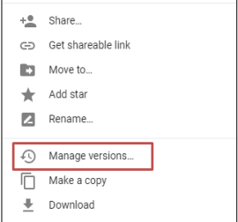
Managing Previous Versions
You may wish to recover older versions of your files should considerable work need to be done on one that may be incorrect or need to be checked against a previous version.
Right click on the file an select Manage Versions or See Revision.

Slide 29

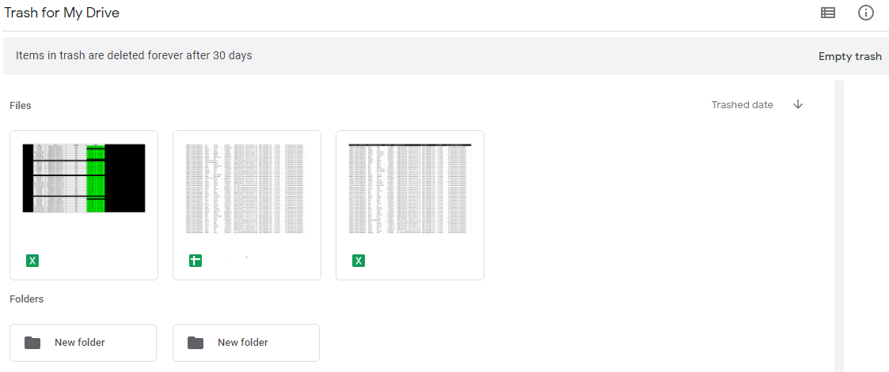
Deleting a File or Folder
To delete a file or folder we can simply right click on the object and select delete from the right click menu.
It is important to keep in mind that deleted items will go into the trash folder (accessible from navigation pane), which will automatically be emptied after 30 days.

Slide 30
Using an Online Calendar
An online calendar allows you to keep track of your events and activities.
You can let others see your calendar, and view schedules that others have shared with you.

Slide 31
Creating An Online Calendar Event
Go to the webpage https://calendar.google.com
Select a date on the Calendar on which you wish to mark an event.
Select a time slot on the selected date and add a title.

Slide 32
Sharing An Online Calendar Event
Click on your already created calendar event.
Select more options.
Add guests you want to share the event with.

Slide 33
Sharing Your Whole Calendar / Viewing A Friends Calendar
Click on the + next to other calendars
Subscribe to a calendar
Enter email address
Click request access

Slide 34
Social Media Tools
Social media tools provide various means of interactions among people, allowing them to create, share, and exchange information and ideas in virtual communities and networks.

Slide 35
Types of Social Media
Social network - A website that is used for social networking or for keeping up with others who share common interests, activities. Ex. Facebook
Professional Social network - A website that is used for professional networking, information sharing and job seeking. Ex. Linked In
Wiki - A website that is used to publish, modify, or delete contents via a web browser. Ex. Wikipedia
Blog / Micro Blog - A website on which an individual or group of users record opinions or information on a regular basis. Ex. Twitter
Content community - A website that allow users to share online multimedia materials. Ex. Youtube

Slide 36
Using Online Meeting Tools
Online collaboration often requires team members to work closely and you can achieve this by hosting a group video chat or conference call.
Google Hangouts is an online communication platform developed by Google which includes messaging, video chat, SMS and VOIP features. Google Hangouts can facilitate group chat or conference call with up to 25 participants for free.

Slide 37
Accessing Online Learning Environments
An online learning environment can be described as a virtual classroom that offers students and teachers opportunities to interact with instructional materials, interactions and events without the need to be physically present in a classroom.
The features of a typical online learning environment include:
  Calendar
  Discussion forum, chats or notice board
  Exercises, quizzes and assessment records

Slide 38
Examples of Online Learning Environments
Virtual Learning Environments (VLEs)
  A web-based e-learning educational environment that models conventional in-person education by providing equivalent virtual access to classes, class content, tests, homework, grades, assessments, and other external resources. Ex. Moodle
Learning Management Systems (LMS)
  A Learning Management System (LMS) is a software application for the administration, documentation, tracking, reporting and delivery of e-learning education courses or training programs. Ex. Coursera

Slide 39
Online Courses
An online course should offer as much support as possible in the form of resources that will help learners to achieve the objectives and complete assignments.
These resources may include:
  Presentations and tutorials
  Documents with handouts, study guide or worksheets
  Audio and video files
  Hyperlinks to articles on the World Wide Web

Slide 40
Mobile Collaboration
A mobile device is a small handheld digital device, such as a tablet or smartphone.
These devices can connect to the Internet and have high resolution touch screens which allow easy interaction with a wide range of programme applications, social media sites, and games that are available on the Internet.
Data can be stored on these devices and stored using online storage services.

Slide 41
Operating Systems
Mobile operating systems combine features of a personal computer operating system with other features useful for mobile or handheld use, and usually including a wireless inbuilt modem and SIM tray for telephony and data connection.
Examples of Mobile OS
  Apple’s iOS
  Google’s Android
  Microsoft’s Windows Phone

Slide 42
Bluetooth
Bluetooth is a wireless technology standard for exchanging data, such as text, audio, or video files over short distances between fixed and mobile devices.
Uses for Bluetooth include:
  Wireless transfer of files between two Bluetooth devices.
  Connecting wireless mouse or keyboard connection to a tablet, smartphone, computer.
  Hands free use of Bluetooth enabled digital devices in a car.
  Sharing the Wi-Fi connection of a smartphone with another device such as a tablet or computer.

Slide 43
Mobile Internet Access
Wireless Network (WLAN)
  Wireless Local Area Network links two or more devices using a wireless distribution method, and usually provides a connection through an access point to the wider Internet.
Mobile Network (3G, 4G)
  4G is the fourth generation of mobile phone mobile communication technology standards. It is a successor of the third generation (3G) standards. A 4G system has the potential to provide high-speed Internet access.
The choice between connecting our mobile phones to the Internet using WLAN or mobile networks can be based on:
  Cost (mobile Internet data plans, especially for multiple devices, can be costly)
  Technological limitations (Wi-Fi-only devices cannot connect to a mobile network connection).

Slide 44
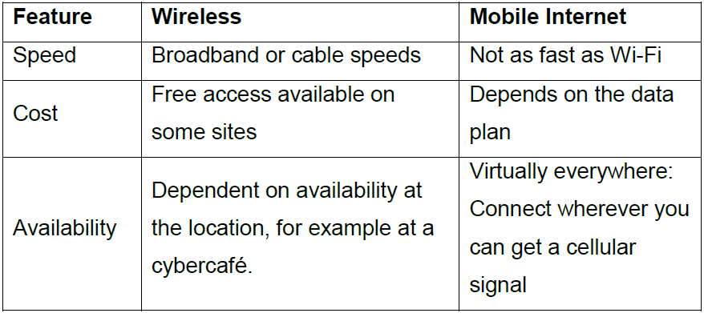
Mobile Internet Access

Slide 45
Mobile Applications
A mobile application is a software application designed to run on smartphones, tablet computers and other mobile devices.
They are available through application distribution platforms such as the Google Play. Some apps are free, while others must be bought.
Usually, they are downloaded from the platform to the device when the device is connected to the Internet.

Slide 46
Common Types Of Mobile Apps
Social media Ex. WhatsApp
Internet search Ex. Google Chrome
Email Ex. Gmail
Productivity tools Ex. Calendar
Meetings Ex. Google Hangout
Maps Ex. Google Maps

Slide 47
Synchronizing Content
Synchronisation technologies are designed to synchronise a single set of data between two or more devices, automatically copying changes back and forth.
For example, a user's contact list on one mobile device can be synchronised with other mobile devices or computers.
Data synchronisation can be local synchronisation where the device and computer are side-by-side and data is transferred or remote synchronisation when a user is mobile and the data is synchronised over a mobile network.

Slide 48
Synchronizing Content
Synchronisation is important because it:
  Acts as a backup.
  Can be used to restore apps and data.
Google Apps is automatically synchronised with the corresponding applications on desktop computers when connected to the Internet.

Slide 49
Mobile Security
Smartphones and other mobile devices such as tablets are increasingly used to store personal and business information, and mobile security is therefore crucial for data security.
Taking steps to keep our mobile devices secure is important as personal information and passwords to access our online accounts are stored in them.

Slide 50
Mobile Security
Use a PIN
  Enable a passcode (PIN) to restrict access to the device. This helps prevent unauthorised individuals from getting at your data.
Back up content
  Back up content regularly to ensure it can be restored when needed or transferred to another device if, for example, you lose your device.
Turning Wi-Fi/Bluetooth off
  Turning off wireless and Bluetooth can prevent unauthorised access to your device.

Slide 51
Taking Precautions Before Installing An App
Mobile malware can exploit the lack of technical support and quality controls that are associated with an unofficial application store.
Apps from an unofficial source may also not be fully tested and quality approved, thus slowing down the performance of your mobile device and other applications.
These apps may also automatically gain permission to access personal data such as contacts, images, and location without the user’s knowledge.
Apps from an unofficial source are also more likely to contain hidden costs for the user – for example, you may unknowingly sign up to contracts or in-application purchases.

