Slide 1
IT Security
Module 1

Slide 2
Common Terms related to Data Threats
Data – Processed to create useful information – raw data
Information – Organised data in a more meaningful format
Cybercrime – An offence which is carried out using
the internet or computer to commit illegal activities.
Hacking – Gaining access to a computer without
Authorisation
Ethical Hacking - Gaining access to a computer with
Authorisation

Slide 3
Key threats to Data Security
System crashes and hard disk crashes – a system or hard disk crash may cause physical damage to the storage media.
Computer viruses which may delete or corrupt files.
Destroyed by natural disasters (Extraordinary Circumstances), such as floods, fire or earthquakes.
Data lost by accidentally deleting or overwriting files.
Deletion by unauthorised users or hackers.
Accidental or malicious deletion by employees

Slide 4
Cloud Computing
Cloud computing is a type of internet based software, it lets users share resources and data with other devices anytime and anywhere. This allows for easy access to services and applications with very little management effort.
Cloud Computing - Vulnerabilities
Session Hijacking – an attacker can intercept and impersonate the user, and log
in using the users details.
Service reliability – The service can have downtime, so may become unavailable
Reliance on the Internet – The service is completely reliant on internet
connectivity.
Loss of Privacy – through sharing of information

Slide 5
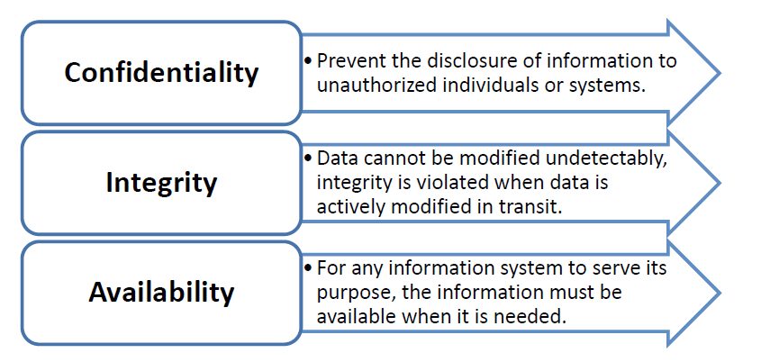
Information Security
The goals are protecting the confidentiality, integrity and availability of information from unauthorised access.
Goals are to protect the following three things:-

Slide 6
Reasons for Protecting Commercially Sensitive Information
Commercially sensitive information is any information owned by a company (business) that could cause harm if it is lost, misused, stolen or altered in any way.
The following are examples of commercially sensitive information
Financial statements such as balance sheets, cash flow, income statements or equity statements.
Information such as lists of current and past clients.
Trade secrets such as designs, formulas, production processes etc.
Information about new products, marketing strategies or patent information.
Commercially sensitive information must be protected to prevent:
Theft of information
Accidental loss of data
Fraudulent use of company data
Corporate sabotage

Slide 7
Data Privacy or Protection Control
With the increased use of the Internet for business and personal transactions, there must be measures in place to ensure that the privacy and security of the data is safe and secure.
Data protection legislation usually provides for the protection of individuals against the unlawful use of a person’s personal data and violation of their privacy.
Data protection legislation is, however, likely to vary between countries.

Slide 8
Data Subjects and Data Controllers relationship
Data Subject is someone who is the subject of personal data
Data Controller is an individual (or a collection of people) who controls and uses that personal data.
Within this relationship, there are guidelines and policies that must be followed in the interest of protection and fairness. The Data Controller will be responsible for obtaining and processing the data fairly, keeping it secure, ensuring that it is adequate and relevant, and will provide a copy of a Data Subject’s personal data on request.

Slide 9
ICT Policies in Companies (Businesses)
ICT policies are usually implemented at work to ensure safe and appropriate use of Internet services and connections.
A company may issue a document (e.g. ICT Policy Document)to be signed by employees to comply with their regulations.
Businesses that you may not work for but which you use, for example universities, restaurants and public transport that have a shared Wi-Fi network, may also have ICT policies that requires you to comply with before connecting to the network.

Slide 10
Social Engineering
What is Social engineering?
It is a way to gather information to manipulate or influence people with the goal to illegally obtain sensitive data (for example, passwords or credit card information).
Social engineers research and learn about the targets (persons) environment, and fake their identity to obtain confidential information from the victim.
In most cases, they infiltrate third-party computer systems to spy on sensitive data.

Slide 11
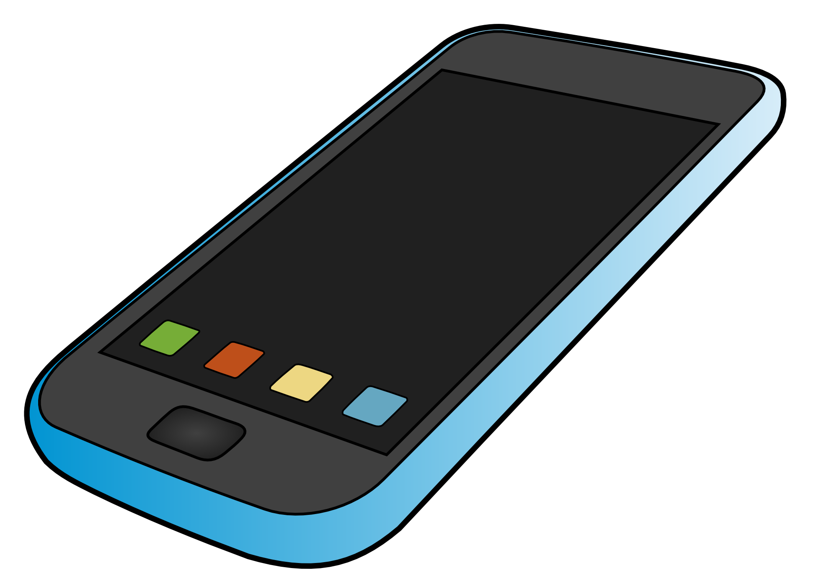
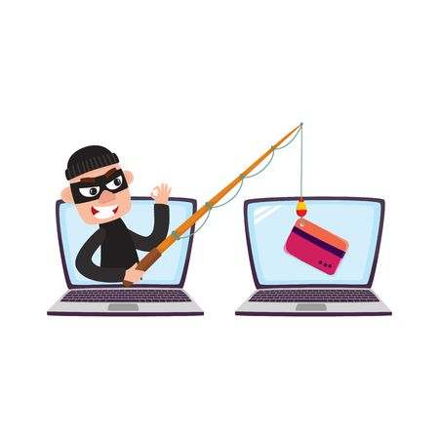
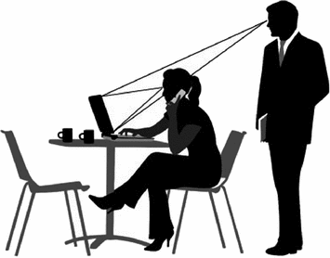
Methods of Social Engineering
Attacker may impersonate
a service to obtain information
Phonecalls
Perpetrator sends e-mail
which appears to be a legitimate source, looks genuine e.g. bank e-mail
Phishing
Someone is deliberately
looking over your shoulder
to obtain passwords or
PIN codes etc.
Shoulder surfing

Slide 12
Identity Theft and Its Implications
Identity theft is when someone deliberately impersonates and uses another person’s identity.
This is usually done to obtain money or to obtain credit and/or other benefits using someone else’s name:
for example, someone may use another persons identity
to obtain a passport or driving license.

Slide 13
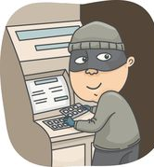
Methods of Identity Theft
Information Diving
Also known as “Dumpster Diving”, it is a method of obtaining personal or private information by going through bins for discarded documents or material such as utility bills or credit card statements.
Skimming
Identity thieves use skimming as a method of capturing a victim’s personal data by using a small electronic device. A skimmer is a device that is usually attached to an ATM machine’s card slot. A victim may unwittingly slide his card into the skimmer, which then reads and stores all the information from the card’s magnetic strip.

Slide 14
File Security
Often, some of the most important information you have is stored on files such as documents and spreadsheets. There are a range of security consideration associated with these files that you should be aware of.
Macros
What are Macros?
Macros are used to automate repetitive or frequently-used tasks in Microsoft Office applications.
A person with malicious intent could potentially create destructive macros, which can spread viruses.
Macros are a potential security threat and must be disabled to ensure full protection.

Slide 15
Saving a File with PASSWORD
When in the program
Click the FILE tab.
Click Save AS
Click Tools
Security Options or General options
Enter Password, you maybe asked to re-enter

Slide 16
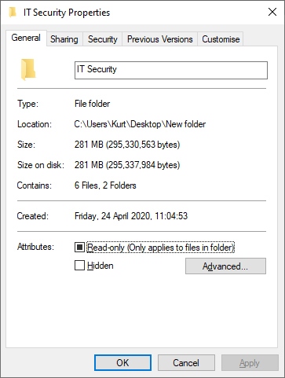
To encrypt a folder:
Right click the folder you wish to encrypt.
2. Select - Properties.
Go to - General Tab,
Click Advanced.
5. Tick the box:- Encrypt contents to secure data.

Slide 17
Advantages and Limitations of Encryption
The single most important reason for using encryption is to preserve confidentiality.
Advantages:
Ensures that private and confidential data can only be viewed by the intended recipient.
Ensures data integrity and prevents any unauthorised alteration of your data.
Encryption allows you to verify if the author of the document is or isn’t who they say they are.
Limitations:
If you forget your password then you may not be able to recover your data.
Some forms of encryption only offer nominal protection and can be broken easily with the right program, for example an older ZIP archive or Word Document.
The very existence of encrypted files attracts suspicion as to what it is you are trying to protect whereas a non-encrypted file would not attract the same level of interest.
Cannot prevent deletion of data

Slide 18
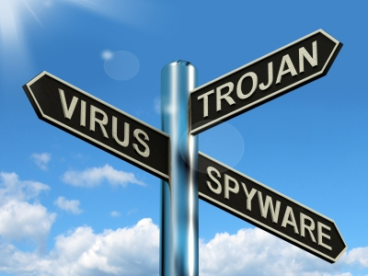
Malware – (Malicious Software)
Definition
Malware is malicious software that is designed to install itself on a computer or device without the owner’s consent. Malware is a term
used to describe the following types of malicious software.
Types of Infectious Malware
Viruses
Malware that can replicate when triggered by a human action
and cause damage to a computer.
Worms
Self-replicating, and uses a computer network to send copies of itself to other computers.

Slide 19
Trojan horses
A non-self-replicating, that pretends to be a harmless application.
Rootkits
Collection of software – designed to enable access to an area that is not otherwise allowed. (for example to an unauthorised user).
Backdoor
A backdoor is a method of bypassing normal authentication in an attempt to remain undetected. This is usually done in an attempt to secure remote access to the computer.

Slide 20
Types of Data Thefts
Data theft is the illegal access (reading, editing, or copying) of data without the data owner’s authorisation. Data can be stolen in many ways. These can be removed using anti virus software.
Examples of the way data theft and extortion can happen using malware:
Adware A type of software that automatically downloads and displays unwanted ads.
Spyware Hackers use spyware to monitor all your activities. Spyware can capture your keystrokes, take screenshots, view your webcam, monitor sites that you visit, and view programs and files that you run on your computer.

Slide 21
Botnet The term bot is short for robot. Criminals distribute malware that can turn your computer into a bot. When this occurs, your computer can perform automated tasks over the Internet, without you knowing it. (Number of internet connected devices)
Keylogger A Keylogger is a hardware or software based tool used to keep track of, or record the keys struck on a keyboard. This is usually done covertly, so to gain passwords etc.

Slide 22
Protection- Anti-VIrus
Anti-virus software identifies and eliminates various malware by scanning files in your computer system.
Viruses that cannot be cleaned or deleted are put in quarantine.
Typically, anti-virus software uses two different techniques to accomplish this:
1. By scanning and examining files on the computer system and comparing them to known malware based on certain virus signatures.
2. By checking programs for various types of bad behaviour which may indicate a new type of virus. This technique is known as “heuristic checking.”

Slide 23
Network and Connections
LAN (Local Area Network)
A local area network is the smallest type of network, usually extending over a small area within a building. When users connect their computers to the LAN, they can access shared resources such as Internet connection, network drives, printers as well as other user’s computers.
When logging-on to a LAN, user’s need to input their user name and password.
WAN (Wide Area Network)
Wide area networks (WANs) can extend over a large geographic area and are connected via the telephone network or radio waves. Many modern companies have offices, shops or factories in various locations around the country, and for large corporations, across the world.

Slide 24
WLAN (Wireless Local Area Network)
A wireless local area network or WLAN allows mobile users to connect to a local area network via a wireless (radio) connection. It provides a link between two or more devices within a limited area such as an office, home, school or office building.
VPN (Virtual Private Network)
A virtual private network (VPN) allows users to access their private network over the internet. Users can access their shared network resources, printers, intranet sites, databases and other services in their organisation remotely through an encrypted connection. This allows the users to send and receive data as if they were directly connected to the private network. A VPN typically uses encrypted traffic and tunnelling protocols to establish a virtual point-to-point connection between the user and the private network.

Slide 25
Firewall – Software program or piece of hardware that helps
block hackers, viruses, and worms from entering your computer via
the Internet .
Backup Data - It is important to make regular backups as your files
can be lost or destroyed accidentally.

Slide 26
Using Personal Hotspots
A personal hotspot provides a way for users to share an Internet connection using a smartphone or tablet. Most current mobile devices have this feature available.
Enabling this feature on a mobile device turns the device into a wireless access point, similar to a Wi-Fi access point. Devices with Wi-Fi radio will be able to access the personal hotspot as long as it is within range.
A personal hotspot has some limitations and constraints compared to a Wi-Fi access point. For instance, the number of simultaneous connections to a personal hotspot is limited. Also, data transferred on the personal hotspot from the Internet may count against the smartphone’s data plan.

Slide 27
Access Controls
Preventing Unauthorised Data Access
Some of the ways you can protect data from unauthorised access:-
Passwords
Passwords need to be set for all of the network’s computer systems. This helps ensure that only authorised users are able to access the computer system and network.
PIN (Personal Identification Number)
A PIN is a type of numeric password that is used by user to login to a system. It usually used in association with debit cards or ATM cards.

Slide 28
Multi-factor authentication
With Multi-Factor Authentication, users are only granted access to a system when they successfully present two or more forms of authentication methods.
One-Time Password
A one-time password (OTP) is a type of password that is valid for only one transaction or log-in session. This type of password can only be used once within a limited period of time, usually lasting a few minutes.

Slide 29
Biometric Security techniques
Fingerprint Scanning
Fingerprint scanners are sometimes used on laptop and desktop computers and flash drives. Fingerprint authentication is the most popular and least expensive method to authenticate using biometrics.
Hand Geometry
Hand geometry identifies a user by measuring their hand along many
dimensions and comparing these with stored measurements.
Facial Recognition
Facial recognition authentication is a security technique that records and measures your facial features such as the distance between your eyes, the height of your cheekbones, and additional characteristics.
Voice Recognition
This security technique works by matching the pattern of a person's voice to a template recording. Voice recognition is not the same as speech recognition, in that the words being said are not as important as the way in which they are said.

Slide 30
Secure Web Use
Content Quality and Currency The quality of the content is often a good indicator as to whether a website is legitimate or not.
Valid URL If a company is selling an item through a host website such as eBay or Amazon, it can be worth checking whether their URL links to a genuine website or not.
Company or Owner Information If a business has little or no information about the company or any of its employees then it may not be operating in a legitimate manner.
Check for Security Certificate and Validate Domain Owner
It is possible to check a website’s security certificate in Internet Explorer by clicking the lock icon in the address bar and then clicking View Certificates. Also Https- (s) secure website.

Slide 31
Clearing Private Data from Browser
Internet Explorer stores information about the websites you visit, as well as information that websites frequently ask you to provide (such as your name and address).
Internet Explorer stores the following types of information:
Temporary Internet files.
Cookies.
A history of the websites you’ve browsed.
Information that you have entered into websites or the Address bar.
Saved web passwords

Slide 32
Pharming - Bogus websites
In a pharming scam, a victim’s computer or server is infected with malicious code that re-directs them to bogus websites. It is similar to Phishing in that it uses fake or spoofed websites to collect confidential data. However, in Pharming, the victim is re-directed to a bogus site even if they have entered the correct web address.
One way a pharming attack is done is by using DNS poisoning. In a DNS poisoning attack, the Domain Name System table in a server is modified so that users are automatically redirected to fraudulent sites.

Slide 33
SOCIAL NETWORKING
Social networks are excellent tools for meeting and engaging with friends, colleagues, and people sharing similar interests.
Potential dangers
Cyber bullying/grooming
Misleading/dangerous information
False identities
Fraudulent links or messages.

Slide 34
Secure and Backup Data
There are a range of measures you can take to enhance the physical security of your, or your organisation’s, devices:
Do not leave unsecured computers or devices unattended – this will reduce the likelihood of them being stolen.
Record details and location of items and equipment, for example PCs. This allows for equipment to be tracked easily.
Use cable locks to secure computers and devices safely, especially if members of the public have access to the work area.

Slide 35
SECURE DELETION AND DESTRUCTION
When you need to dispose of a storage device that contains important information, appropriate steps must be taken to ensure that the data is permanently erased and cannot be recovered by unauthorised individuals.
Data remains on media even after it has been “permanently deleted”. When a user deletes a file, it is usually moved to the recycle bin. A user can empty the trash bin, seemingly “permanently” deleting the file from the computer.
Common Methods of Permanently Destroying Data Shredding
Paper containing sensitive information should be shredded. Shredders are very cost effective. Specialised shredders can also be used to permanently destroy storage media such as DVDs or hard drives.

Slide 36
Specific destruction techniques include:
Physically breaking the media apart, by grinding, shredding, etc.
Incineration.
Phase transition (liquefaction or vaporisation of a solid disk).
Application of corrosive chemicals, such as acids, to recording surfaces.
Corrosive Liquids
Using Data Destruction Utilities
Magnetic storage, such as computer hard drives, can be cleaned by
software that uses an over-writing or "wiping" processes. USB
"flash drive" devices can also be cleaned in this way. This special
software over-writes all the usable storage locations. Most secure
file deletion software offers a choice of more and less secure
over-writing options. More secure options take more time, given the multiple over-write operations.

