Slide 1
Digital Marketing
Notes:
Hi, In this video we will be covering the fundamentals of digital marketing in preparation for your exam. Important that apart from this video you also go through the notes where you will find more details.

Slide 2
Topics
Social Media Marketing & Promotion
Social Media Engagement, Lead Generation and sales
Online Advertising
Email Marketing
Mobile Marketing
Web Analytics
Social Media Insights
Email Marketing Analytics
Online Advertising Analytics
Key concepts
Planning
Web Presence Options
Website Consideration
Search Engine Optimisation
Social Media Considerations
Social Media Accounts
Using Social Media
Social Media Management Services
Notes:
As you can see we will be covering substantial number of topics within Digital marketing, from web, search engine, social media, online advertising, email and analytics

Slide 3
1. Key Concepts

Slide 4
Digital Marketing - Key Concepts
Digital Marketing (aka Internet or online marketing), can be described as the set of techniques and technologies used to promote brands, products and services to consumers over a range of online channels.
Notes:
People are spending more and more time online carrying out a range of tasks, including shopping, searching for information, reading news, watching videos, using e-mail, booking holidays, and using social media. Therefore, it is important that you are present in these channels and to exploit such opportunities.

Slide 5
Importance of Digital Marketing
On average, Facebook users scroll 90m metres of news feed per day.
In 2020, total turnover generated by local businesses in Malta through e-commerce sales amounted to €2.1Billion (NSO)

Slide 6
Digital Marketing Goals
Increased brand awareness among current and potential customers
Lead generation
Sales generation
Informing customers
Improved customer service
Direct customer engagement
Generating Traffic
Notes:
Before a business decides to incorporate digital marketing, you need to ask what are you expecting to achieve from digital marketing?
Lead generation is about stimulating and capturing interest in a product or service for the purpose of developing a sales pipeline
Informing customers – as a way to have a conversation, updates
Improved customer service – nowadays it has become common that if you want to ask a question to a business, you do not call but contact them via facebook
Generate traffic: It can be that you have a physical store and want to implement digital marketing to drive footfall to your store. This strategy is used a lot by local restaurants in Malta.

Slide 7
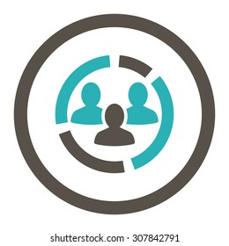
Advantages of Digital Marketing vs Traditional Marketing
€
More cost effective
Easier to track & measure
Larger demographic reach
Higher engagement
Catering to mobile customers
Notes:
More cost effective: youtube vs TV
Easier to Track: to measure the effectiveness and reach of a TV advert you need to commission a market research company, whilst with youtube you can collect all this data from your account
Reach: not limited by geography or other constraits
Engagement: digital provides new creative and dynamic ways to create content that with traditional methods was not possible

Slide 8
Limitations of Digital Marketing
01
Lack of face-to-face interaction
02
Can be obtrusive
03
Time commitment
04
May not be suitable for your product
Notes:
Obtrsuive - interfering

Slide 9
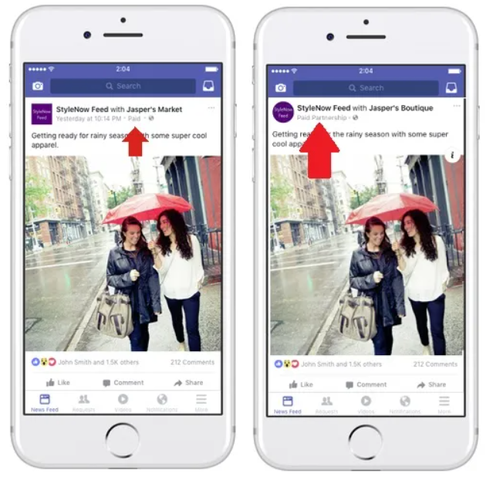
Legal & Regulatory Obligations
These differ depending on the country
Includes: data protection and privacy, copyright and e-commerce
GDPR in EU - Cookie Banner
Some advertising platforms have their own regulations
Facebook: Organic vs sponsored posts
Notes:
If your website uses cookies and it is targeted for EU, the GDPR requirements for “cookie consent” is important

Slide 10
2. Digital Marketing Strategy Considerations

Slide 11
Digital Marketing Strategy Considerations
Strategy example:
Leverage the popularity of social media to drive traffic to our physical store by targeting 20 year olds via creative content.
Goals
Audience
Competitors
Platforms
Content
Budget
Reporting

Slide 12
Design Considerations
Any design elements used online such as logo, colours, images, messaging, tone of voice and visual style should be in line with your corporate identity and design.
Online design must be consistent with your offline identity
Notes:
Coca cola examples

Slide 13
Content Marketing
Content marketing involves the creation and sharing of free, relevant and valuable content to attract and convert leads into customers, and turn customers into repeat buyers.
Importance of content marking:
Show your audience how your products and services solve their problems
Increases reach, brand awareness, consideration and loyalty

Slide 14
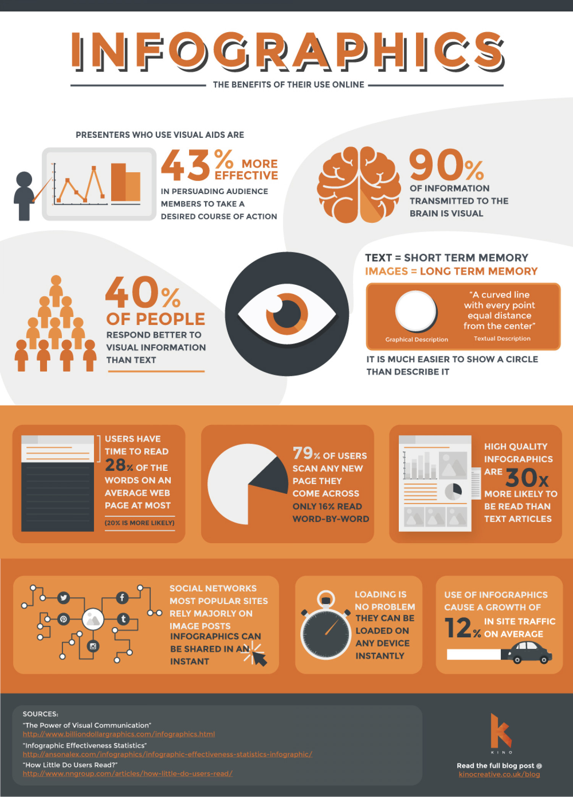
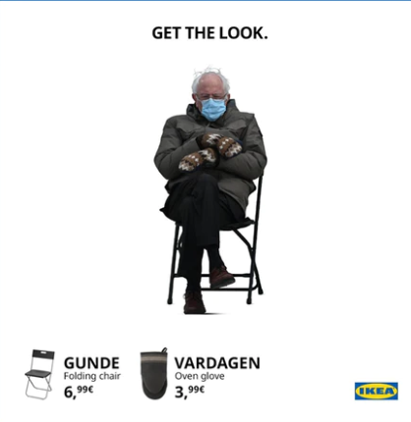
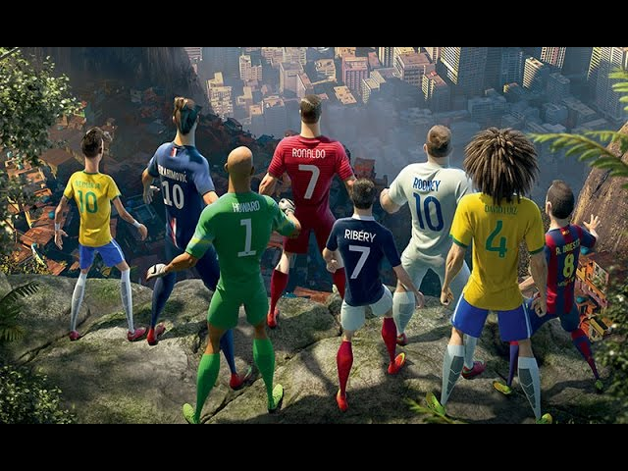
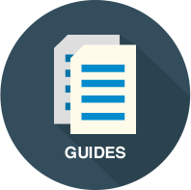
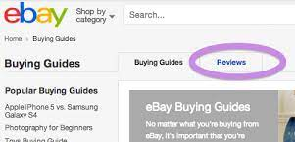
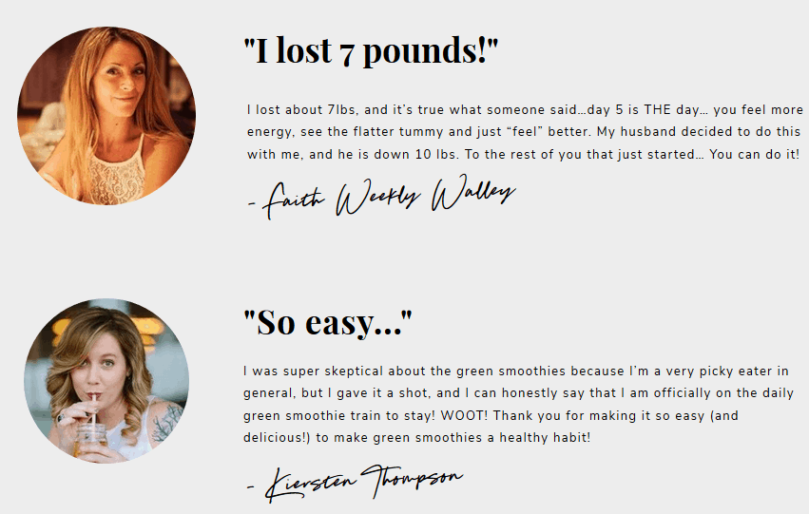
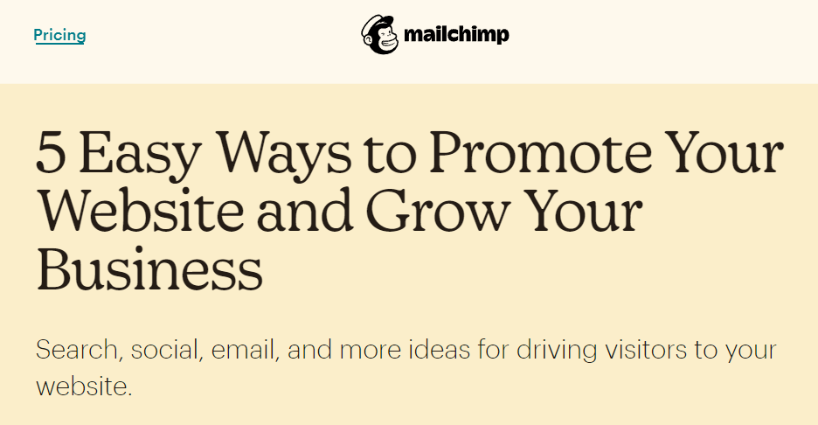
Content Marketing
1. Infographics
2. Meme
3. Videos
4. Guides
5. Product Reviews
6. Testimonials
7. Lists
8. Whitepaper
Notes:
Infographics (a clipped compound of "information" and "graphics") are graphic visual representations of information, data, or knowledge intended to present information quickly and clearly.
What was great about Nike Last game advert?
A whitepaper is a persuasive, authoritative, in-depth report on a specific topic that presents a problem and provides a solution. Marketers create whitepapers to educate their audience about a particular issue. This is quite common in B2B. Example a consultancy firm would publish a report about current issues and possible strategy ideas.

Slide 15
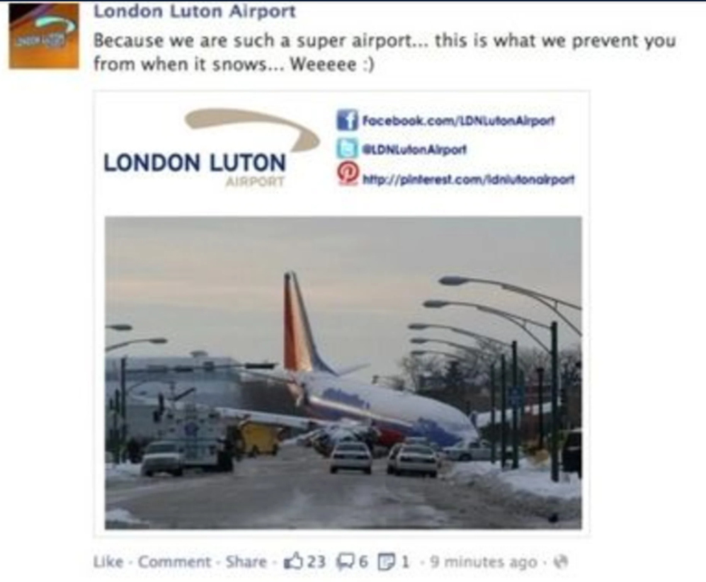
Policies and Access Controls
Misuse of digital marketing accounts can have a negative impact on a company’s reputation.
Businesses need to set appropriate guidelines, tone of voice, policies and access controls for company accounts.

Slide 16
3. Web Presence Solutions

Slide 17
Web Presence Solutions
Business Directory e.g. Google My Business, Yellow.
Social Media
Website (info/e-commerce)
Blog
Web application
Mobile application
Google My Business Example
Notes:
A business directory is an online list of businesses within a particular niche, location, or category. One way local businesses can get found by online searchers is through inclusion in business directories.
A blog is a type of online journal that is regularly updated with content, known as posts. Blog can be a very important traffic generator to a site.
A web application is an application program that is stored on a remote server, but that a user can access over the Internet through a web browser. Businesses often include these in their online presence as a part of their service to customers. Common examples include online auctions, online banking, webmail, and webbased office software like word processors and online spreadsheets.

Slide 18
Creating a website
Register an appropriate website address
Choose the domain name e.g. https://www.asos.com/
top level domain e.g. .com, .net, .org, .edu
Register with a website hosting service provider e.g.
Design the site
Build the site
Promote the site
Notes:
Step 1: It is about identifying and check your chosen domain name is available
Step 2: website hosting service provider -where your site will live

Slide 19
Content Management Systems
A content management system (CMS) is an authoring and administration tool for developing and maintaining a website.
A CMS offers a simple user interface for creating and modifying web content, so a user can publish and manage changes to the site even if they have no programming skills.
Notes:
Not everybody has the programming skills to build and design styles. This is where CMS comes into place.

Slide 20
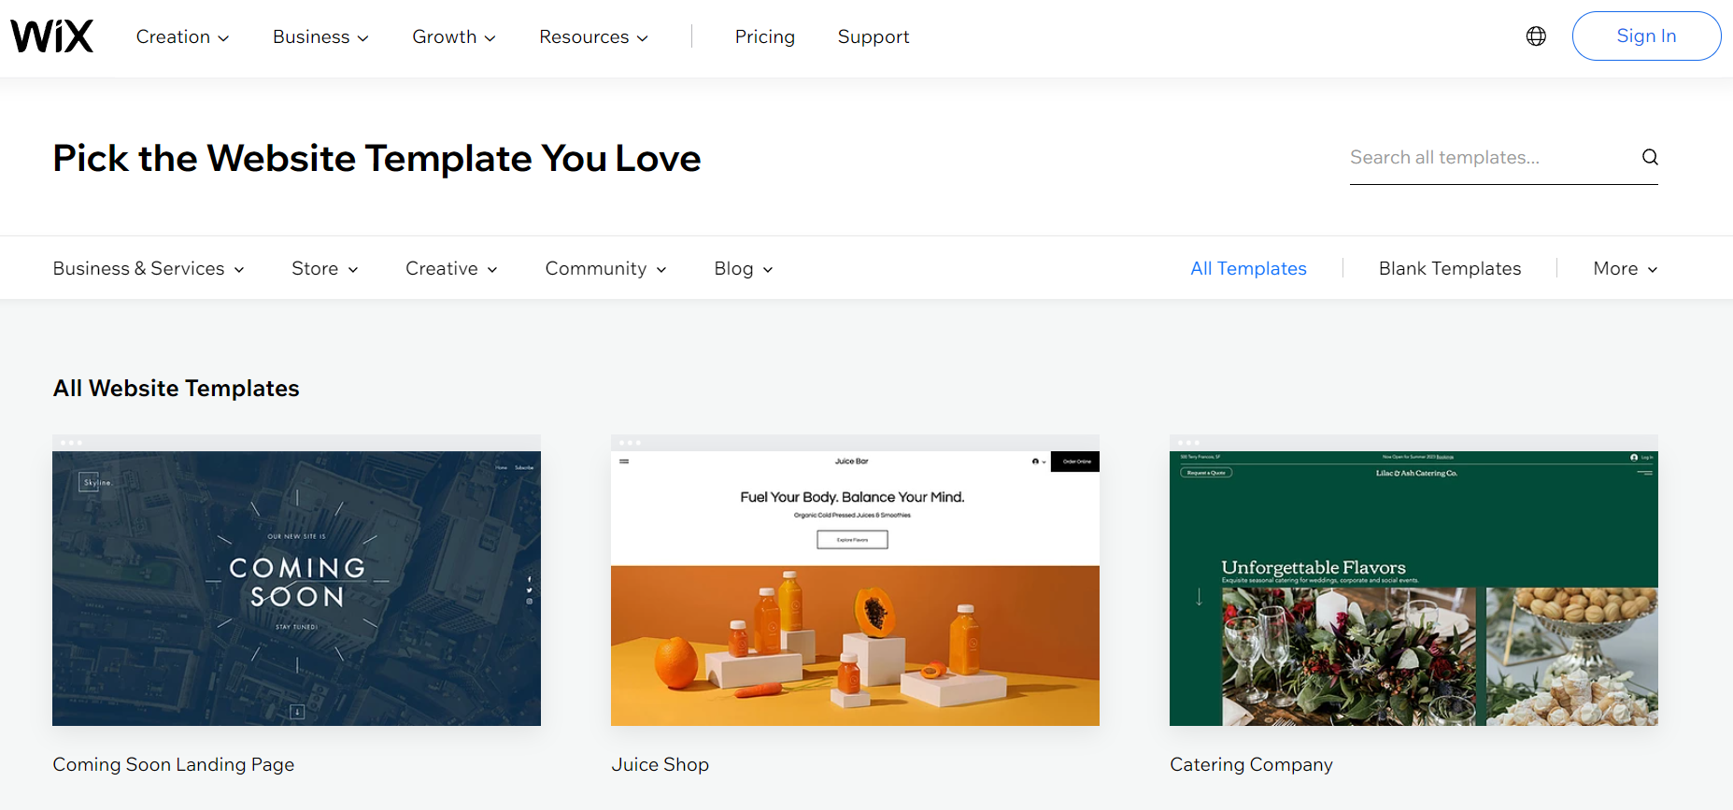
WIX Templates

Slide 21
4. Website Structure

Slide 22
Website Structure
Notes:
The design stage of a new website requires a lot of planning and thought.
You need to determine what is the scope of the website first, is it to sell, provide info, generate traffic to a physical stores

Slide 23
Website Design
The overall experience of a visitor to your site is known as the User Experience (UX).
The customer interacts with your site through the content on the webpage, known as the User Interface (UI).
UX Tips
Use eye-catching elements to draw attention.
Make the checkout process and payments faster.
Notes:
Some websites are very confusing to navigate through, whilst others are very simple and straightforward.
Theuser experience on your website is as important as a customer experience in a shop because it is a big part of the overall customer sales journey.

Slide 24
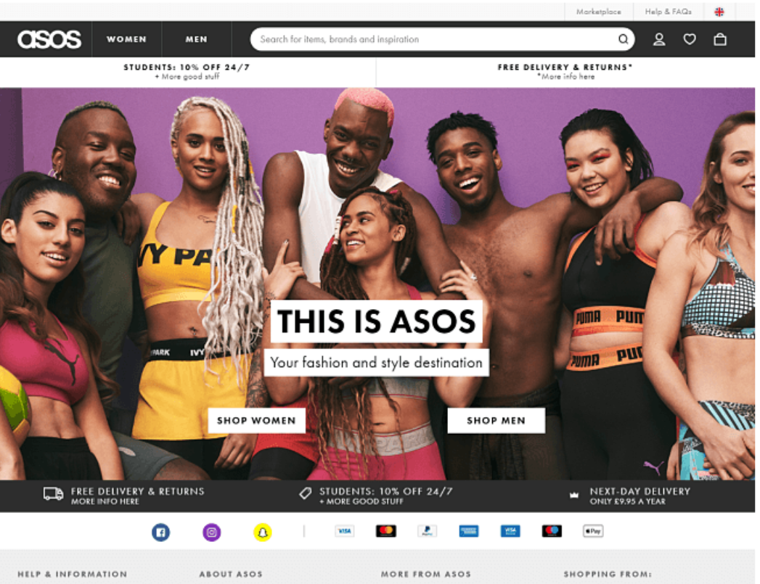
Website Design
Great value proposition (free delivery)
Clear Call to action (CTA)
Quality imagery
Simple navigation

Slide 25
Website Design – Key terms
Responsive Design - Users should have a consistent experience regardless of the type of device/screen size they are using.
Accessibility - A website should be accessible, so it can be viewed and navigated by people with disabilities.
Performance optimisation – Webpages should download quickly
Browser compatibility - A website should work on different types of browser without loss of content or browsing experience.
Notes:
When you are designing a website you need to keep in mind the below:
Accessibility - Ensure that videos come with subtitles to aid people with hearing impairments.
Common web browsers include Microsoft Edge, Internet Explorer, Google Chrome, Mozilla Firefox, and Apple Safari

Slide 26
Website Content – Creating good quality content
Audience focused
Clear and concise content
Use of keywords
Consistent branding
Quality images and videos
Regularly updated
Notes:
Audience focused- for instance asos identified that consumers wanted to have a more intimate buying experience and experience how the clothes would look real. So with their items online they added the catwalk video.
Clear and concise – remember nowadays there is an overload of information and people have become very good at filtering information.
Consistent branding – if I had to show you a Coca Cola advert and I would remove the logo, most likely you would still think that this is a Coca Cola advert since all of the adverts have a similar colour tone, they consist of people which are smiling.

Slide 27
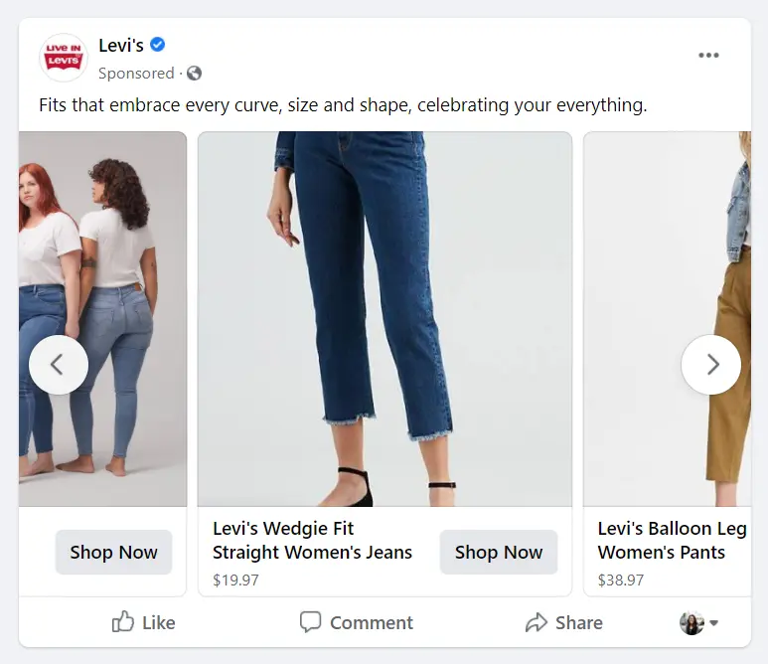
Website Promotion
Link website to the content on social media
Online advertising
Competition
E-mail marketing
Example: Link website to the content on social media
Notes:
It is not enough that you create a website. You need to promote the website.
Online advertising – we will be going into more details on this in the coming slides.

Slide 28
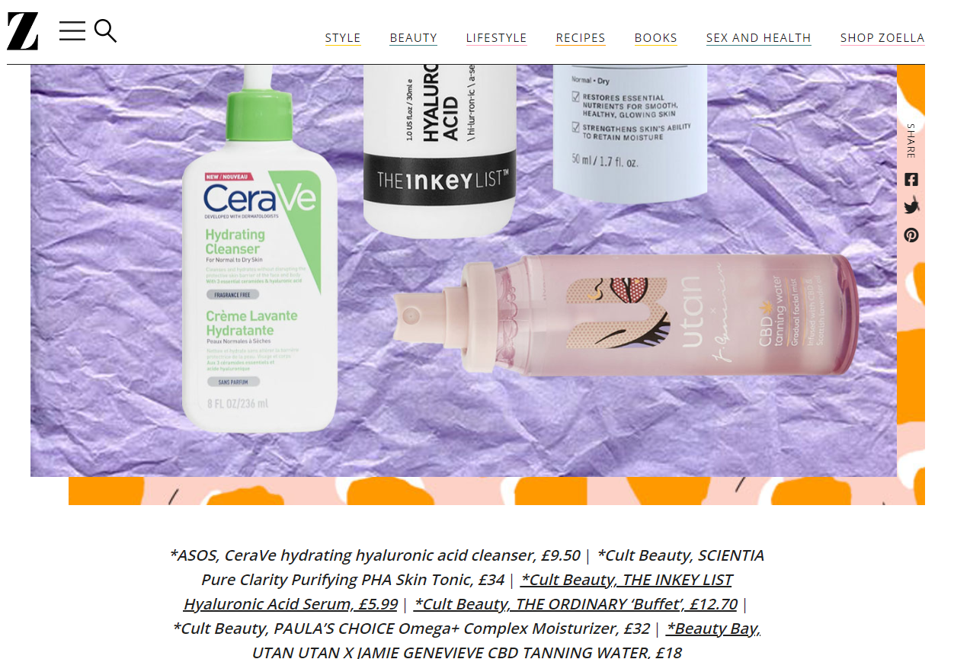
Website Promotion
Inbound links or backlinks.
Register your website address with web directories and search engines
Include the website address on the business's printed marketing materials,
Notes:
Register your website address with web directories – say example you are looking for a burger shop in the south of malta and you type this query in Google, if you register with Google my Business, when people type this, it will pop up.

Slide 29
5. Search Engine Optimisation (SEO)
Notes:
As we have outlined, you cannot create a website and stop there. You need to make sure that when people are searching online, your website pops up. Remember that online there are millions of websites.

Slide 30
How do search engines work?
Search engines use automated robots to “crawl” the web, find web pages, understand them, and store specific information about them
When a user enters a term or phrase (search query) on a search engine, the search engine will search its databases for web pages that best respond to the user’s search query.
When the search engine finds web pages that it considers to be the best match for the search query, it returns a list of results. The list is referred to as the search engine results page (SERP).
Notes:
The majority of Internet sessions begin with an online search. Users turn to search engines to ask questions, find products and services, and search for videos and images. Popular search engines include Google, Yahoo, and Bing.
Therefore, we need to understand how search engines work.

Slide 31
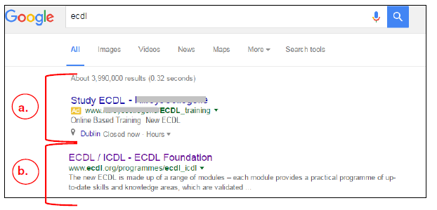
Google Search Engine Results Page (SERP)
Paid Advertisements typically appear at the top of a SERP.
Organic results typically appear below the ads.
SERP

Slide 32
What is SEO?
Search Engine Optimisation (SEO) is the technique of increasing the visibility of a website in the organic (unpaid) results of a search engine result page (SERP).
Website owners do not pay when the user clicks on the organic results.
The top results are deemed to be the most relevant and popular by the search engine.
The order of organic results is determined by a mathematical equation known as an algorithm.
Notes:
We as online users rarely click on the second page of the SERP

Slide 33
Algorithms
The algorithms are very complex, continuously changing and usually include hundreds of variables known as ‘ranking factors’.
SEO techniques help to improve your ranking factors and increase your webpage’s visibility in organic results

Slide 34
Typical Ranking Factors
Two Main influential ranking factors:
Keywords – They are phrases or words in the webpages that match or are considered relevant to the search query.
Links - The number and quality of hyperlinks to your website from other websites and social media platforms and the words in the hyperlinks.

Slide 35
Keywords for SEO
Keywords are descriptive and information-rich words or phrases used in web page content and often the key items in a search query.
Optimising your webpages for search by:
1. Identifying important keywords for your webpage.
2. Adding those important keywords to your on-page content and website code.
Short tail keywords | Long tail keywords
Moisturiser | Face moisturiser for anti-ageing
Hotel Malta | 5-star hotel in Malta with squash court

Slide 36
Identifying Keywords
Start by researching and defining a list of keywords and phrases that relate to what your website is about
Identify search queries that brought your target audience to your website using Google Search Console
Check the volume of search queries using online tools such as keywordtool.io and Moz.
Consider which keywords are going to be most effective for your business goals.
Analyse the user’s intent in a keyword.
Search query 1: Iphone 13 release date (Informational intent)
Search query 2: Iphone 13 Pro Price (Transactional intent)
Notes:
Identify search queries that brought your target audience to your website - example say you have a business teaching digital marketing and you find that a lot of the people that click on your website is because when they are searching in the search box they write practical digital marketing course.
Consider which keywords are going to be most effective for your business goals. Taking the previous example it can be that using the keyword ‘practical’ rather than ‘’hands on’’ , even though they mean the same thing the first one coverts more to customers.

Slide 37
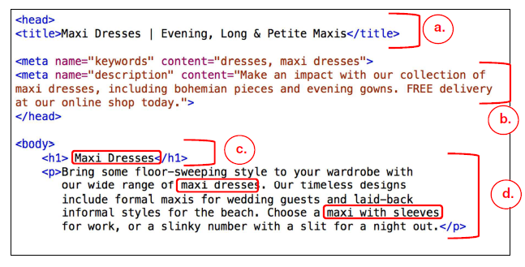
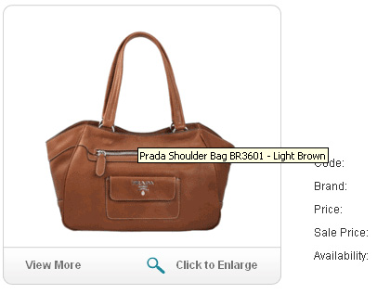
Where to use Keywords
Page title
Meta description
Heading
Main Content
URLs (web page addresses).
Alternative text and image file names.
Keywords in HTML
Example: Alt text

Slide 38
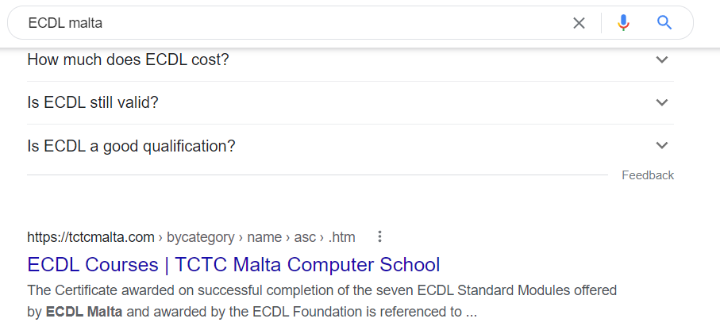
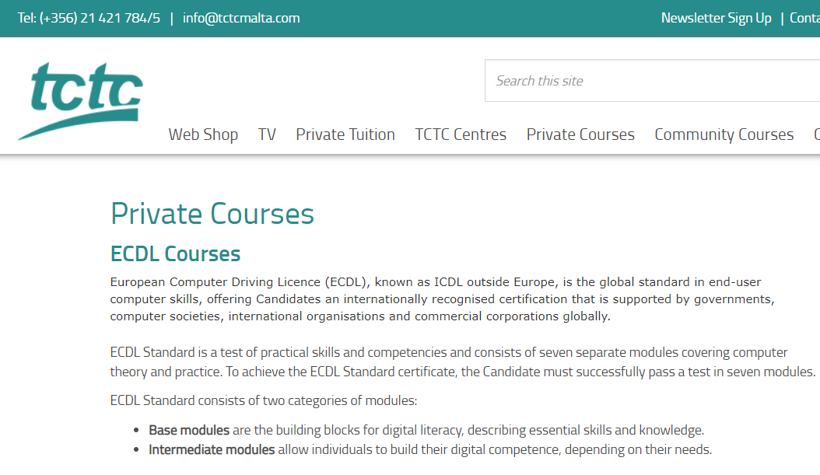
Where to use Keywords
Page Title
Meta Description

Slide 39
6. Social Media

Slide 40
Social Media
A social media platform is an online environment that allows users to connect and create online networks through the creation and exchange of content.
Social Media Platforms

Slide 41
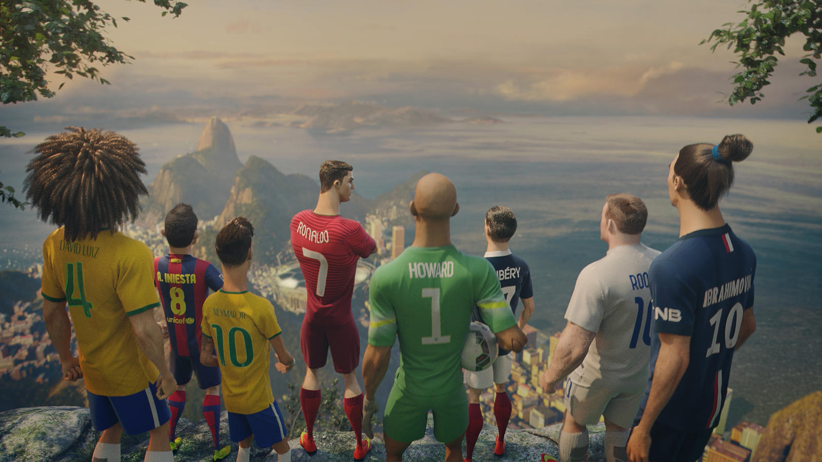
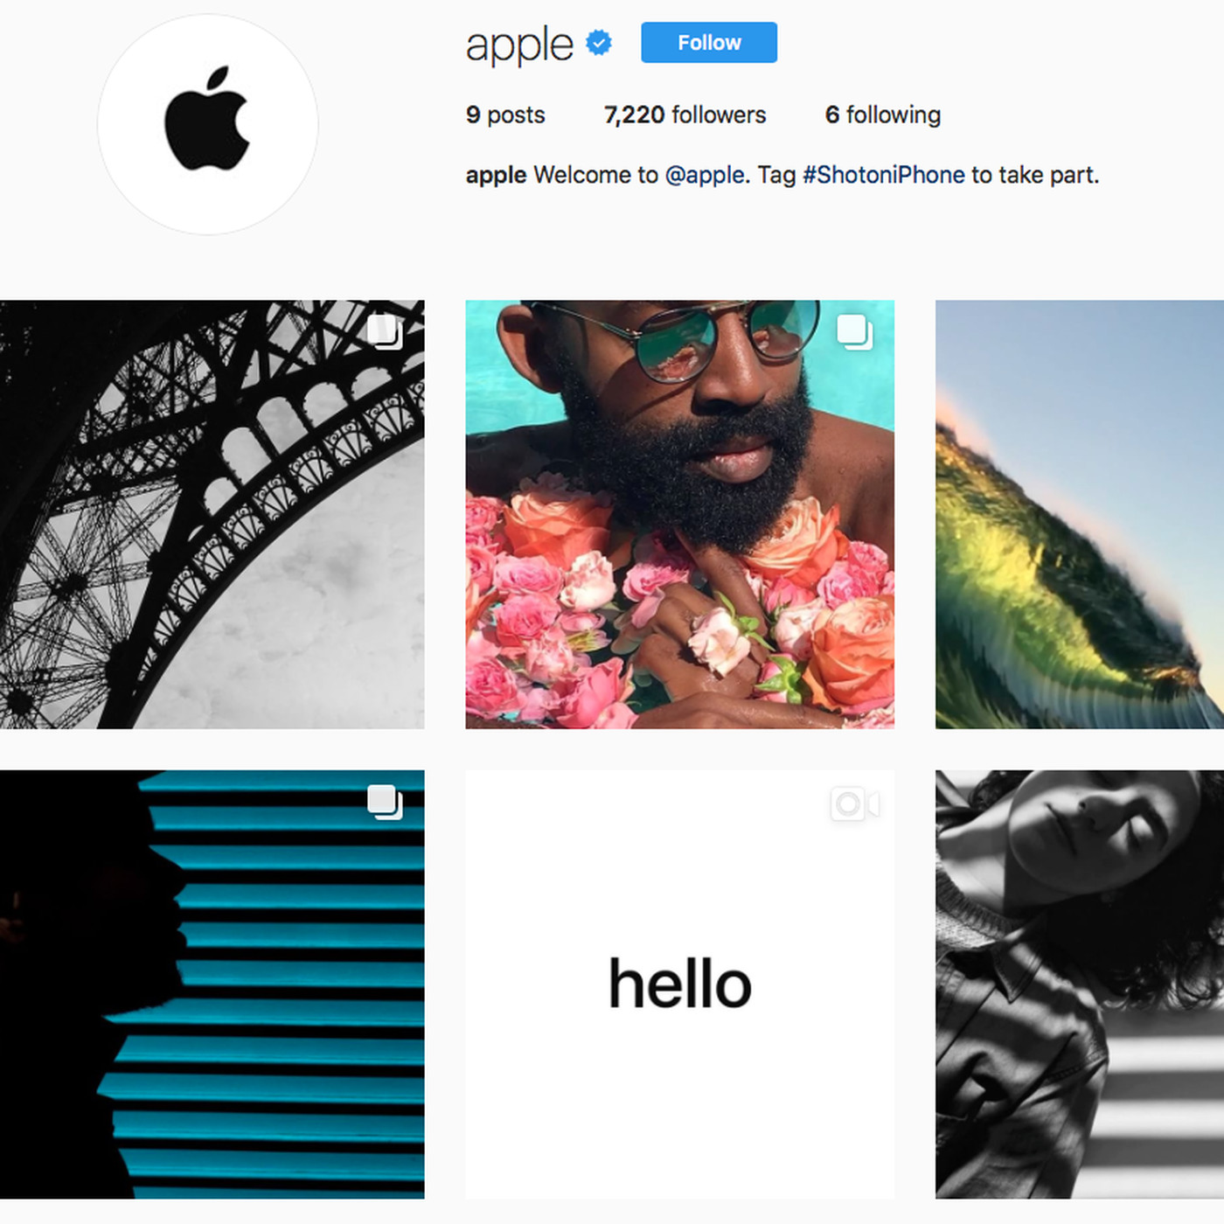
Social media marketing campaign
An effective social media campaign is based on making connections and having conversations rather than broadcasting marketing messages.
Excellent social media marketing campaign examples:
Nike Risk Everything Campaign
Apple #ShotOniPhone Campaign
Notes:
Apple #ShotOniPhone Campaign - It was a worldwide challenge that invited users to submit their own best photos using the hashtag #ShotoniPhone. From these photos, Apple selected images to display across media outlets and on over 10,000 billboards around the world

Slide 42
Social media marketing campaign
When you are planning your social media marketing campaign there are a number of things to consider:
Select appropriate platforms
Plan suitable content
Create content
Track campaign
Evaluate performance
Notes:
Select appropriate platforms – if you are targeting the late fifties, does not make sense to use Instagarm

Slide 43
7. Social Media Profile Types

Slide 44
Social Media Profile Types
Personal
Business
Groups
Events

Slide 45
8. Social Media Actions

Slide 46
Social Media Actions
Post
Comment
Share
Like
Tag
Hashtag
Follow
Notes:
Why Facebook included the reactions button?

Slide 47
Posts on Social Media
Type of Posts on Facebook
News
Event
Poll
Offer

Slide 48
9. Social Media Management Services

Slide 49
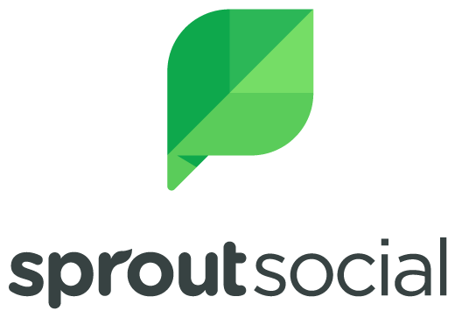
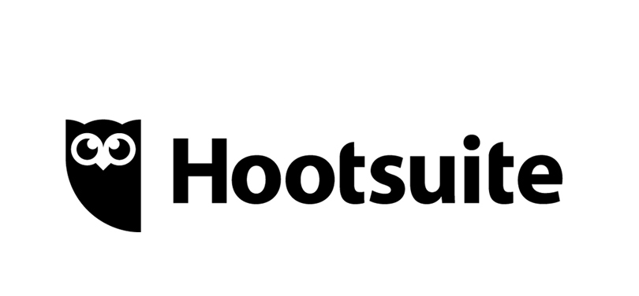
Social Media Management Services Tools
For organisations that manage many social media profiles across multiple platforms, social media management services can help make the tasks more efficient.

Slide 50
URL Shortener
There are many URL shortener services available but some common ones include
bit.ly
goo.gl (Google’s URL Shortener)
tinyurl.com
ow.ly
Long URL
Short URL

Slide 51
10. Social Media Marketing & Promotion

Slide 52
Influencers, Reviews & Rereferrals
Influencers are social media power users who have built up a large number of followers on social media in their field. Influencers are highly respected by their followers.
Reviews are an evaluation of a product or service by a customer or a third-party.
A referral is a website visitor that has come to your site from clicking a link on another site.
Notes:
Online reviews can affect a business’s reputation, their search engine ranking, and influence conversions.

Slide 53
Targeted Audience
A targeted audience is a particular group which a product or service is aimed towards.
Content should be tailored depending on the targeted audience.
Social media platforms allow very specific audience targeting

Slide 54
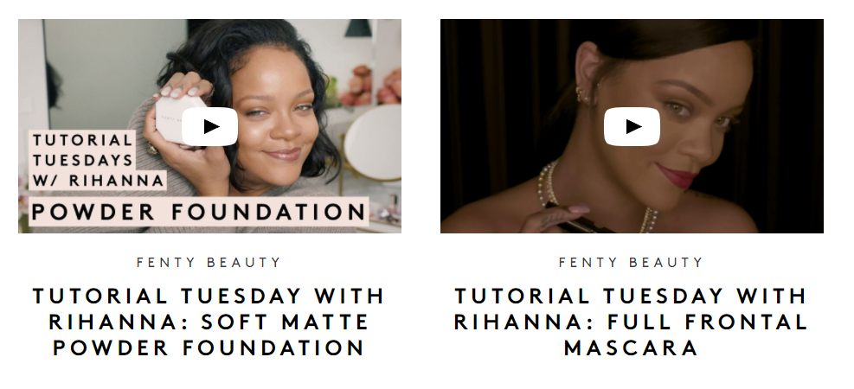
Engaging Content
Video marketing is widely used in digital marketing. Why?
Can create higher engagement and leave a lasting impact and
Communicate information more easily
Popular types of video on social media
Emotionally appealing ads
How-to video tutorials
Product demonstrations
Testimonial videos
Events

Slide 55
Viral Content
Viral content is content that is shared quickly and widely over the Internet
Content is more likely to become viral when it is:
Humorous
Original
Resonates with the audience
Generates discussion
Viral marketing helps to reach a large audience in a cost-effective way.
Notes:
There is no guarantee that the campaign will ‘go viral’

Slide 56
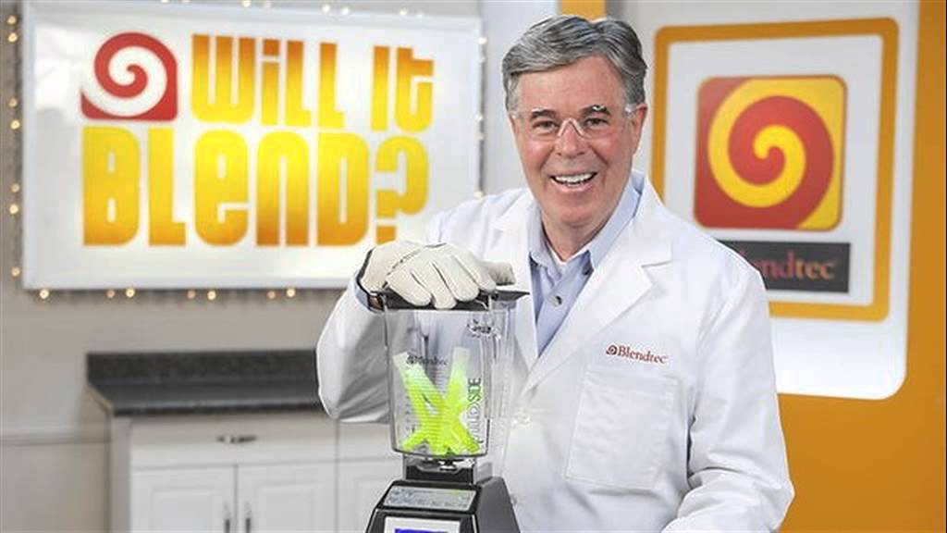
Viral Content
Example of viral marketing campaigns:
Dove Real Beauty Sketches Campaign
Will it Blend Campaign by Blendtec

Slide 57
Good Practice for creating engaging content
Post regularly
Post at times that your target audience are most likely to be online
Post content that is relevant and tailored specifically to appeal to your target audience.
Post good quality images and videos
Notes:
Post regularly – to keep top of the mind awareness

Slide 58
11. Social Media Engagement, Lead Generation & Sales

Slide 59
Comments & notification
Brands should provide timely and appropriate responses to all comments on their posts or page.
Positive comments act as recommendations and have a positive influence on potential customers.
Negative comments and complaints on social media sites should be dealt with quickly and appropriately.
Notifications
Notifications alert you when there has been some activity on your social media profile such a mention or a comment.
Notes:
When you are online you need to accept the fact that people have a lot of things to say. So you need to be open for both positive and negative comments.
Often it’s best to ask the customer to contact you and to try resolve the issue offline.

Slide 60
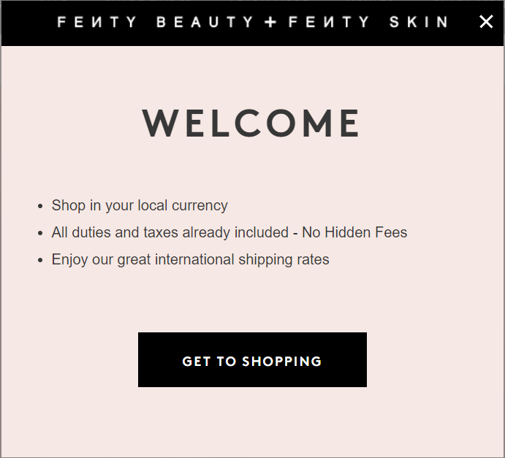
Call to Action (CTA)
A call to action is an instruction to an audience to complete a specific action or goal. It should be enticing, attention-grabbing and clearly explain what the audience will get in return for the action.
Some examples include:
Get a quote
Sign up
Buy now
Shop now
Learn More
Download app

Slide 61
12. Online Advertising

Slide 62
Online Advertising Channels
Search Engine Marketing (SEM)
Display Advertising
Social Media Advertising

Slide 63
Search Engine Marketing
Search engine marketing (SEM) includes ads that appear in search engine results pages. This is known as pay-per-click advertising (PPC).
Search engine advertising enables you to reach customers at the exact time that they are searching for your product or service.
The two most common SEM platforms for search engine advertising are

Slide 64
How does Search Engine Marketing work?
Step 1: Create an SEM platform account. For example, set up a Google AdWords account.
Step 2: Create an ad campaign
Define the budget, select target audience, select keywords, write ad text
Step 3: A user searches for a word or phrase in the search engine.
Step 4: Your ad is displayed in the SERP (depending if the search term matches the keywords you have identified in your ad)
Step 5: Your ad is clicked.

Slide 65
Display Advertising
Display ads are ads that are shown on the articles, videos, or websites that consumers browse
Online advertising platforms: Google Display Network, Yahoo! Bing Network

Slide 66
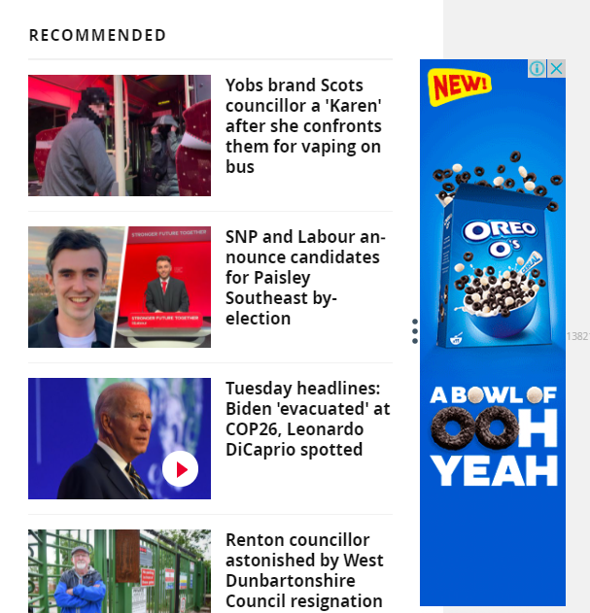
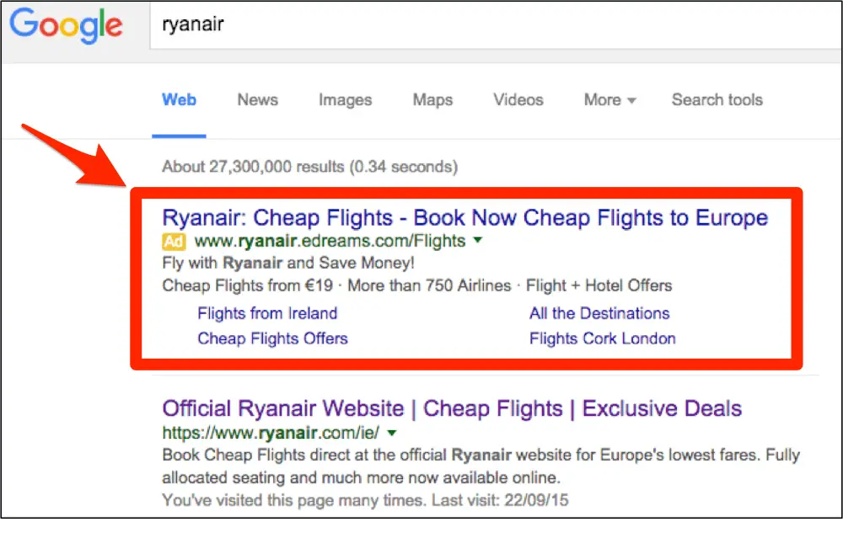
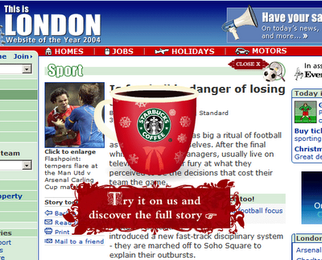
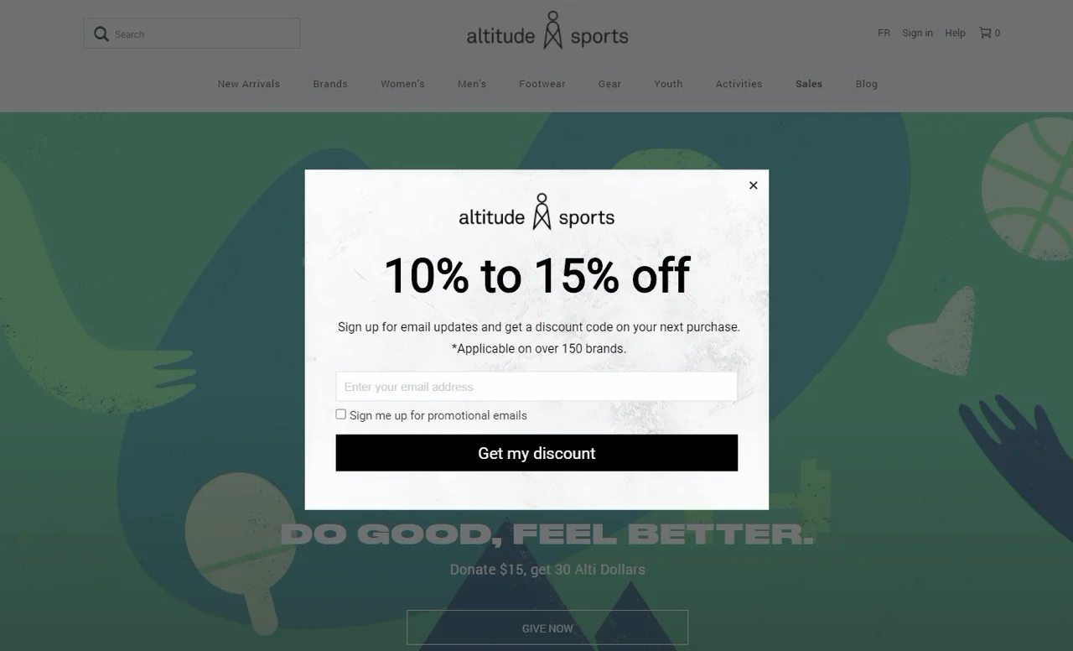
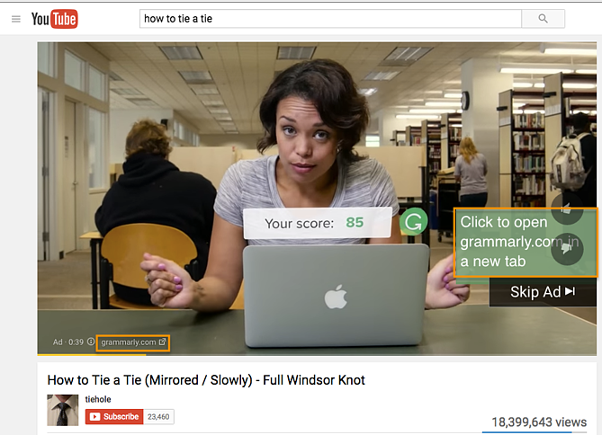
Types of Online advertisement
Text Ad (e.g. google search ads)
Floating Ad
Banner/image Ad
Pop Up Ad
Video Ad

Slide 67
How does display advertising work?
Imagine you have a wedding photography business and want to show your ads to people who are planning their wedding.
Step 1: Create an Online Advertising account
Step 2: Create an ad campaign (specify keywords, budget, placement, targeting)
Step 3: Create your ad (text, artwork)
Step 4: Your ad is displayed
Step 5: Payment
Your ads will show on wedding venue websites, blog posts on wedding flowers etc.
Notes:
Step 5: Payment – Your payment depends on whether your ad is viewed, clicked or a specified action is completed. This depends on what you specified during set up.

Slide 68
Search ads vs display ads
Search Ads
Pull approach
Ads are viewed to online users that are looking for your product/service
Display Ads
Push approach
Ads are viewed to online users while browsing online

Slide 69
Social Media Advertising
Why use social media advertising?
Allow brands to leverage real word of mouth and recommendations
Sponsored posts are an opportunity for brands to be more playful, fun and experimental than traditional media ads
The turnaround time for producing and getting ads live on social media is also attractive.
Clicks on social media ads are often more cost-effective than other ad platforms.
Ability to apply audience targeting

Slide 70
Audience targeting
Demographics
Location
Interests
Behaviours
Connections
Etc.

Slide 71
How does social media advertising work?
Step 1: Select your ad type depending on your goal (Reach, engagement, leads, etc)
Step 2: Create your ad (targeting, placement, ad format)
Step 3: Your ad is displayed

Slide 72
13. Email Marketing

Slide 73
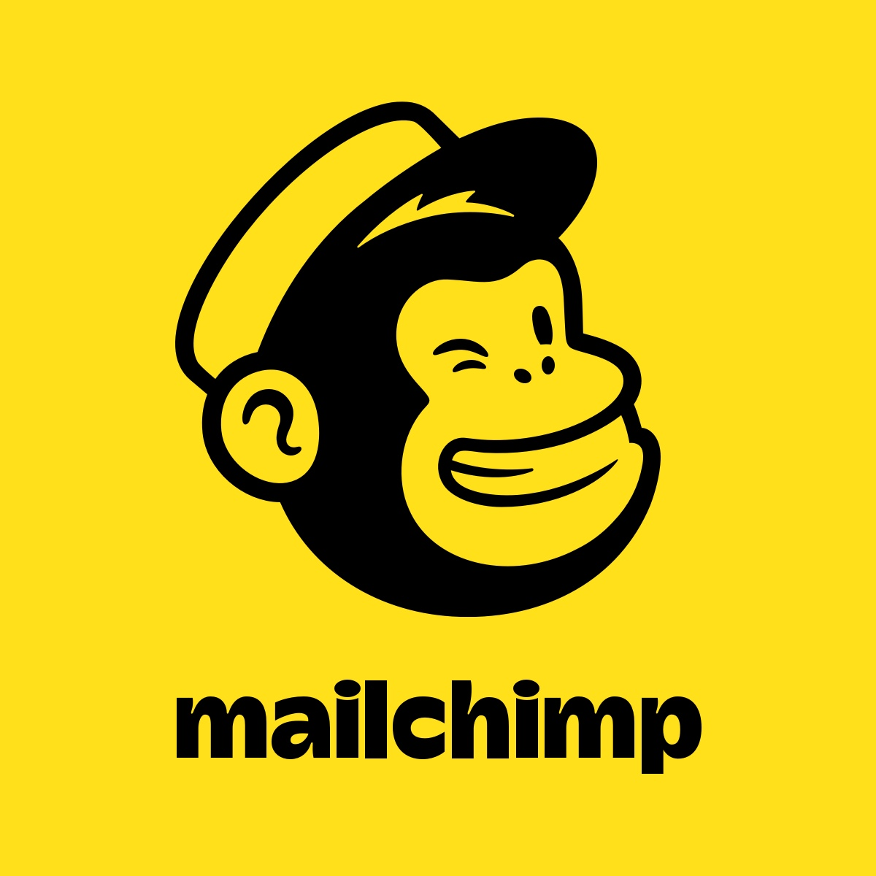
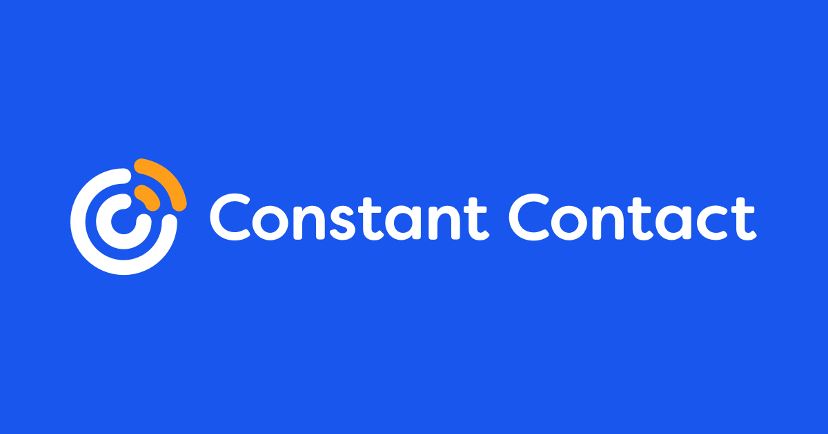
Email Marketing
Benefits of email marketing
Good tool to keep the conversation going with your customers
Ability to segment/tailor messages
Most cost-effective tactic to communicate/sell your brand
Email Marketing Platforms:

Slide 74
Email Marketing
Mail list can be built from:
Past customer sales
Opt-in subscribers
Opti in and opt out
Organise
Contact details should be categorised
Example: First time customer, Loyal customer, prospect
Notes:
To send emails you need to have a mailing list with contacts

Slide 75
14. Mobile Marketing

Slide 76
Mobile marketing
Mobile marketing is the use of marketing techniques to reach people directly on devices, including smart phones, tablets and mobile phones.
Why use mobile marketing?
Targeting customers based on location
Access to more customers
Help customers find you.
Notes:
Targeting customers based on location – example make special offers available that are near the shop
Help customers find you – how many times have we researched something online while we are in the shop

Slide 77
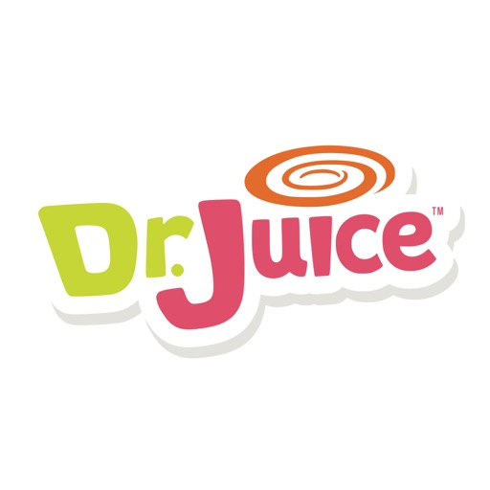
Mobile Applications
A mobile application, commonly known as an app, is an application designed to run locally on mobile devices, such as a smartphones and tablets.
How can apps be used for marketing?
Promoting businesses and services
Offering services
Generating Sales

Slide 78
Mobile Marketing Considerations
Creating a mobile-friendly website
Tailoring keywords for mobile
Tailor your ads for mobile
Mobile Advertising
Mobile advertising targets ads directly to customers on mobile devices.
Mobile ads can be targeted based on geolocation, device model, operating system, apps used in the past, demographic targeting and behavioural targeting.

Slide 79
15. Analytics Overview

Slide 80
Analytics Overview
Analytics for digital marketing is the process of capturing, reporting and analysing data based on user behaviour, to find patterns and gain actionable insights.
Why is analytics important?
Analytics offers real-time insights
Ability to measure Return on Investment (ROI)

Slide 81
Process to incorporate analytics
Set goals
Track and measure
Identify improvements
Implement changes
Continue to track and measure

Slide 82
Website Analytics
Website analytics is the process of tracking, reporting and analysing the behaviour of visitors to a website (web traffic).
What can you track using analytics tools?
Traffic Source (Organic, Direct, social media, referrals)
Type of visitors (unique visitors, return visitor)
Bounce rate
Conversion rate
Notes:
Unique visitors, which is the total number of unique visitors in a specific time frame, regardless of the number of times a user visited.
bounce rate – The percentage of visitors who only accessed one page of your website, without visiting any other pages, is known as the.

Slide 83
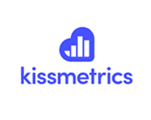
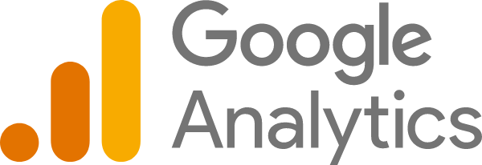
Analytics Tools
Notes:
MOZ – SEO
Google analytics, crazy egg and kissmetrics are very similar

Slide 84
16. Social Media Insights

Slide 85
Social media insights
Social media insights involve tracking and analysing the behaviour of visitors to a social media account.
Common insights include:
Reach
Engagement
Mentions
Trends
Inbound links
Views
Actions
People
Notes:
The most imp insight is reach

Slide 86
17. Email Marketing Insights

Slide 87
Email Marketing Insights
Key e-mail marketing metrics
Delivery rate
Bounce rate
Open rate
Click rate
Total subscribers, Unsubscribes

Slide 88
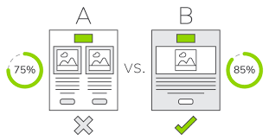
Split testing in e-mail analytics
Split testing, also known as A/B testing, is a way to test two elements of an e-mail campaign to determine which version returns the best results.
Split testing is a useful tool to evaluate subject line, images, sender name, call to action, body text, hyperlinked images, or time sent

Slide 89
18. Online Advertising Analytics

Slide 90
Online Advertising Analytics
Online advertising analytics is the process of tracking and analysing the performance of online ads.
Common online advertising analytics terms
Click through rate (CTR)
Pay per click (PPC)
Cost per thousand (CPM)
Cost per acquisition (CPA)
Cost per conversion (CPC)
You can track:
Clicks
Impressions
Notes:
CTR is the number of clicks that your ad receives divided by the number of times your ad is shown

