Slide 1

Computing 1.0 Syllabus

Slide 2

Computing
Computing is the process of using computer technology to complete a given goal-oriented task. Computing may encompass the design and development of software and hardware systems for a broad range of purposes - often structuring, processing and managing any kind of information - to aid in the pursuit of scientific studies, making intelligent systems, and creating and using different media for entertainment and communication.

Slide 3
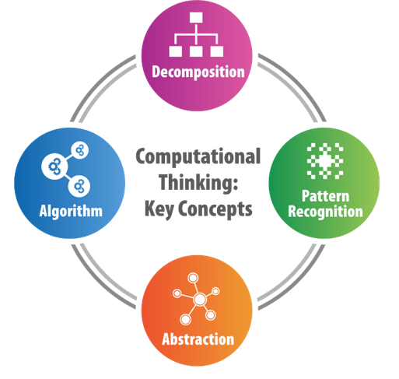
Computational Thinking
Computational thinking is the step that comes before programming. It’s the process of breaking down a problem into simple enough steps that even a computer would understand.
Computational thinking allows us to take a complex problem, understand what the problem is and develop possible solutions. We can then present these solutions in a way that a computer, a human, or both, can understand.

Slide 4

Program
A computer program is a collection of instructions that performs a specific task when executed by a computer. Most computer devices require programs to function properly. A computer program is usually written by a computer programmer in a programming language.

Slide 5
Source Code and Executable code
Computer code refers to the set of instructions, or a system of rules, written in a particular programming language.
Source code is the code written by the programmer, whereas executable code (machine code), Source code mainly refers to a set of commands, instructions, and statements of a particular application written by a developer in programming languages such as Java, C, C++ and Python.
Executable code (machine code) is the source code compiled

Slide 6
Program Description and Specification
Program description means a complete presentation of processes in suitable, sufficiently detailed form to determine a set of instructions constituting the relevant computer program. A program description is the document that explains what a program is designed to do and how it works.
A program specification describes the results that a program is expected to produce -- its primary purpose is to be understood not executed. Specifications provide the foundation for programming methodology.

Slide 7
System analysis
Systems analysis is the practice of studying an existing system (such as how a school or library works) in order to develop a better system. Here we shall see how this is done when a system is improved using computers.
The person who does systems analysis and manages the development of the new system is called a “systems analyst”.
Stage 1: Project
selection and
feasibility study
Stage 7: System
Stage 2: Present
maintenance
system study and
analysis
Stage 6: Control and
Stage 3: Design of
review
new computerized
system
Stage 5:
Stage 4:
Implementation and
Programming and
changeover methods
documentation

Slide 8
System Analysis: Project selection and feasibility study
The first thing the systems analyst does is to make sure that the new system is worth creating, that is, is feasible. A report detailing the advantages and disadvantages of the new system is produced. The owner of the system (who also hired the systems analyst) will then decide if the new system is worth building or if it just isn’t worth the trouble.
Some information which might be included in such a report includes:
The estimated cost to build and run the system
The estimated time to build the system
The required new and lost jobs due to the system

Slide 9
System Analysis: Present system study and analysis
Once a proposed system is chosen, the systems analyst must now elaborate the details of the report with a full blown study of the owner’s current system and a detailed report of what the new system should do.
Data about the current system is gathered through interviews and questionnaires to both customers and employees and spending time using the current system with the other customers and employees to observe it.

Slide 10
System Analysis: Design Phase
Now that it is clear what the new system should do, the systems analyst needs to find the best way how it should do it. A report detailing the system’s design is drawn up which includes the following details:
What is the best way for input and output to be gathered from the users of the system?
What is the most efficient and cost effective way to run the system?
What sort of data needs to be stored and what is the best way to store it?

Slide 11
System Analysis: Programming and Documentation
The software part of the system can now start being programmed. The systems analyst guides programmers to build the programs that are required for the new system. Documentation describing how the programs were built is also written for future reference when a future programmer or systems analyst needs to understand it to add features or fix errors.

Slide 12
System Analysis: Implementation
The expected stage is finally put into action and the new system is built and put into operation. The new hardware is brought in, software is installed and employees are trained. However there are different ways on how to make the changeover from the old system to the new one.

Slide 13
System Analysis: Control and Review
After having the new system in place, the systems analyst must now check that the system is running correctly and that nothing has gone wrong. A fixed period of time is set for the analyst to constantly check the system, after which the owner should feel safe using the system on its own.

Slide 14
System Analysis: System Maintenance
Now the systems analyst is only responsible for periodically maintaining the system. He or she may either make a small update to the program such as changing the VAT used, fix any errors that are discovered or add minor new features to the system.
If the times change too much for the system to be kept up to date, a new system is built from scratch and the system life cycle starts from the first stage again.

Slide 15
Formal Language and Natural Language
A natural language is a language that evolved among human beings such as Italian and English. They were not designed by people (although people try to impose some order on them); they evolved naturally.
A formal language is a language invented to serve a purpose with well defined syntax and semantics.

Slide 16
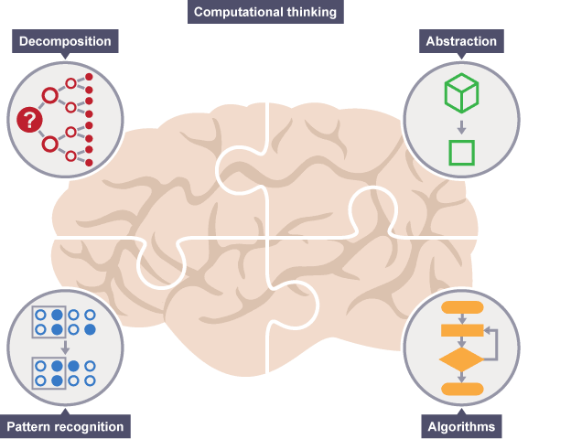
Computational Thinking
Computational thinking involves taking that complex problem and breaking it down into a series of small, more manageable problems (decomposition). Each of these smaller problems can then be looked at individually, considering how similar problems have been solved previously (pattern recognition) and focusing only on the important details, while ignoring irrelevant information (abstraction). Next, simple steps or rules to solve each of the smaller problems can be designed (algorithms).
Finally, these simple steps or rules are used to program a computer to help solve the complex problem in the best way.

Slide 17
The four cornerstones of computational thinking
There are four key techniques (cornerstones) to computational thinking:
decomposition - breaking down a complex problem or system into smaller, more manageable parts
pattern recognition – looking for similarities among and within problems
abstraction – focusing on the important information only, ignoring irrelevant detail
algorithms - developing a step-by-step solution to the problem, or the rules to follow to solve the problem

Slide 18
Sequencing
When designing algorithms, it is important to make sure that all the steps are presented in the correct order. This is known as sequencing, and can be displayed in pseudocode or flowcharts.
Sequencing is the specific order in which instructions are performed in an algorithm.
For example, a very simple algorithm for brushing teeth might consist of these steps:
  put toothpaste on toothbrush
  use toothbrush to clean teeth
  rinse toothbrush
  Each step is an instruction to be performed. Sequencing is the order in which the steps are carried out.

Slide 19
Pseudocode
Pseudocode is a simple way of writing programming code in English. Pseudocode is not actual programming language. It uses short phrases to write code for programs before you actually create it in a specific language. Once you know what the program is about and how it will function, then you can use pseudocode to create statements to achieve the required results for your program.

Slide 20
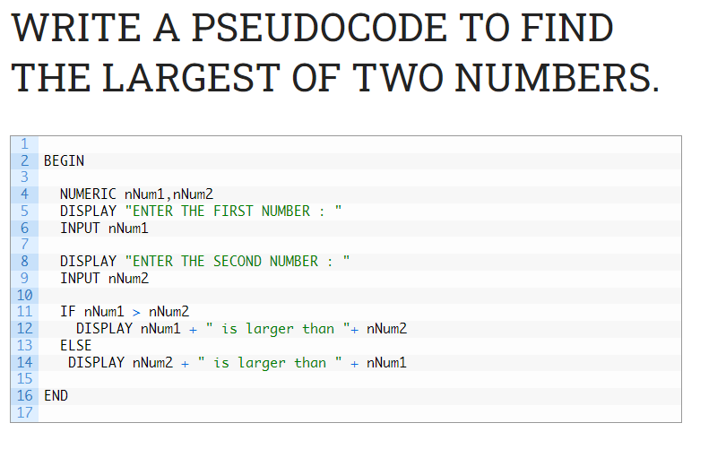

Slide 21
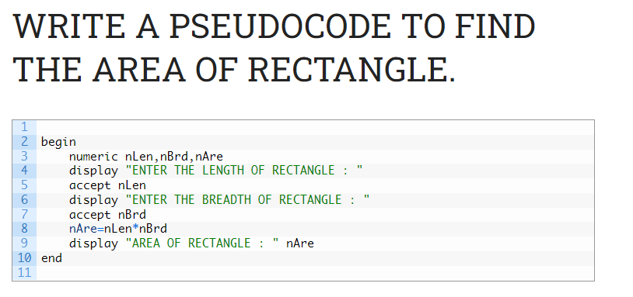

Slide 22
Flowchart
A flowchart is simply a graphical representation of steps. It shows steps in sequential order and is widely used in presenting the flow of algorithms, workflow or processes. Typically, a flowchart shows the steps as boxes of various kinds, and their order by connecting them with arrows.

Slide 23




Flowchart Symbols
Flowchart Symbol | Name | Description
 | Process symbol | This shape represents a process, action, or function. It’s the most widely-used symbol in flowcharting.
 | Start/End symbol | This symbol represents the start points, end points, and potential outcomes of a path. Often contains “Start” or “End” within the shape.
 | Input/Output symbol | This shape represents data that is available for input or output as well as representing resources used or generated.
 | Decision symbol | Indicates a question to be answered — usually yes/no or true/false.
 | Connector symbol | Usually used within more complex charts, this symbol connects separate elements across one page.

Slide 24
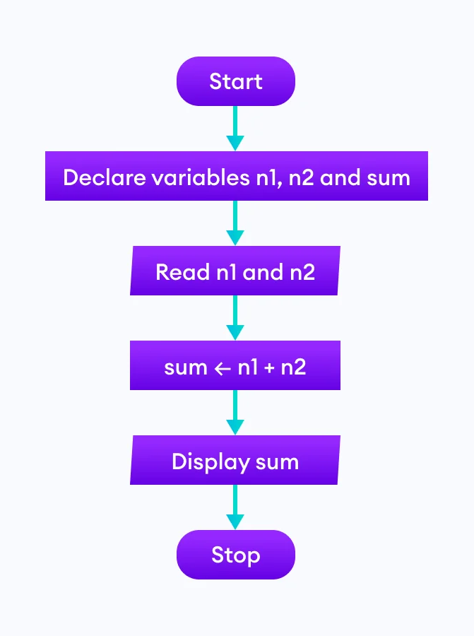
Flowchart Examples
1. Add two numbers entered by the user.

Slide 25
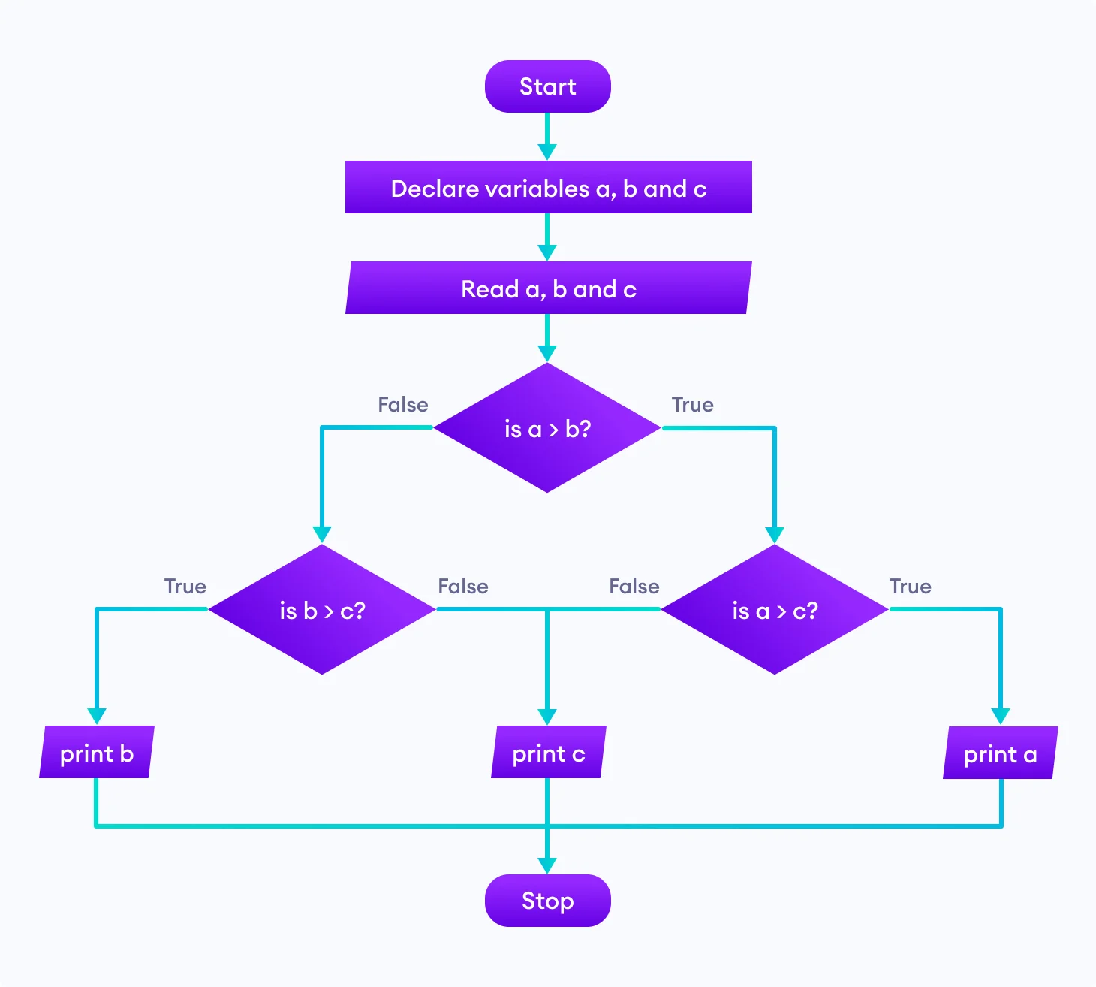
Flowchart Examples
2. Find the largest among three different numbers entered by the user.

Slide 26
Python
Download Python from https://www.python.org/.
Python is a popular programming language.

Slide 27
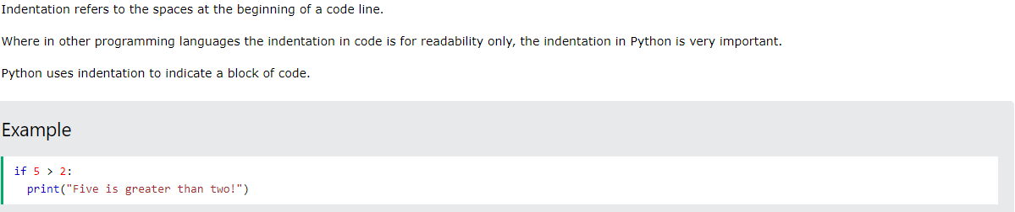
Python Indentation

Slide 28
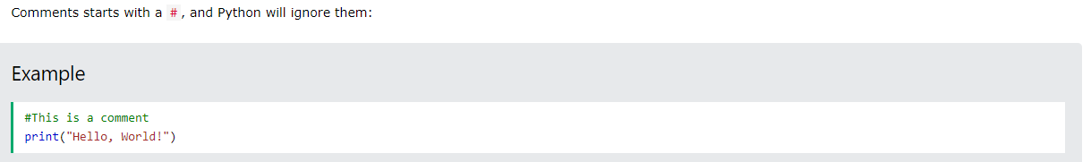
Python Comments
Comments can be used to explain Python code.
Comments can be used to make the code more readable.
Comments can be used to prevent execution when testing code.

Slide 29
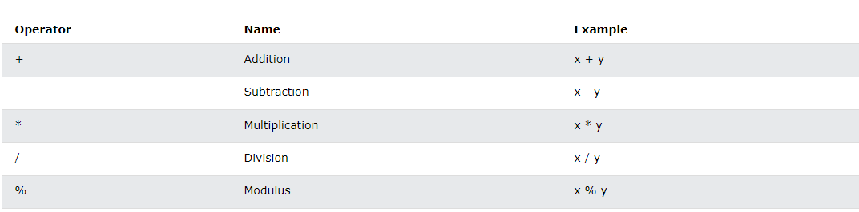
Python Arithmetic Operators
Remainder

Slide 30
Python precedence of operators
You might have heard about the BODMAS rule in your school’s mathematics class. Python also uses a similar type of rule known as PEMDAS.
P – Parentheses
E – Exponentiation
M – Multiplication
D – Division
A – Addition
S – Subtraction

Slide 31
Python precedence of operators
Evaluate this expression: ((((6+4)*2)-10)//2)-4*2

Slide 32
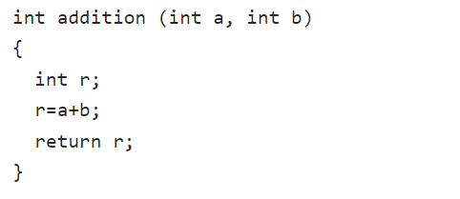
Parameter
A parameter is the variable listed inside the parentheses in the function definition. Parameters identify values that are passed into a function. For example, a function to add two numbers might have two parameters.

Slide 33
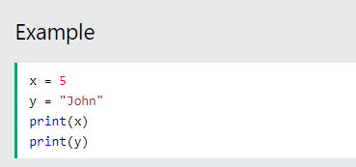
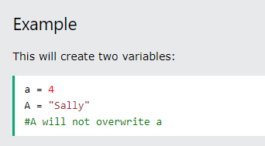
Variable
Variables are a placeholder to store values. In Python, variables need not be declared or defined in advance, as is the case in many other programming languages. To create a variable, you just assign it a value and then start using it. Assignment is done with a single equals sign (=):

Slide 34
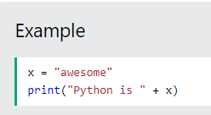
Output Variables
The Python print statement is often used to output variables.
To combine both text and a variable, Python uses the + character:

Slide 35
Data Types
In programming, data type is an important concept.
Variables can store data of different types, and different types can do different things.
Python has the following data types built-in by default, in these categories:
Text Type: str
Numeric Types: int, float, complex
Sequence Types: list, tuple, range
Boolean Type: bool

Slide 36
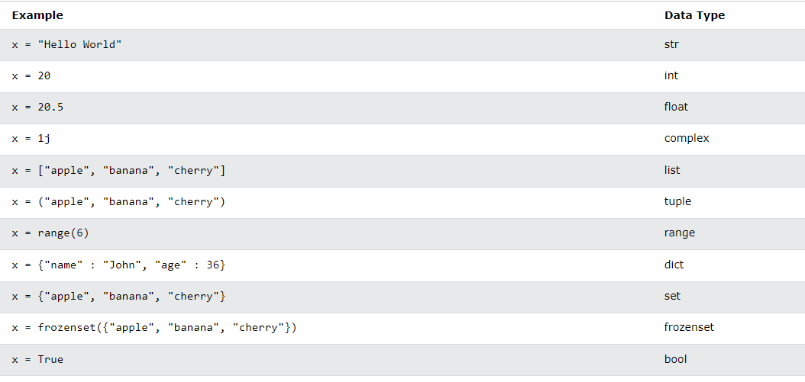
Setting the data type

Slide 37
Setting the data type

Slide 38
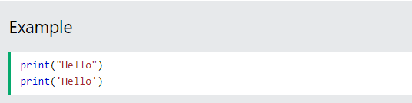
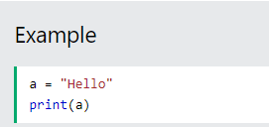
Python Strings
Strings in python are surrounded by either single quotation marks, or double quotation marks.
'hello' is the same as "hello".
You can display a string literal with the print() function:

Slide 39
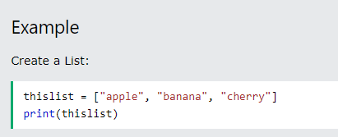
Python Lists
Lists are used to store multiple items in a single variable.
List items are ordered, changeable, and allow duplicate values.
List items are indexed, the first item has index [0], the second item has index [1] etc.
Lists are created using square brackets:

Slide 40
Data Input from user
Python user input from the keyboard can be read using the input() built-in function.
The input from the user is read as a string and can be assigned to a variable.
After entering the value from the keyboard, we have to press the “Enter” button. Then the input() function reads the value entered by the user.
The program halts indefinitely for the user input. There is no option to provide timeout value.

Slide 41

Data Input from user
The following example asks for the username, and when you entered the username, it gets printed on the screen:
Python stops executing when it comes to the input() function, and continues when the user has given some input.

Slide 42
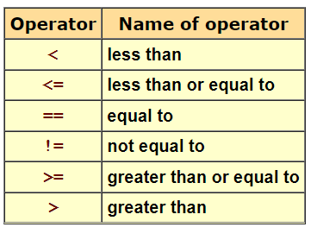
Logic Test
A boolean expression is an expression that results in a boolean value, that is, in a value of either true or false.
There are six arithmetic tests that can be used to create boolean values:

Slide 43
Logic Test
A boolean expression is an expression that results in a boolean value, that is, in a value of either true or false. The output of the expression depends on the logic test (the condition to be checked by the program). For example if the user’s age is greater than or equal (>=) to 18 then he can drive, else if not he cannot drive.
There are six arithmetic tests that can be used to create boolean values:

Slide 44
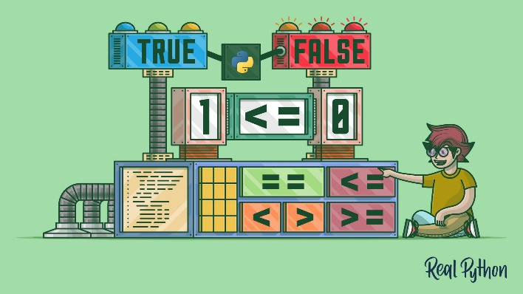
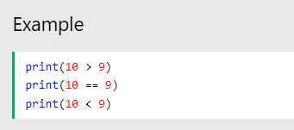
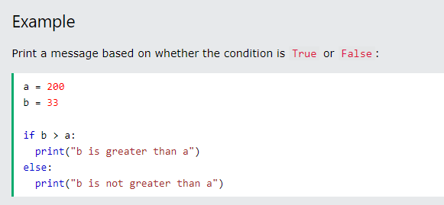
Python Values
In programming you often need to know if an expression is True or False.
You can evaluate any expression in Python, and get one of two answers, True or False.
When you compare two values, the expression is evaluated and Python returns the Boolean answer:

Slide 45
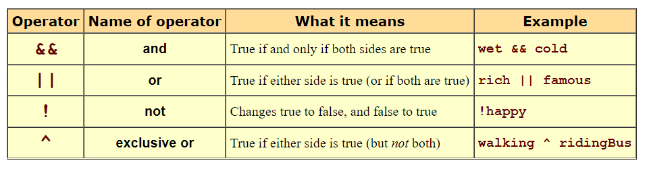
Logic Test
More complex boolean expressions can be built out of simpler expressions, using the following boolean operators:

Slide 46
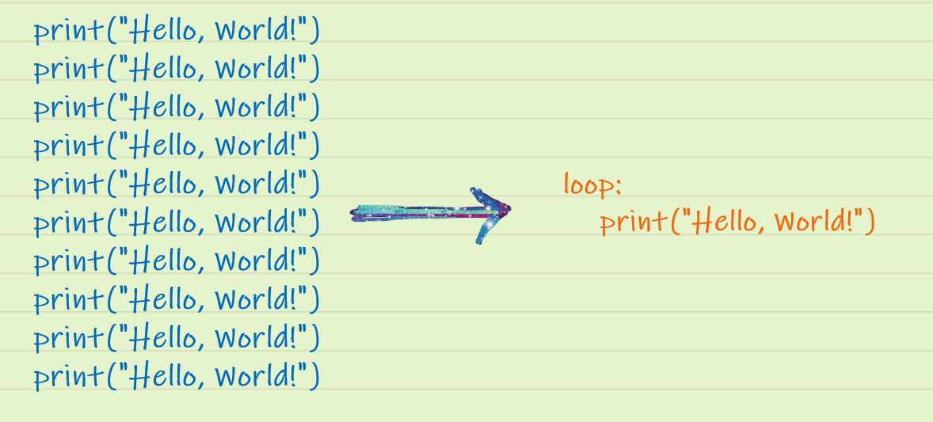
Iteration (Loops)
In general, statements are executed sequentially: The first statement in a function is executed first, followed by the second, and so on. There may be a situation when you need to execute a block of code several number of times.
Loops help us remove the redundancy of code when a task has to be repeated several times. With the use of loops, we can cut short those hundred lines of code to a few. Suppose you want to print the text “Hello, World!” 10 times. Rather than writing a print statement 10 times, you can make use of loops by indicating the number of repetitions needed.

Slide 47
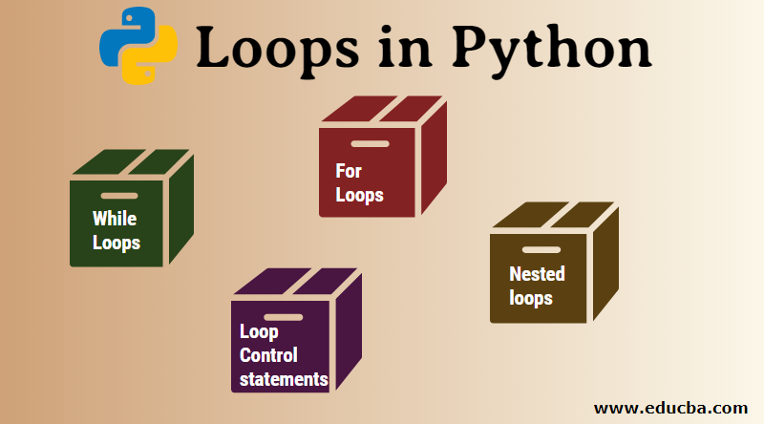
Python Loops
Python has two primitive loop commands:
  while loop
  for loop

Slide 48
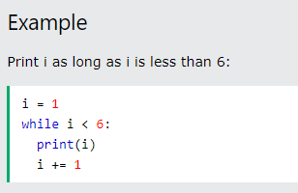
Python While Loop
With the while loop we can execute a set of statements as long as a condition is true.

Slide 49
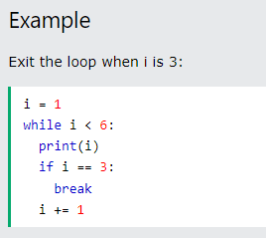
Python While Loop: The Break statement
With the break statement we can stop the loop even if the while condition is true:

Slide 50
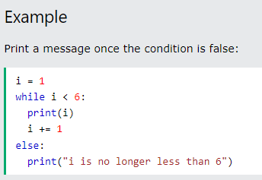
Python While Loop: The Else statement
With the else statement we can run a block of code once when the condition no longer is true:

Slide 51
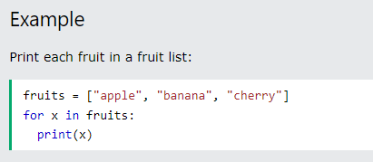
Python For Loop
A for loop is used for iterating over a sequence (that is either a list or a tuple)
With the for loop we can execute a set of statements, once for each item in a list, tuple, set etc.

Slide 52
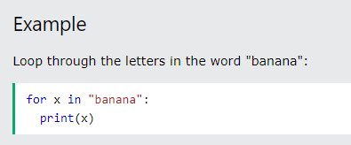
Looping through a String
Even strings are iterable (can be repeated) objects, they contain a sequence of characters:

Slide 53
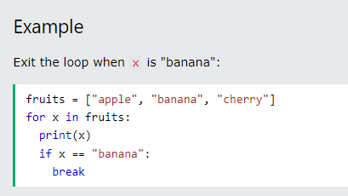
The break statement
With the break statement we can stop the loop before it has looped through all the items:

Slide 54
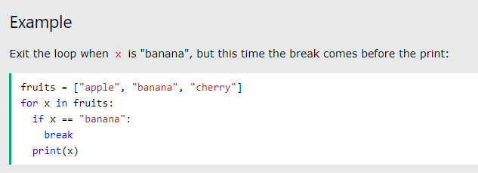
The break statement

Slide 55
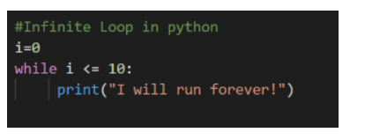
Infinite Loop
An Infinite Loop in Python is a continuous repetitive conditional loop that gets executed until an external factor interferes in the execution flow, like insufficient CPU memory, a failed feature/ error code that stopped the execution, or a new feature in the other legacy systems that needs code integration. In the below diagram, since there is no code to increment the value of the integer, it will continue to print that until we terminate the program.

Slide 56
Recursion
Python also accepts function recursion, which means a defined function can call itself. Recursion is the process of defining something in terms of itself. A physical world example would be to place two parallel mirrors facing each other. Any object in between them would be reflected recursively.

Slide 57
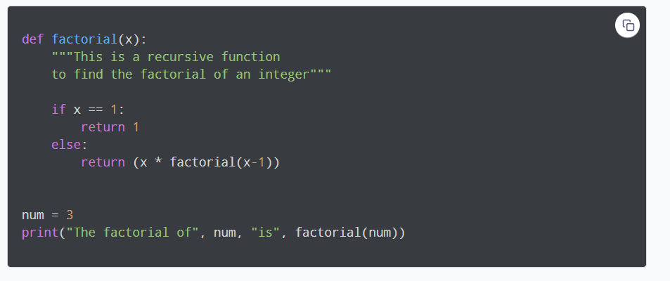
Example of a recursive function
Following is an example of a recursive function to find the factorial of an integer. Factorial of a number is the product of all the integers from 1 to that number. For example, the factorial of 6 (denoted as 6!) is 1*2*3*4*5*6 = 720.

Slide 58
Python If statement
Conditional Statement in Python perform different computations or actions depending on whether a specific Boolean constraint evaluates to true or false. Conditional statements are handled by IF statements in Python. Python if Statement is used for decision-making operations. It contains a body of code which runs only when the condition given in the if statement is true. If the condition is false, then the optional else statement runs which contains some code for the else condition.

Slide 59
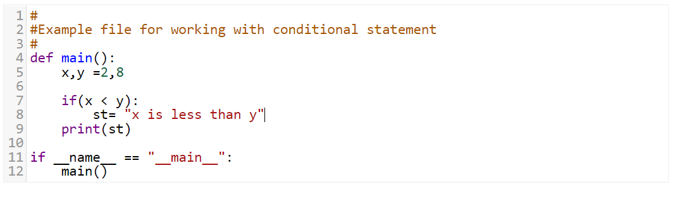
Python If statement
When you want to justify one condition while the other condition is not true, then you use Python if else statement as displayed below.

Slide 60
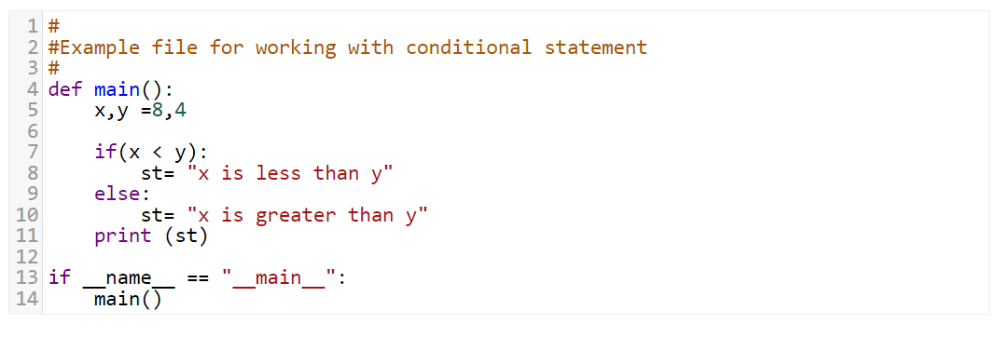
Python If else statement
The “else condition” is usually used when you have to judge one statement on the basis of other. If one condition goes wrong, then there should be another condition that should justify the statement or logic.

Slide 61
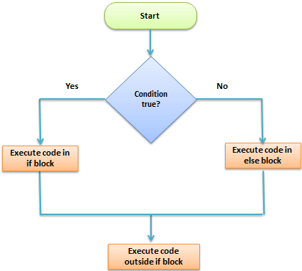
Python If Else flowchart

Slide 62
Conditional statement
Python supports the usual logical conditions from mathematics:
  Equals: a == b
  Not Equals: a != b
  Less than: a < b
  Less than or equal to: a <= b
  Greater than: a > b
  Greater than or equal to: a >= b

Slide 63
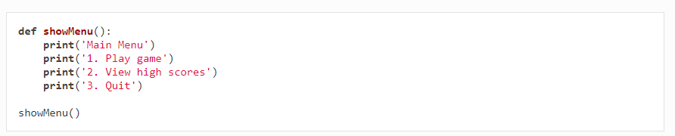
Procedure
Procedure is a subroutine that executes an action in a program without returning a value. A procedure allows us to group a block of code under a name, known as a procedure name. We can call the block of code from anywhere in the program to execute the instructions it contains.
We can also pass values to the procedure to change how it works.

Slide 64
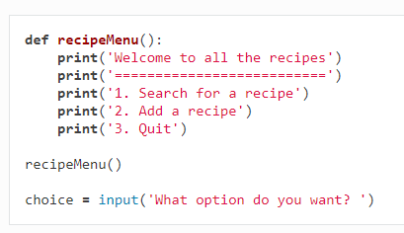
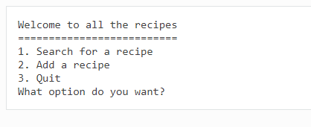
Procedures Example One
Answer
Notes:
Answer:

Slide 65
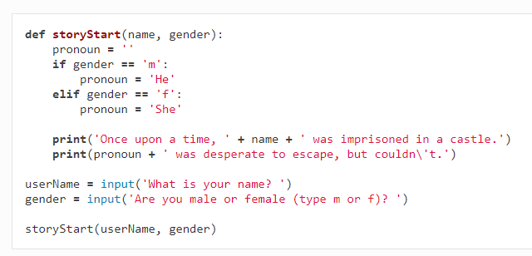
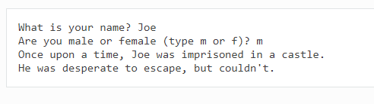
Procedures Example Two
Answer
Notes:
Answer:

Slide 66
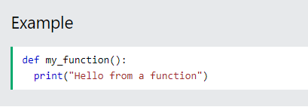
Function
A function is a block of code which is executed when it is called from somewhere in the program. A function will return a value.
In Python a function is defined using the def keyword:

Slide 67
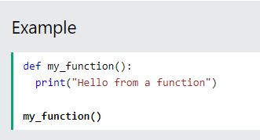
Calling a Function
To call a function, use the function name followed by parenthesis:

Slide 68
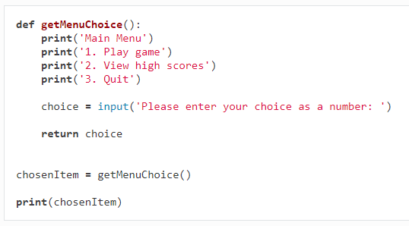
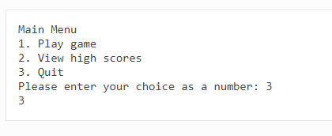
Function: Example One
Answer

Slide 69
Events
An Event is simply an action, like clicking a button, which then leads to another event, which the developer already assigns.
A very simple example to understand the working of events and event handlers is a user form. After the user is done filling out the information, the user has to click on the submit button, sending the details and processing it.

Slide 70
Event handlers
In programming, an event is an action that occurs as a result of the user or another source, such as a mouse click. An event handler is a routine that deals with the event, allowing a programmer to write code that is executed when the event occurs
Mouse click
Keyboard Input
Button click
Timer

Slide 71
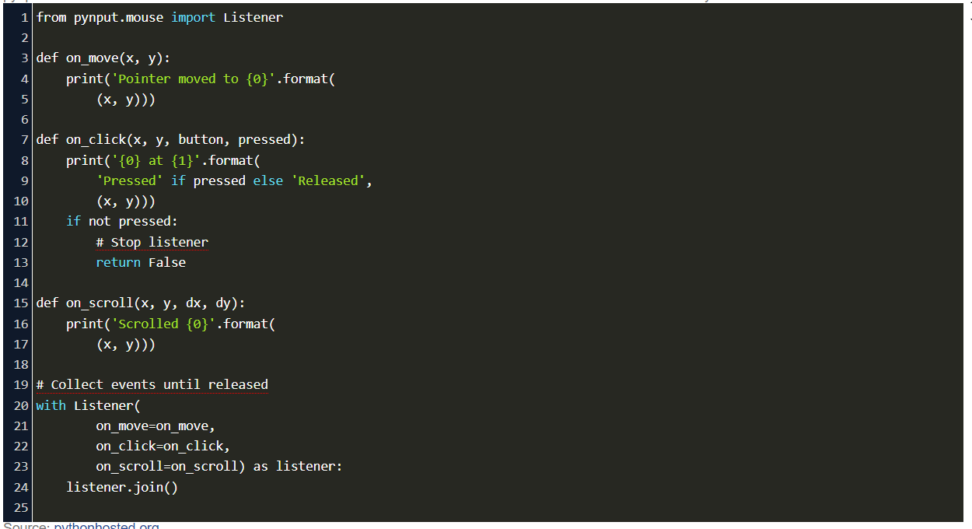
Python Mouse Click Event handler
The mouse event handler is needed so that different types of mouse events such as left button click, right button click, double-click and so on can be handled.

Slide 72
Generic Libraries: Math
The Python Math Library provides access to some common math functions and constants in Python, which can be used throughout the code for more complex mathematical computations. The library is a built-in Python module, therefore you don't have to do any installation to use it.

Slide 73
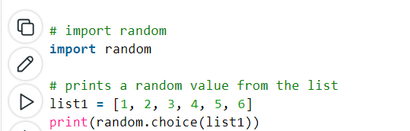
Generic Libraries: Random
Python Random module is an in-built module of Python which is used to generate random numbers. This module can be used to perform random actions such as generating random numbers, print random a value for a list or string, etc.

Slide 74
Generic Libraries: Timer
Python Timer is a class/library to manage the time complexity of your code. Using multiple time modules, you can create a system in your code to check the time taken by the respective code snippet. There are different types of timer implementations in python according to user needs, namely, python timer function (to check script execution time), python threading timer (to check the time taken by a thread to finish), python countdown timer (create a countdown timer) and basic python time module (to help with other activities).

Slide 75
Testing and Debugging
Testing is the process to find bugs and errors. The purpose of testing is to identify what happens when there is a mistake in a program's source code. The testing process does not help the developer figure out what the coding mistake is -- it simply reveals what effects the coding error has on the program.
Debugging is the process to correct the bugs found during testing. The purpose of debugging is to locate and fix the mistake.
Debugging, in computer programming and engineering, is a multistep process that involves identifying a problem, isolating the source of the problem, and then either correcting the problem or determining a way to work around it. The final step of debugging is to test the correction or workaround and make sure it works.

Slide 76
Programming Errors
Programming errors can either occur during compile time (when the source code is supposed to be converted to machine code) or during run time (when the program is expected to work).
When developing programs there are three types of errors that can occur:
  Syntax error
  Logic error
  Run time error

Slide 77
Syntax Error
A syntax error occurs when the code given does not follow the syntax rules of the programming language. Examples include:
  misspelling a statement, eg writing pint instead of print
  using a variable before it has been declared
  missing brackets, eg opening a bracket, but not closing it
A program cannot run if it has syntax errors. Any such errors must be fixed first.

Slide 78
Logic Error
A logic error is an error in the way a program works. The program can run but does not do what it is expected to do.
  Logic errors can be caused by the programmer:
  incorrectly using logical operators, eg expecting a program to stop when the value of a variable reaches 5, but using <5 instead of <=5
  unintentionally creating a situation where an infinite loop may occur
  incorrectly using brackets in calculations
  unintentionally using the same variable name at different points in the program for different purposes
Unlike a syntax error, a logic error does not usually stop a program from running. The program will run, but not function as expected.

Slide 79
Runtime Error
A runtime error is an error that takes place during the running of a program.
An example is writing a program that tries to access the sixth item in a tuple that only contains five items. A runtime error is likely to crash the program.

